Slide 1
Hamlin County
Planning Commission/Board of Adjustment
October 29, 2018
We ask that you silence your cell phones and if you need to have any conversations with anyone in the audience we ask that you step outside so everyone can hear the Board and other testimony.
If you wish to testify on an issue, you are required to sign in.
Anyone responsible for disruptive behavior or noise may be asked to leave the meeting.
Prior to any testimony a motion will be made in the affirmative based upon staff recommendation as read.
Staff will provide report and recommendation/ Public Hearing is opened.
The applicant may address the Board (from table up front)
Proponents will be called to testify – you may address the Board (from table up front)
Opponents will be called to testify – you may address the Board(from the table up front)
Please provide your name and address before providing comment
All comments and questions are to be directed to the Board
The public hearing will be closed.
The Board will discuss the item and ask questions of the applicant or audience members.
The Board will amend any conditions or findings it deems necessary
A roll call vote will be held – An affirmative vote of 5 members is required to rule in favor of an applicant/applicants.

Slide 2
Planning Commission Agenda
Call to Order
Items to be added to the Agenda by the Commission members or staff
Invitation for citizens to schedule time on the Planning Commission agenda for an item not listed. 5-minute maximum time allotted.
Approval of Agenda
Approve September 24th, 2018 Planning Commission Meeting Minutes
Board Discussion – Agribusiness Ordinance Amendment

Slide 3
Board Discussion: Agribusiness Ordinance Amendment

Slide 4
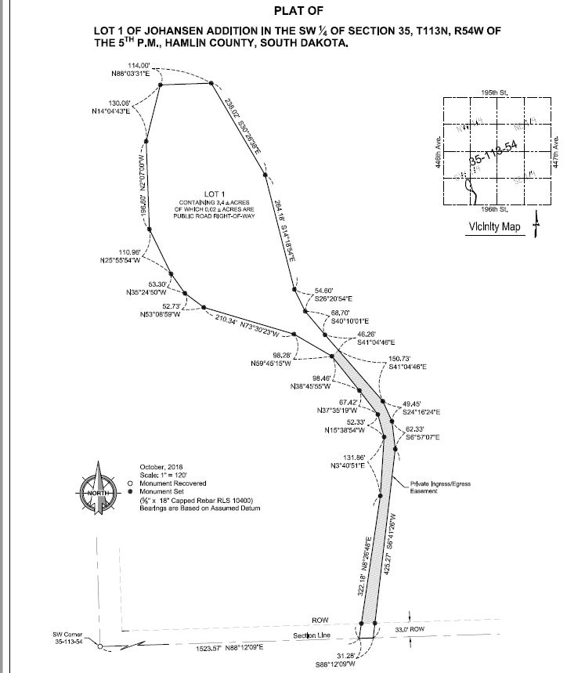
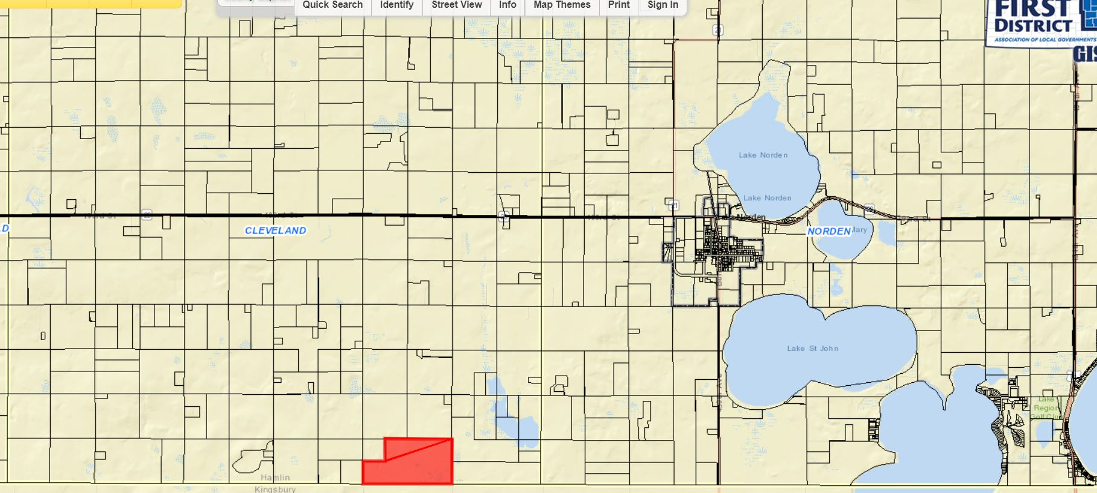

Slide 5
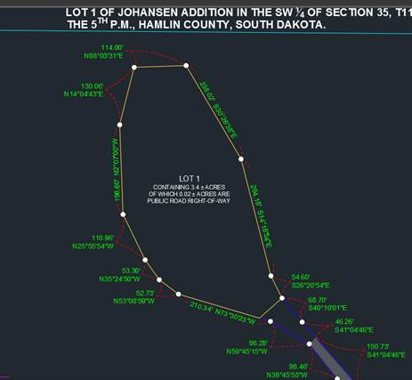

Slide 6
Board of Adjustment Agenda
Call to Order (at the conclusion of the Planning Commission)
Items to be added to the agenda by the Board members or staff
Invitation for citizens to schedule time on the Board of Adjustment agenda for an item not listed. 5-minute maximum time allotted.
Approval of Agenda
Approve September 24th, 2018 Board of Adjustment Meeting Minutes
New Business
Public Hearing: Amendment to Condition #5 of the Conditional Use Permit issued to Josh Spilde on January 30th, 2018. Property Description: Block 1, Spilde Addition SE ¼ Section 36, Township 113N, Range R53W of the 5th P.M. Hamlin County, South Dakota.
Variance: Front Yard Setback (3.07.10) – Applicant/Owner: Thomas and Megan Kreutner – Property Description: The S ½ of Lot 5 Saaranen’s Beach in Govt Lot 1 in NE ¼ of Section 16, Township 113N, Range 52W of the 5th P.M., Hamlin County, South Dakota.
Staff Report/BP Update/Permitted Special Uses
Open
Executive Session
Adjourn

Slide 7
Public Hearing: Spilde Campground
Property Description: Block 1, Spilde Addition SE ¼ Section 36, Township 113N, Range R53W of the 5th P.M. Hamlin County, South Dakota.
Action Item: Amendment to Condition #5 in Letter of Assurance

Slide 8
Kreutner Variance
Property Description: The S ½ of Lot 5 Saaranen’s Beach in Govt Lot 1 in NE ¼ of Section 16, Township 113N, Range 52W of the 5th P.M., Hamlin County, South Dakota.
Variance: Front Yard Setback (Lake Park Regulations 3.07.10)

Slide 9
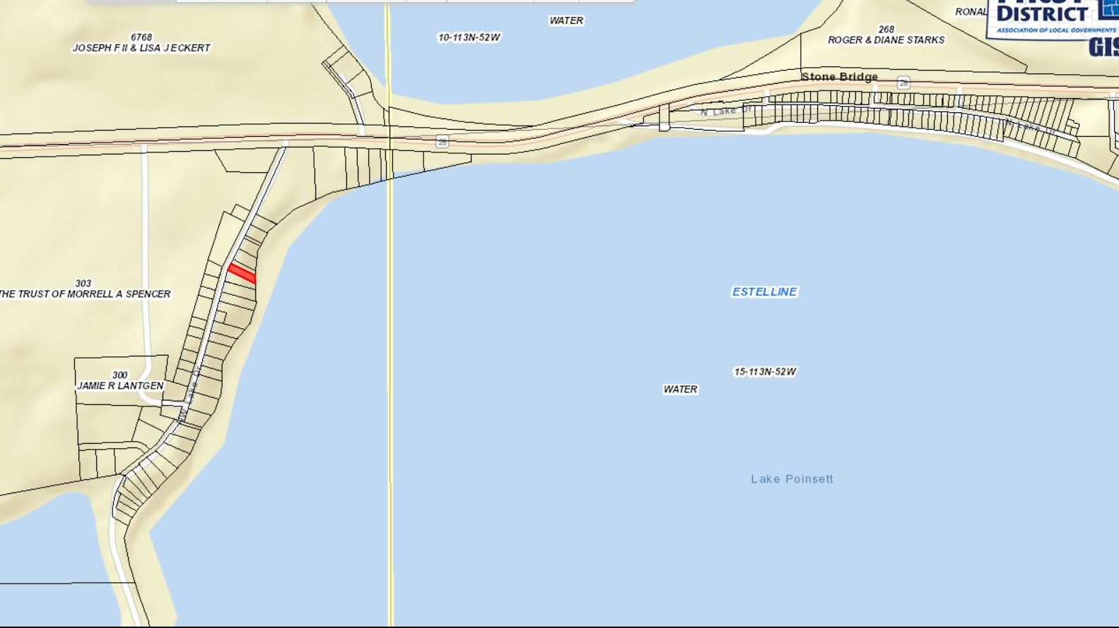

Slide 10
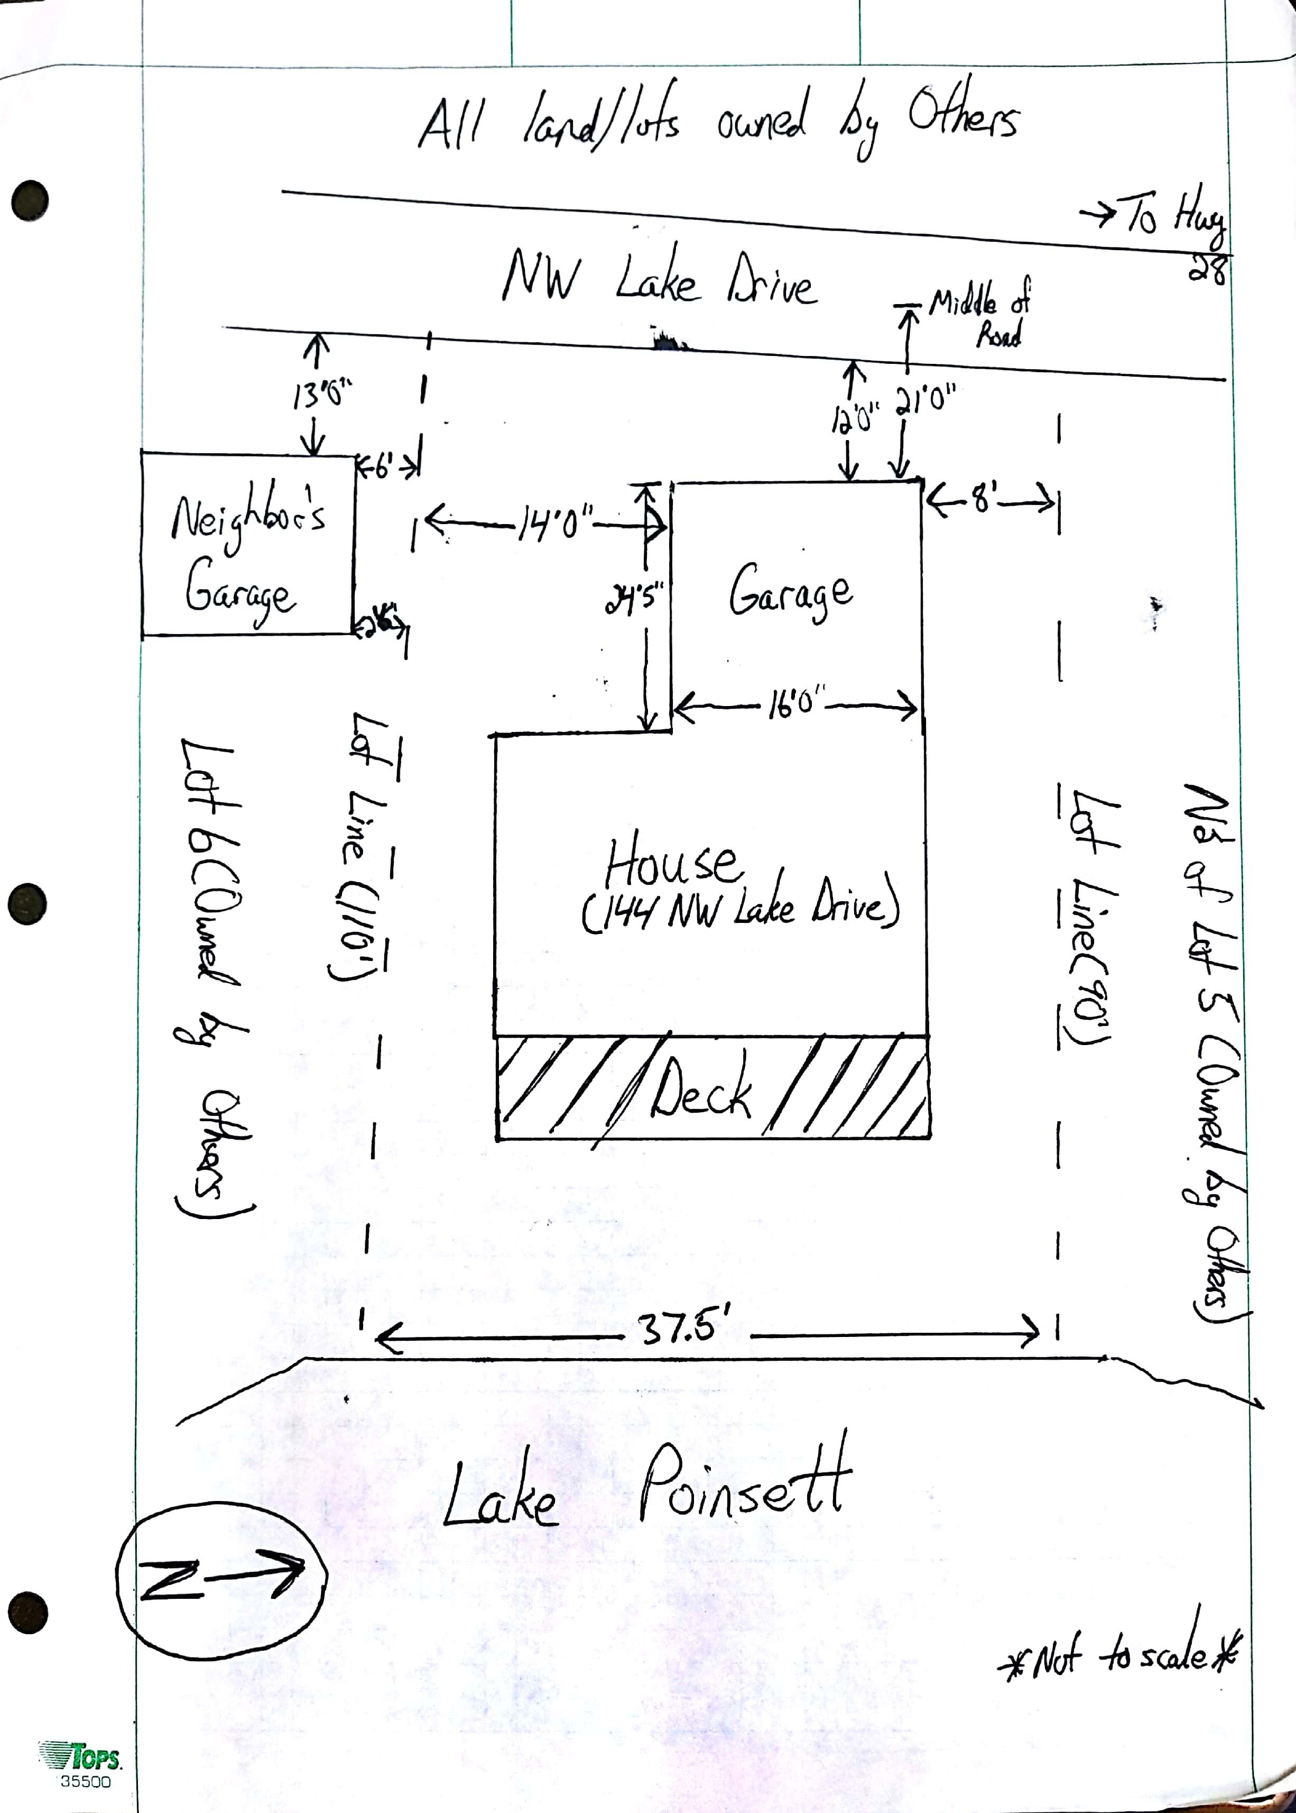

Slide 11
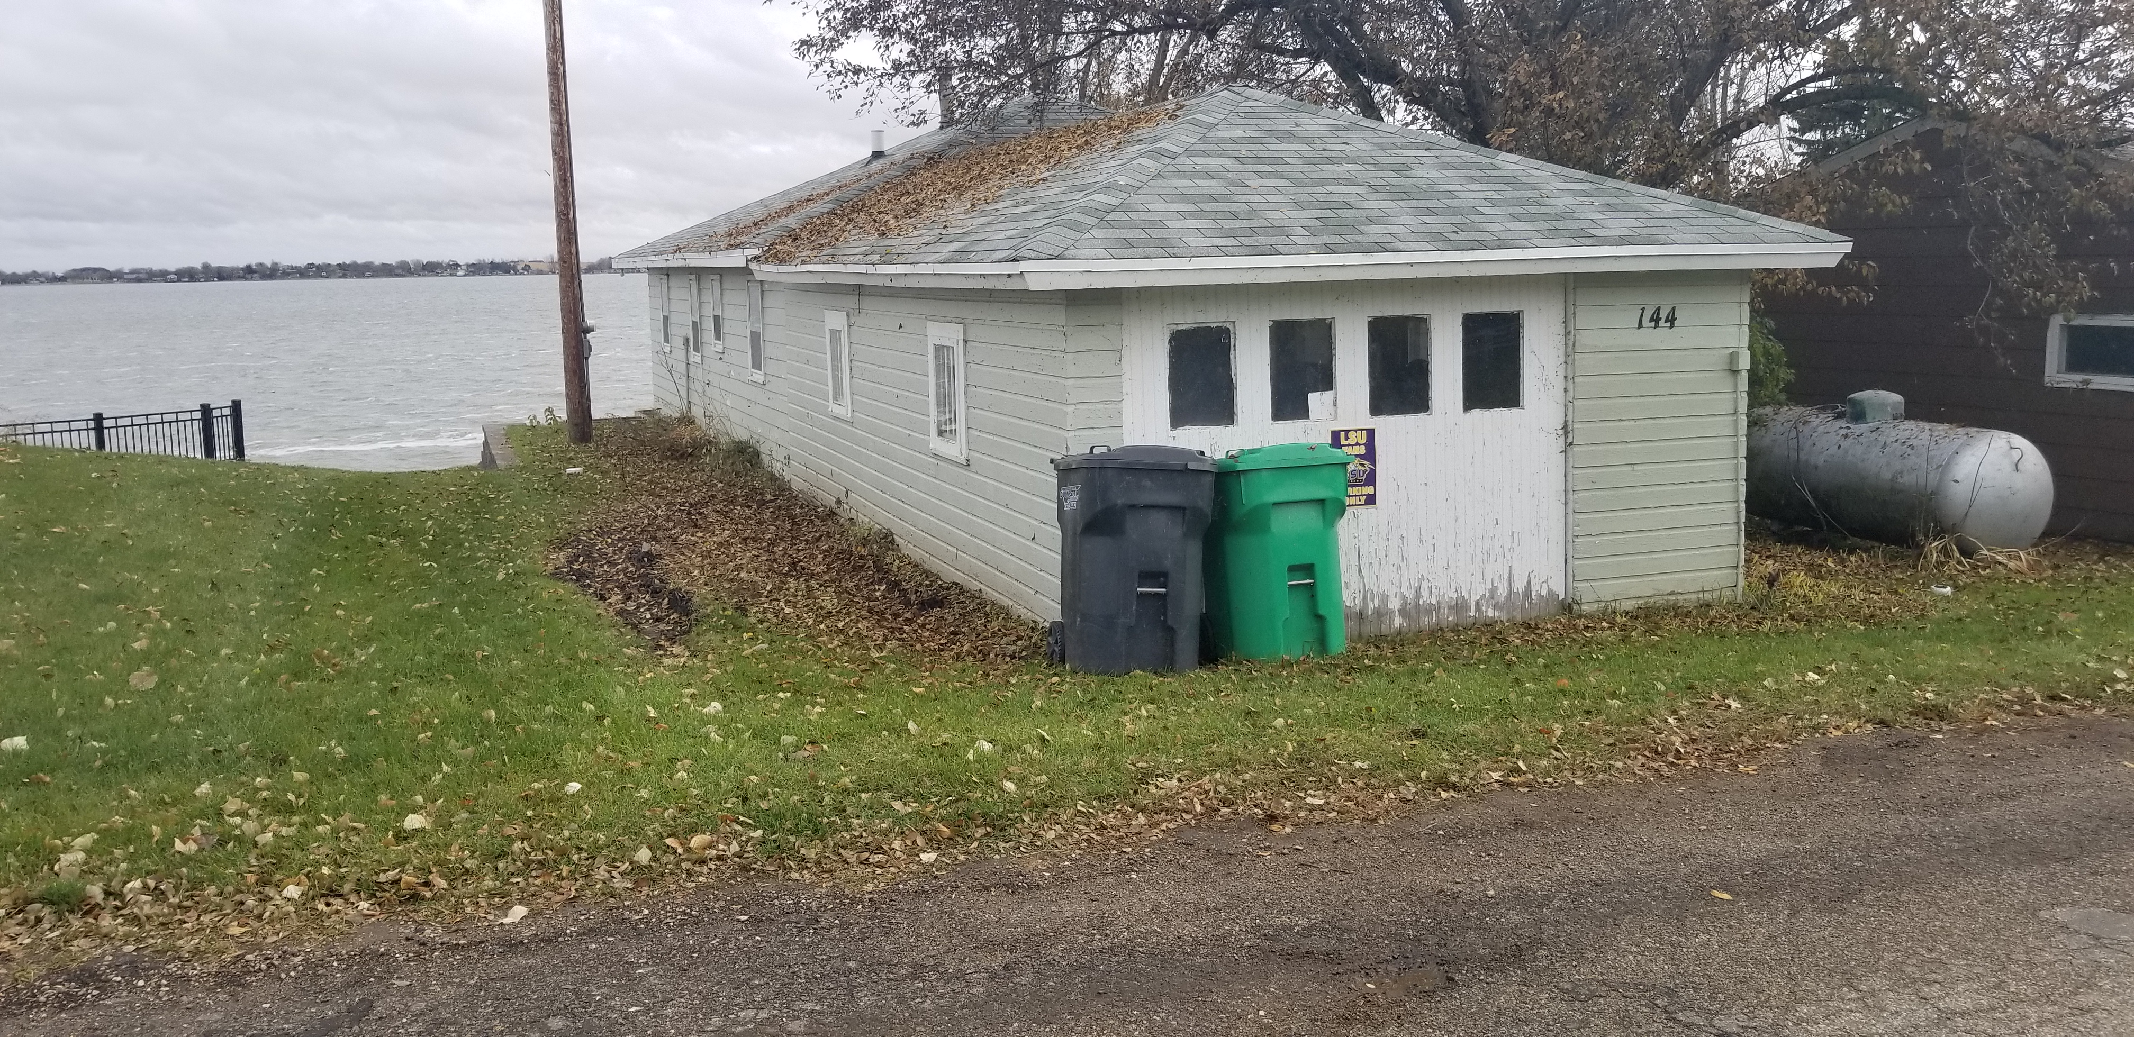

Slide 12
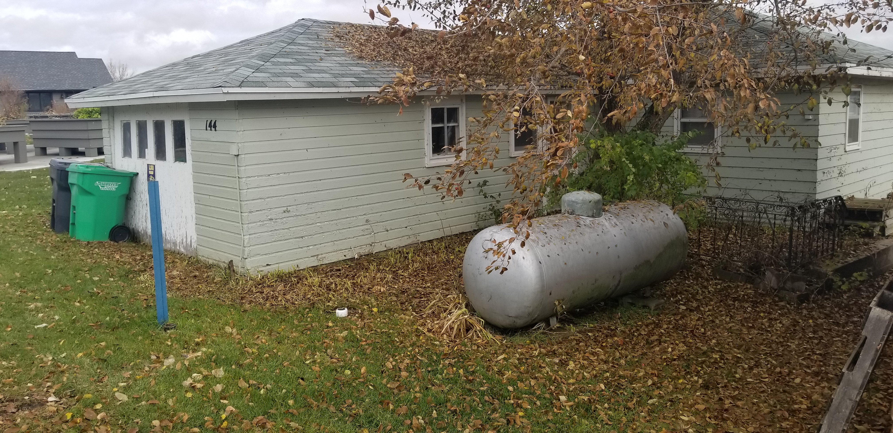

Slide 13
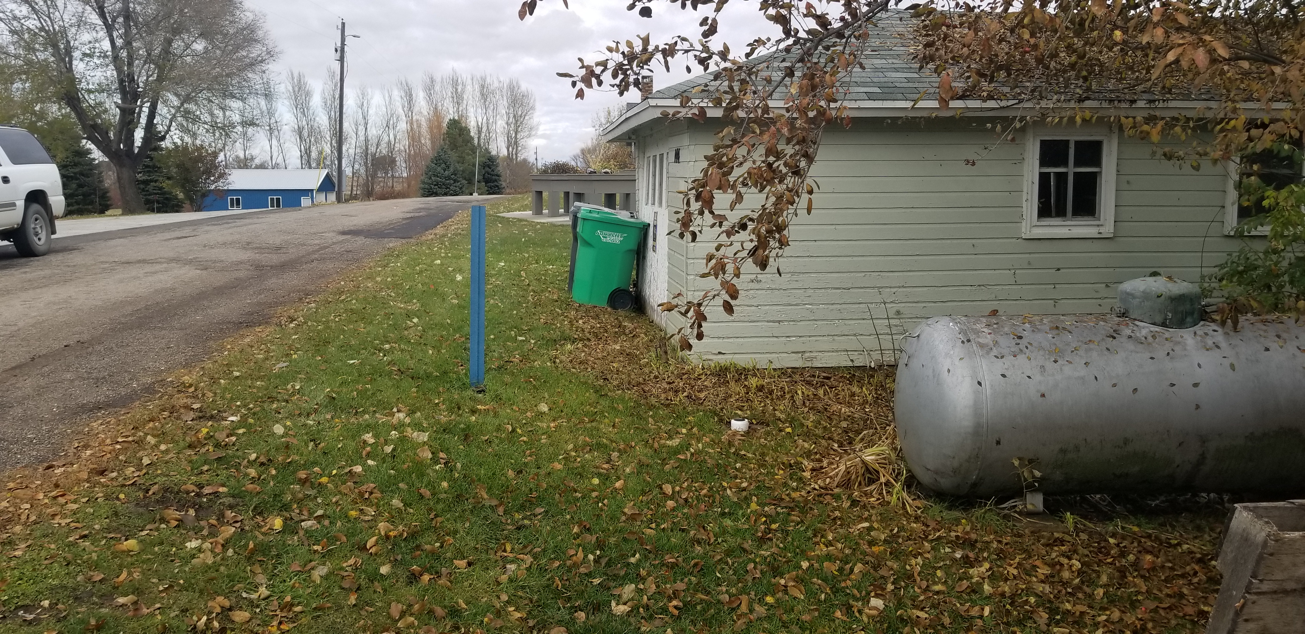

Slide 14
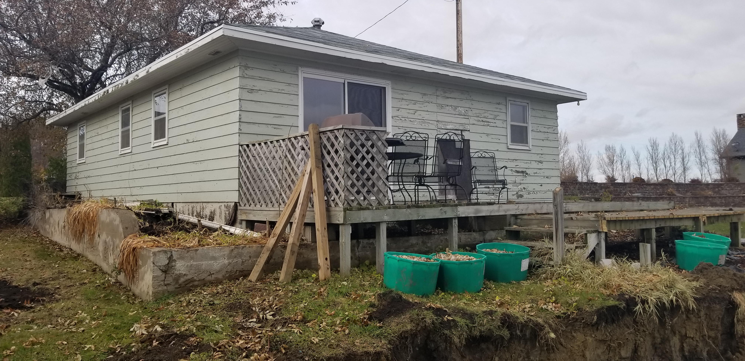

Slide 15
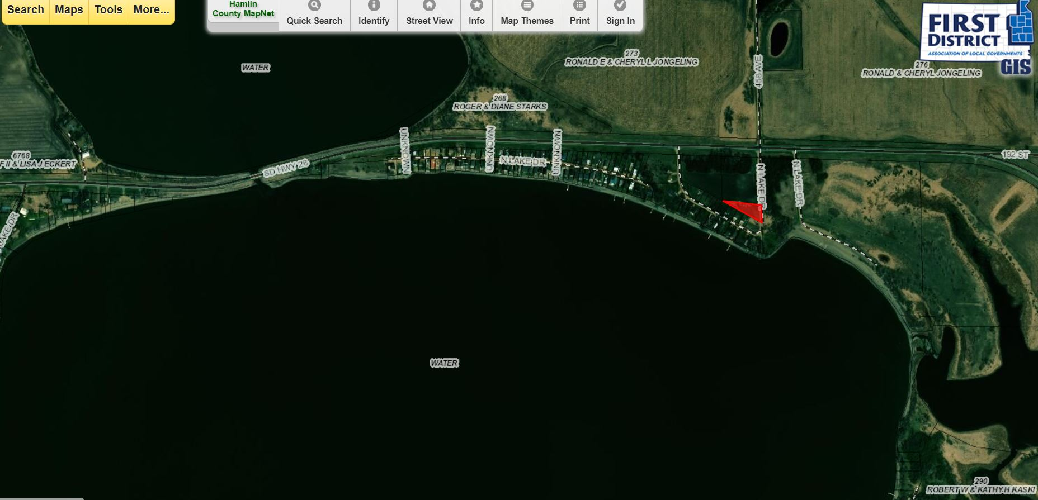
Permitted Special Use: Tree’s closer to the road

Slide 16
