Slide 1
Hamlin County Planning Commission/Board of Adjustment
July 31st, 2018 –7:00 P.M.
We ask that you silence your cell phones and if you need to have any conversations with anyone in the audience we ask that you step outside so everyone can hear the Board and other testimony.
If you wish to testify on an issue, you are required to sign in.
Anyone responsible for disruptive behavior or noise may be asked to leave the meeting.
Prior to any testimony a motion will be made in the affirmative based upon staff recommendation as read.
Staff will provide report and recommendation/ Public Hearing is opened.
The applicant may address the Board (from table up front)
Proponents will be called to testify –you may address the Board (from table up front)
Opponents will be called to testify –you may address the Board(from the table up front)
Please provide your name and address before providing comment
All comments and questions are to be directed to the Board
The public hearing will be closed.
The Board will discuss the item and ask questions of the applicant or audience members.
The Board will amend any conditions or findings it deems necessary.
A roll call vote will be held –An affirmative vote of 5 members is required to rule in favor of an applicant/applicants.

Slide 2
Hamlin County Board of Adjustment/Planning Commission
July 31, 2018
Hamlin County 4-H Building 310 Pheasant Ave Hayti, SD
7:00 PM
Planning Commission Agenda
Call to Order
Items to be added to the Agenda by the Commission members or staff
Invitation for citizens to schedule time on the Planning Commission agenda for an item not listed. 5-minute maximum time allotted.
Approval of Agenda
Approve June 26th, 2018 Planning Commission Meeting Minutes
Plats
Larry & Mike Steffensen – Plat of Lot(s) 109-111, 132, 133, and 137-142 North Bay 12th Addition
Discussion on Bryant TIF
Board of Adjustment Agenda
Call to Order (at the conclusion of the Planning Commission)
Items to be added to the agenda by the Board members or staff
Invitation for citizens to schedule time on the Board of Adjustment agenda for an item not listed. 5-minute maximum time allotted.
Approval of Agenda
Approve June 26th, 2018 Board of Adjustment Meeting Minutes
New Business
Variance: Continuation of Nonstandard Uses (3.02.06) – Applicant/Owner: Erik and Barbara Jensen – Property Description: Paulson’s Subdivision Block 1 Lot 19 in Section 31, Township 113N, Range 52W of the 5th P.M., Hamlin County, South Dakota. (Norden Township)
Conditional Use: Conditional Use in the Town District (3.09.03.7) – Applicant/Owner: Otter Tail Power Company – Property Description: Lot 7 of Railroad Addition, a part of Lot 5 of the Plat of Lots 5 and 6 of Railroad Addition in S ½ of Section 33, Township 114N, Range 51W of the 5th P.M., Dempster, Hamlin County, South Dakota.
Conditional Use: Conditional Uses in the Agricultural District (3.04.04.13) Applicant/Owner: Otter Tail Power Company – Property Description: A 50’ wide strip of private property adjacent to (west of) 449th Avenue from 196th Street to the North side of 194th Street; and A 50’ wide strip of private property on the North side of 194th Street from 449th Avenue to the Western boundary of Lake Norden City limits.
Staff Report
Open
Executive Session
Adjourn

Slide 3
Plat: North Bay 12th Addition
Property Description: Plat of Lot(s) 109-111, 132, 133, and 137-142 North Bay 12th Addition in Section 36, Township 113N, Range 53W (Norden Township)

Slide 4
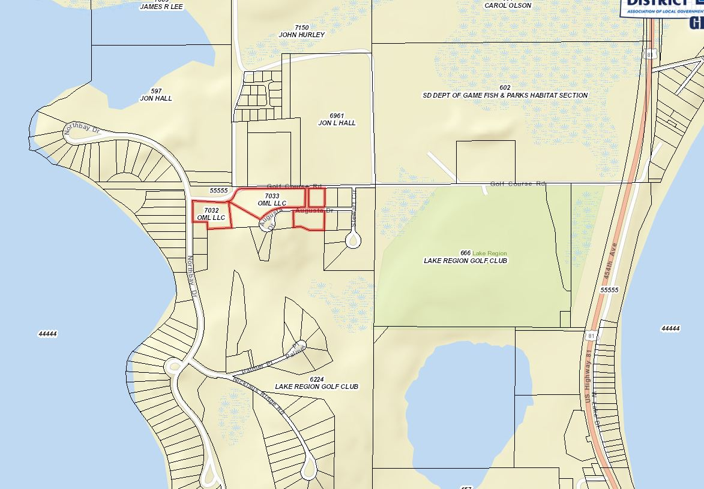

Slide 5
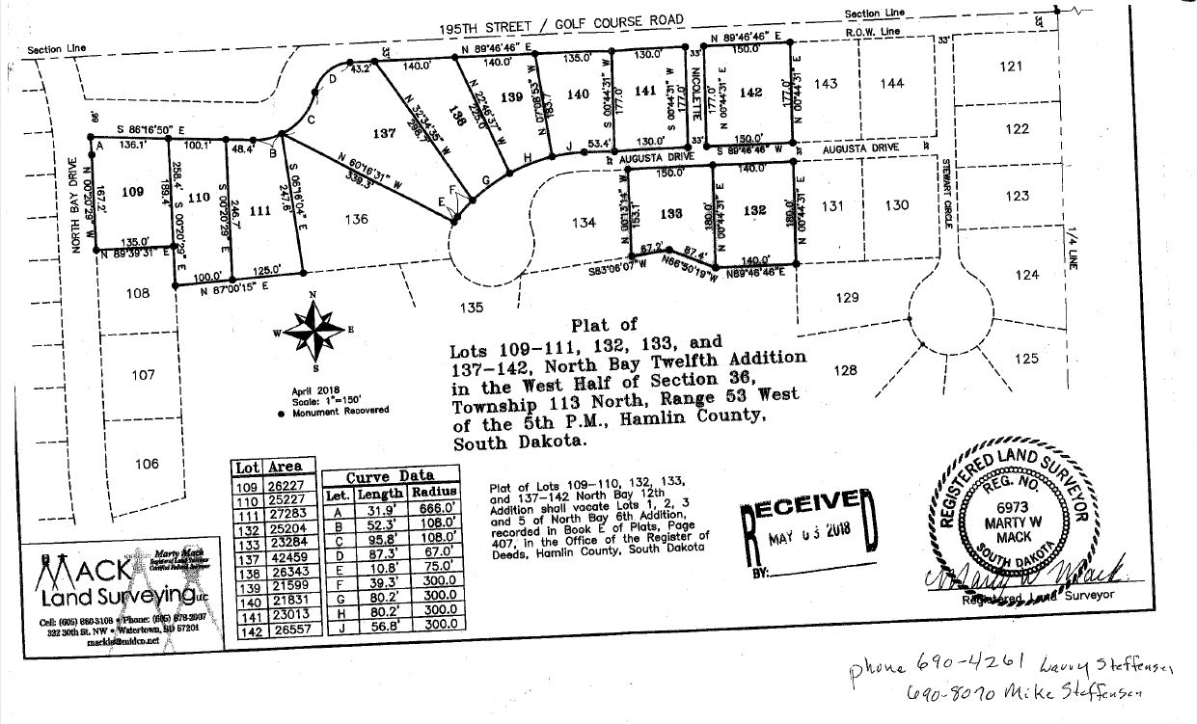

Slide 6
Bryant TIF
Toby Morris – Dougherty & Company

Slide 7
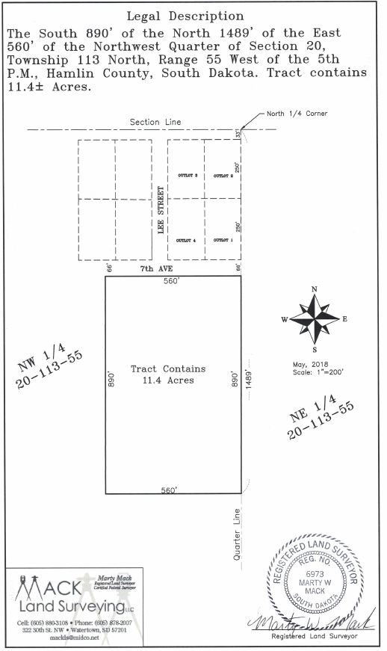

Slide 8
Jensen Variance
Property Description: Paulson’s Subdivision Block 1 Lot 19 in Section 31, Township 113N, Range 52W of the 5th P.M., Hamlin County, South Dakota. (Norden Township)
Variance: Lake Park Area Regulations (3.07.09) Side Yard Setback

Slide 9
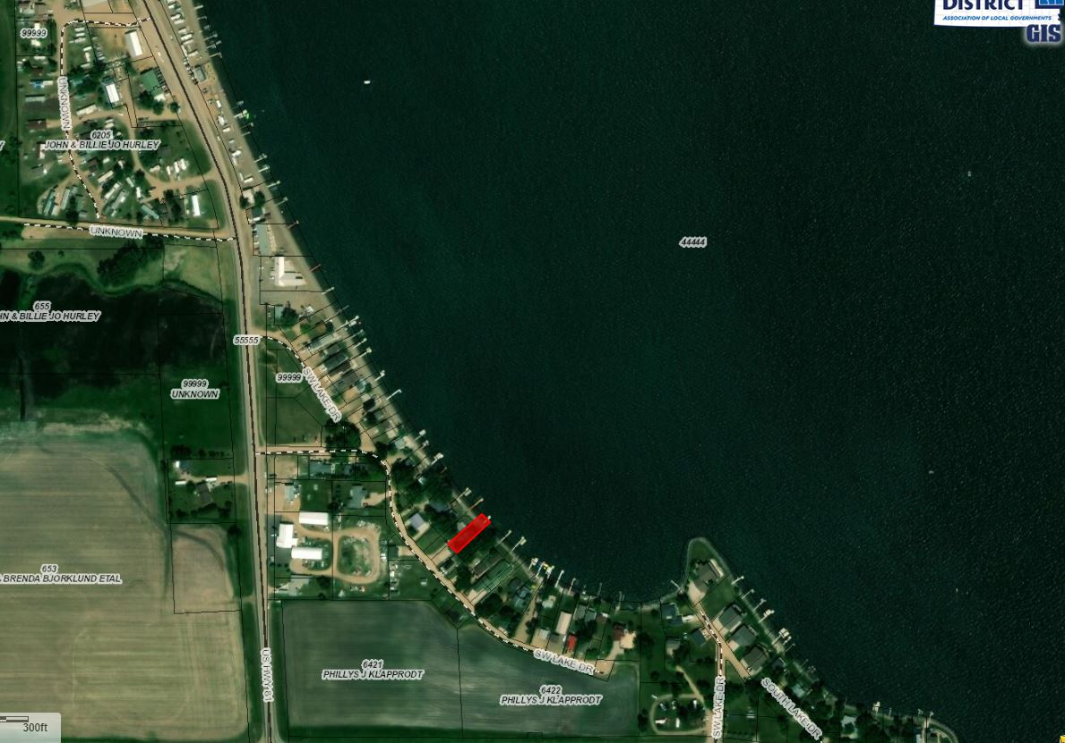

Slide 10
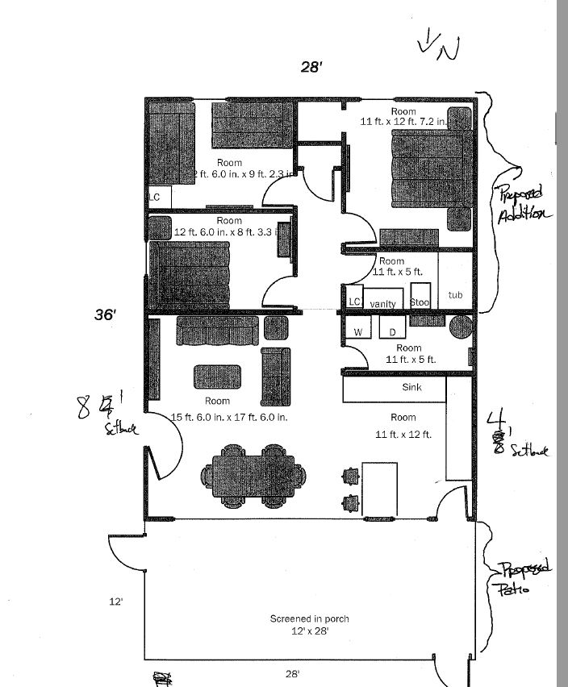
Proposed Additions

Slide 11
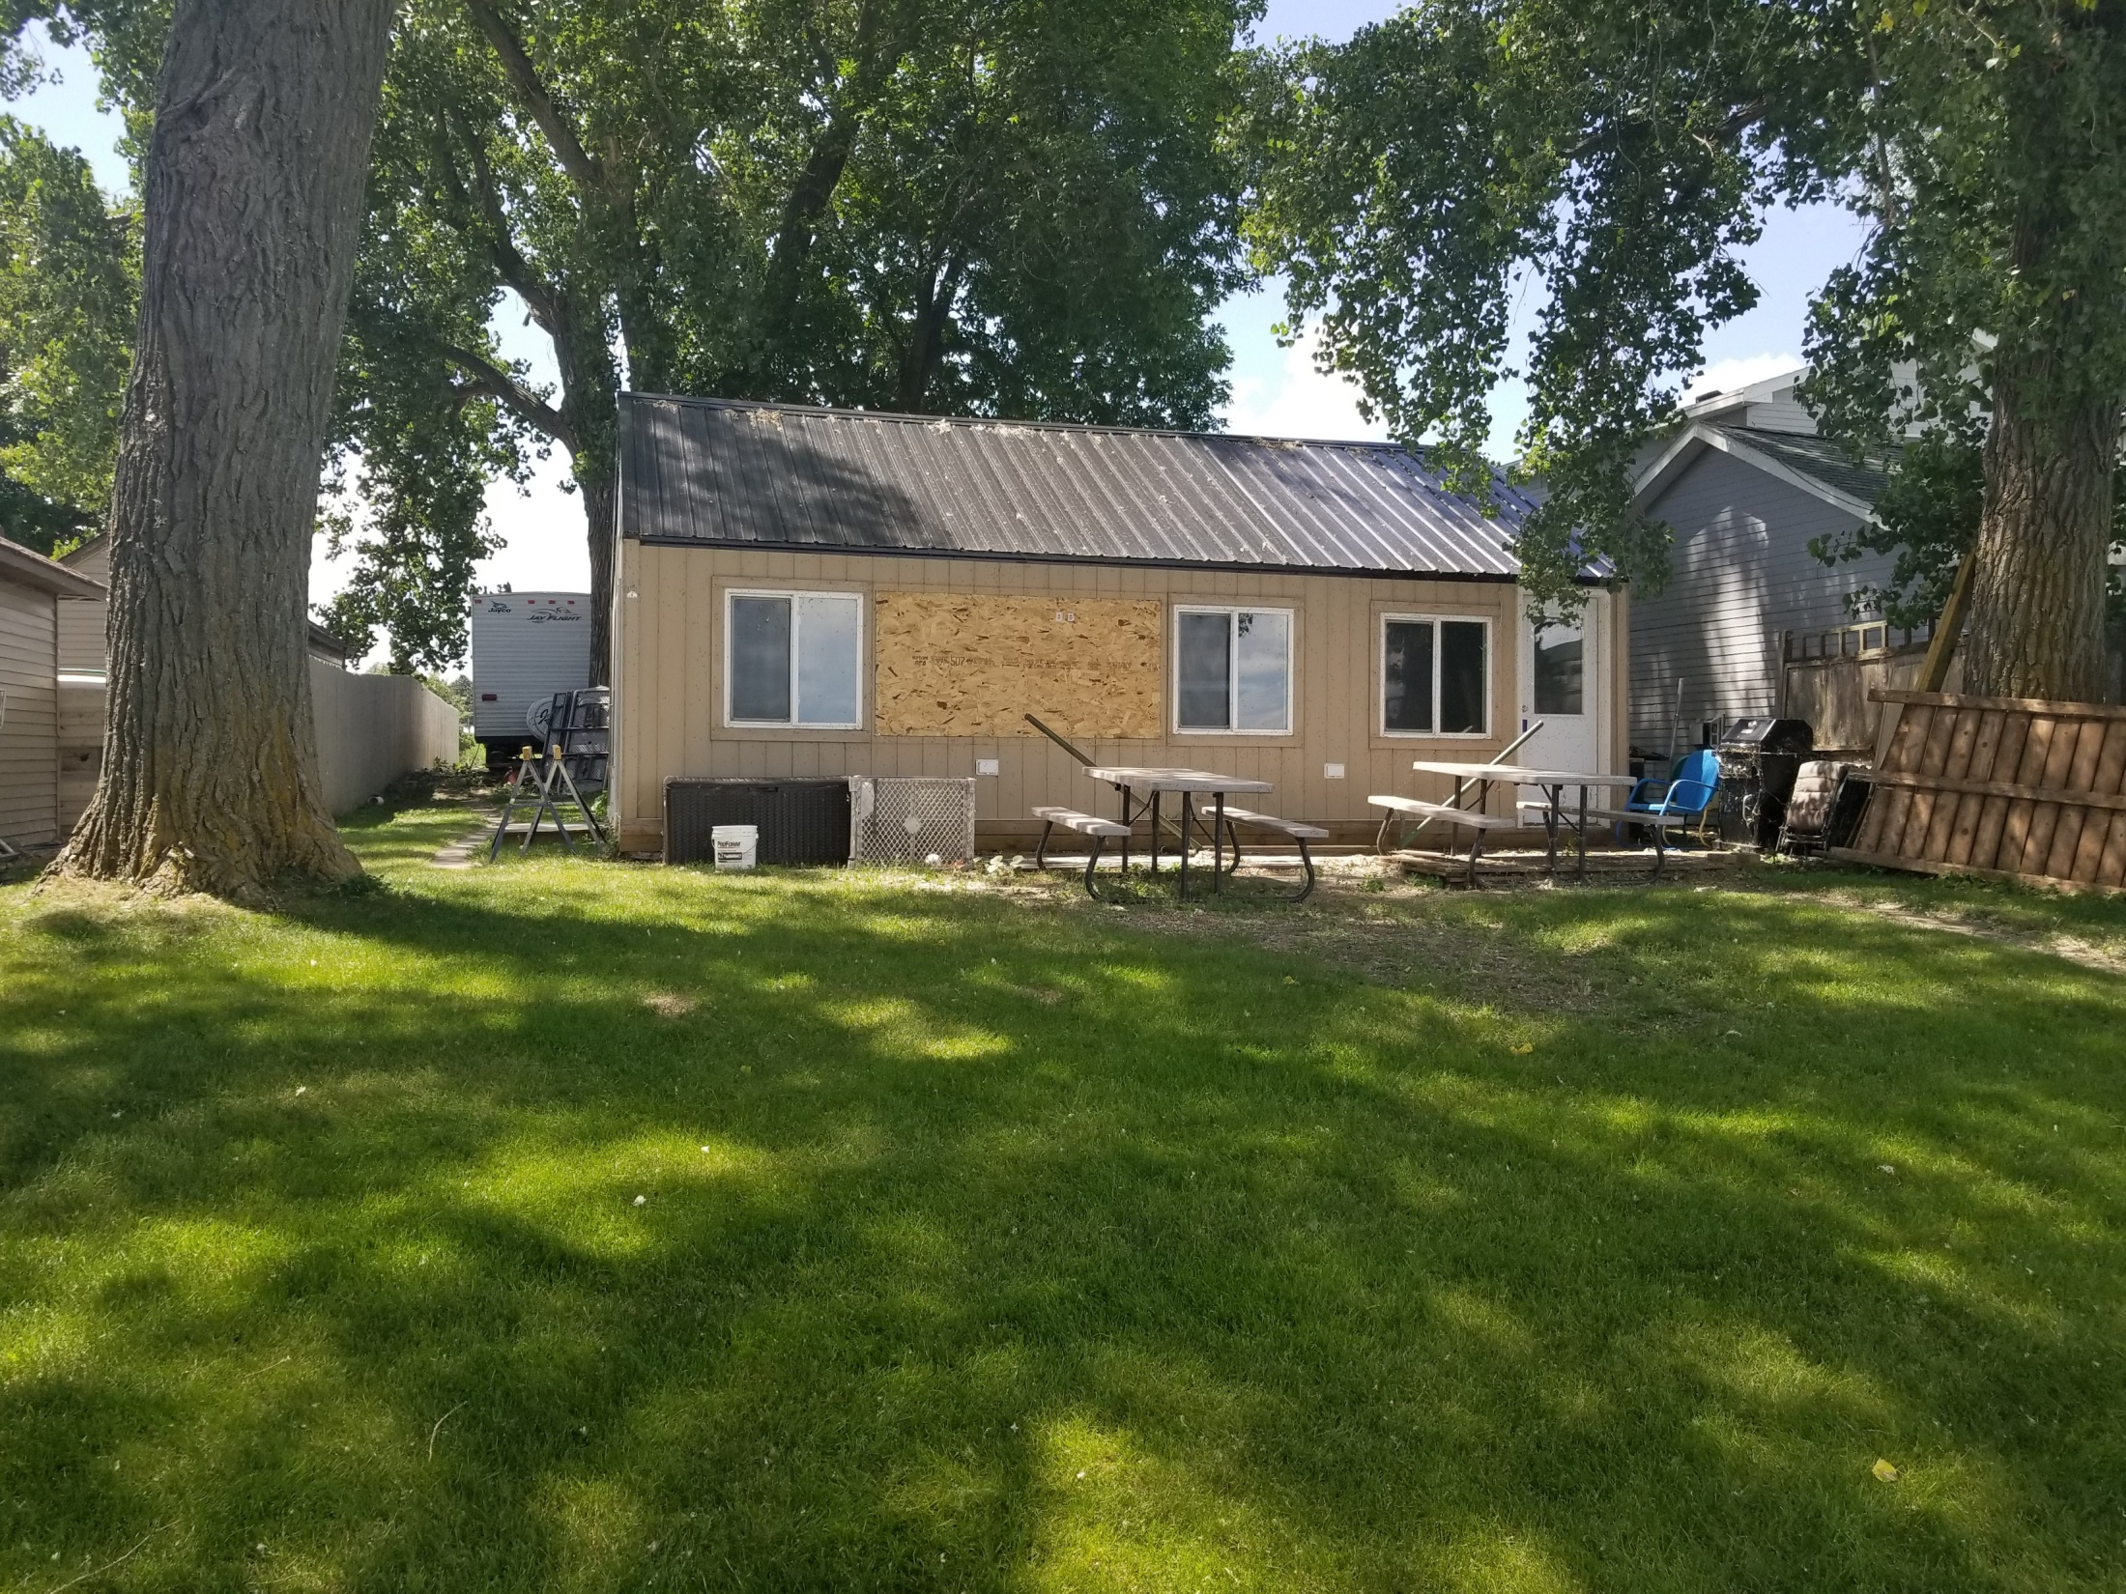

Slide 12
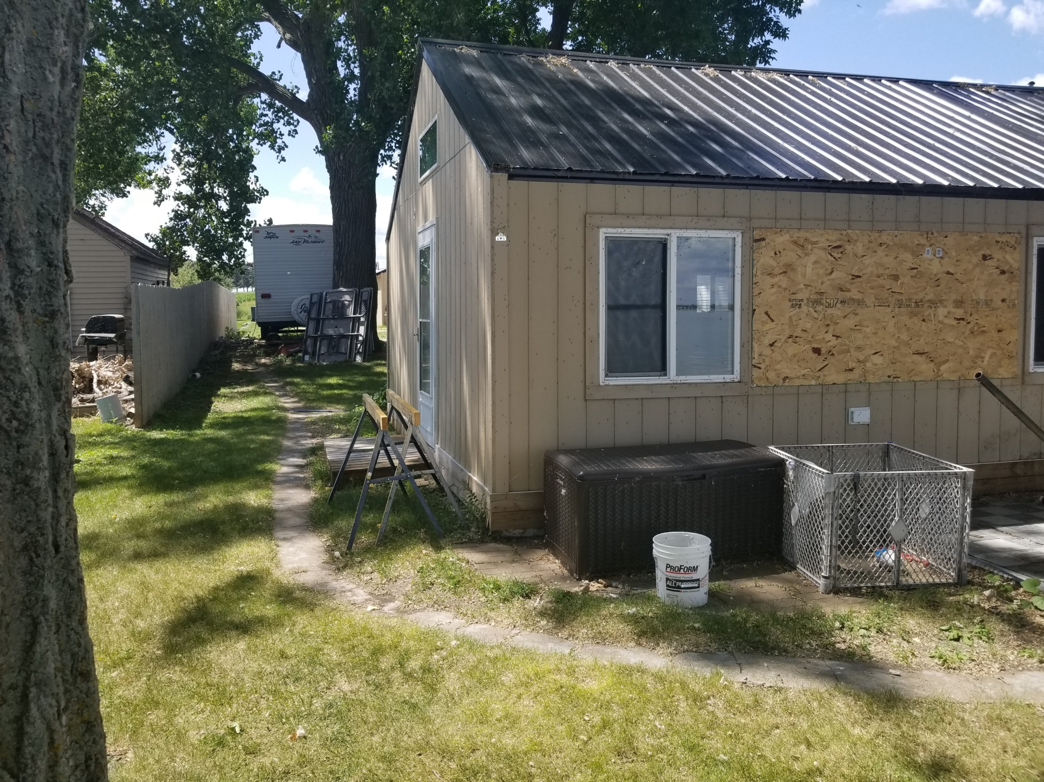

Slide 13
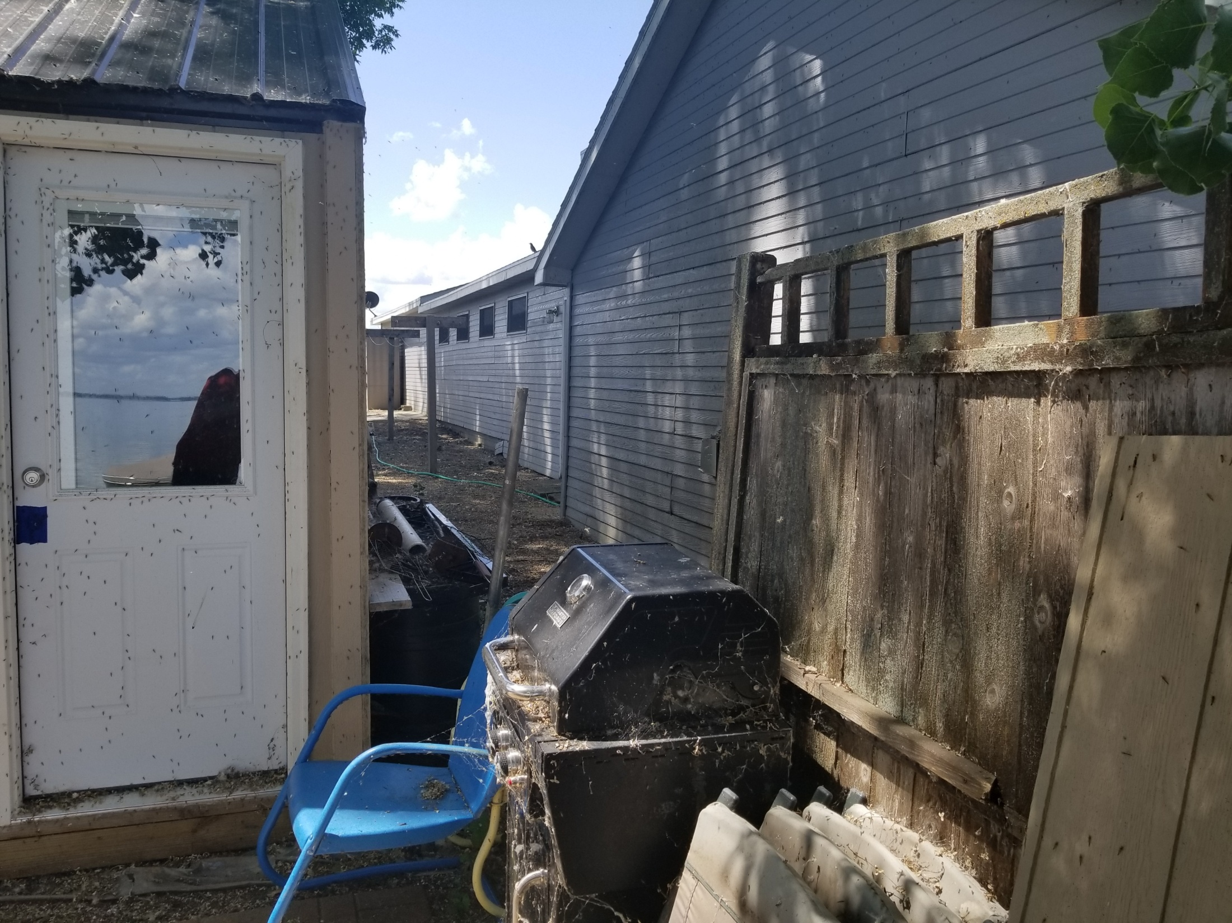

Slide 14
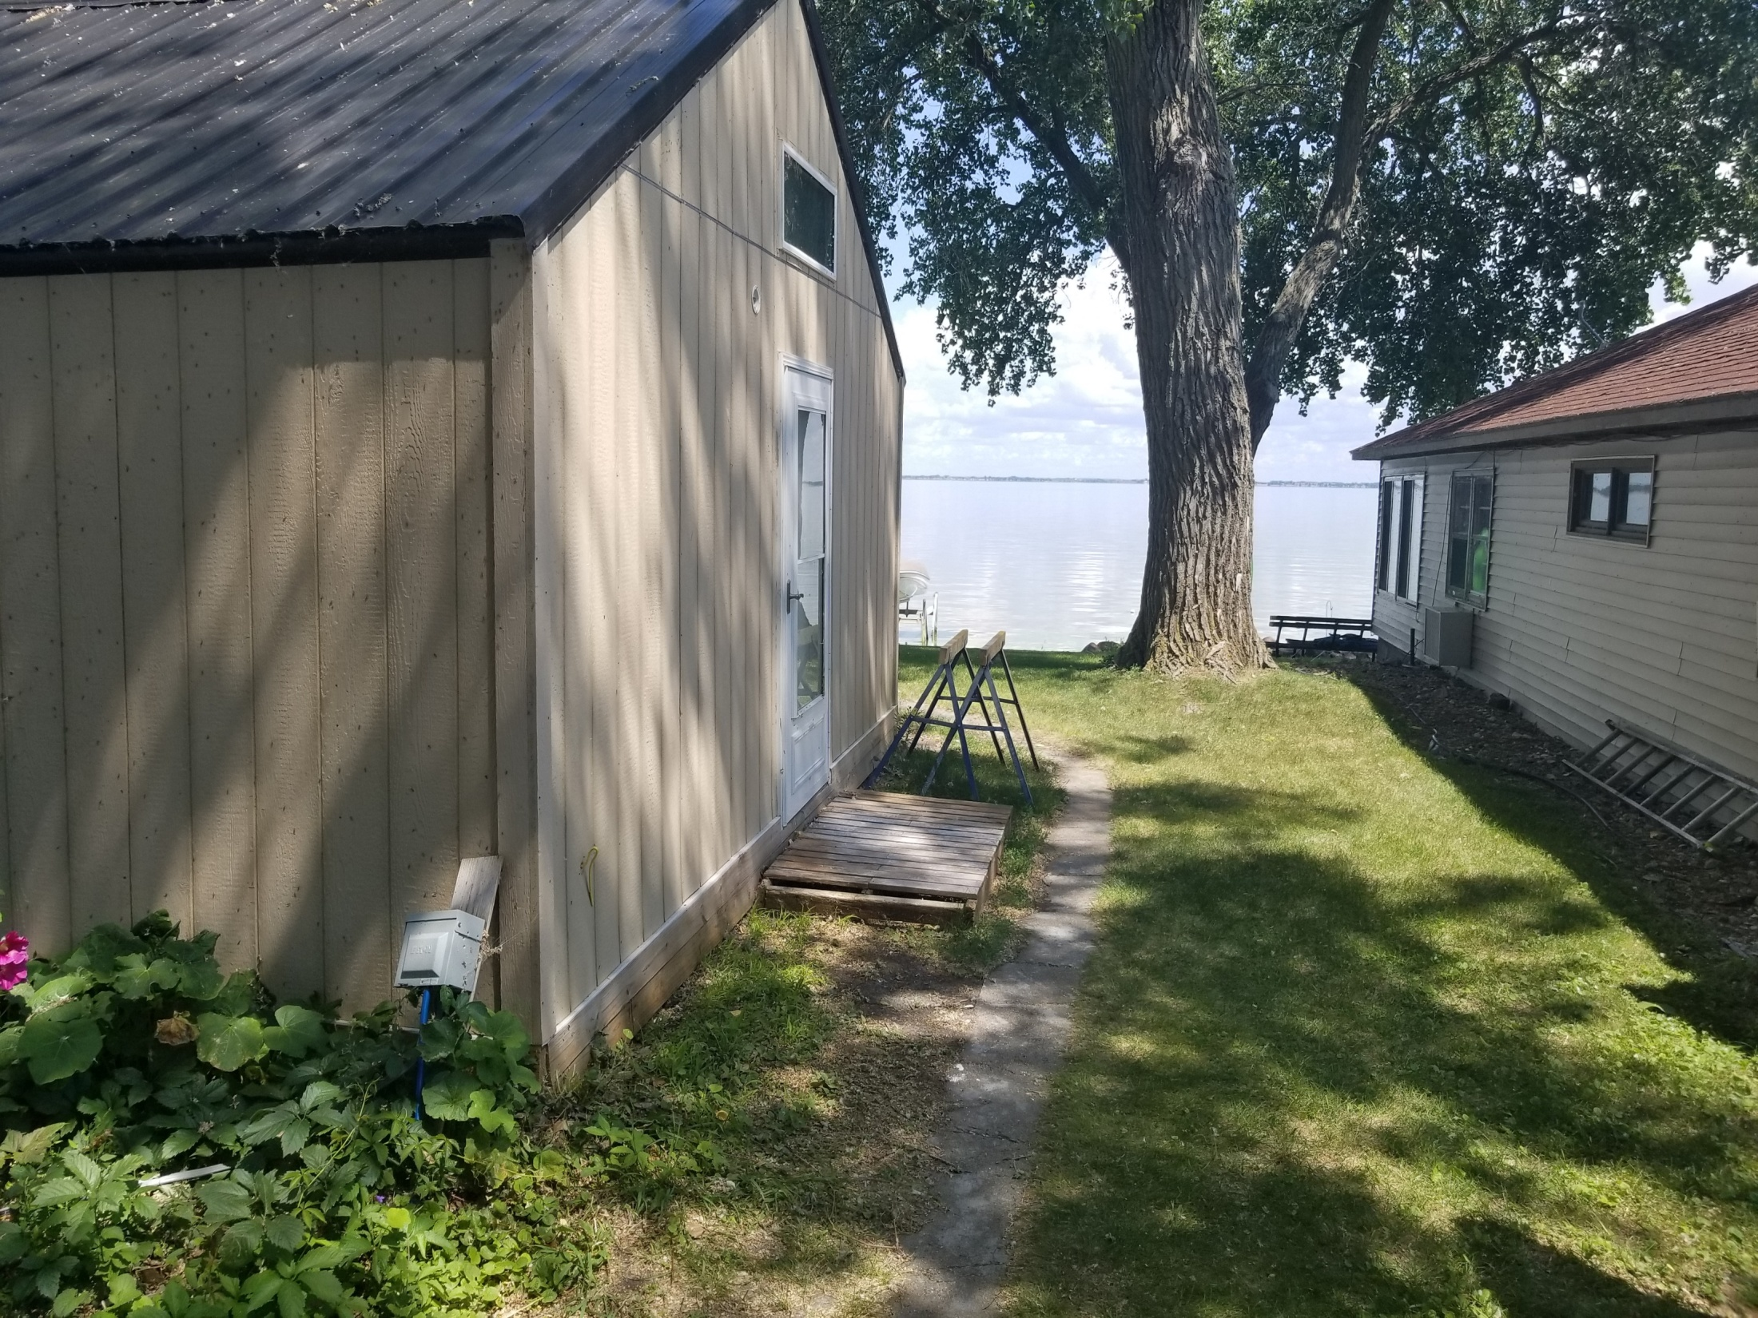

Slide 15
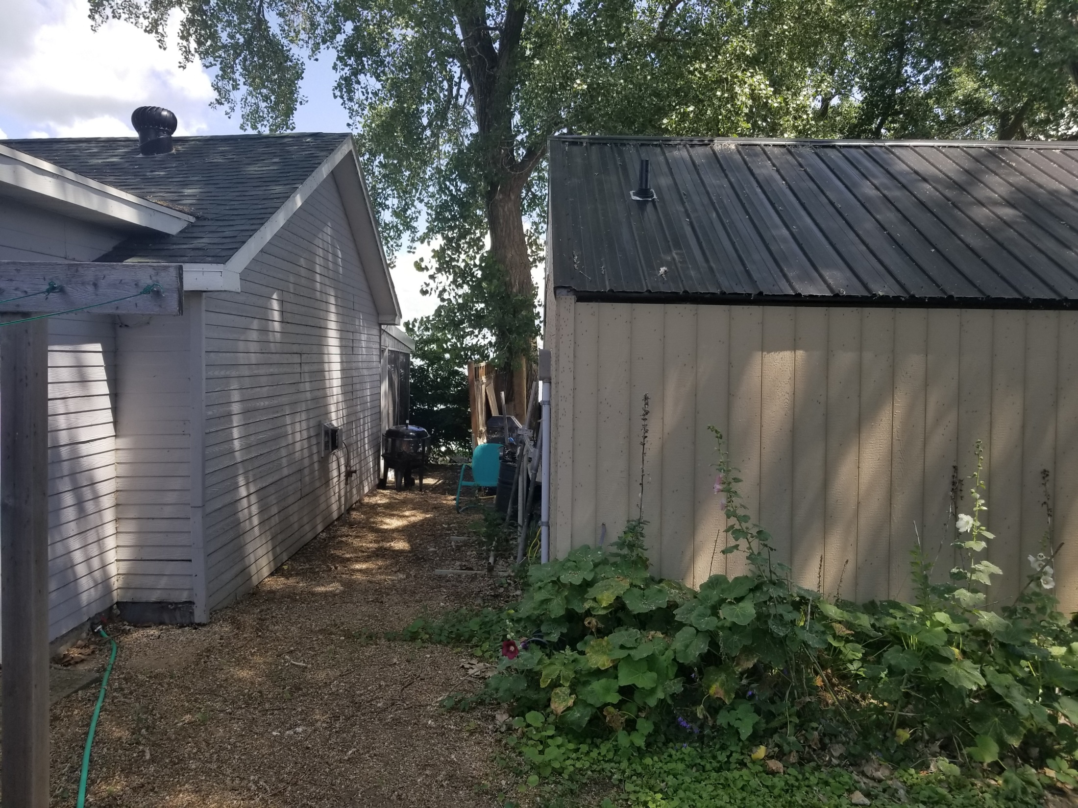

Slide 16
Otter Tail Conditional Use
Property Description: Lot 7 of Railroad Addition, a part of Lot 5 of the Plat of Lots 5 and 6 of Railroad Addition in S ½ of Section 33, Township 114N, Range 51W of the 5th P.M., Dempster, Hamlin County, South Dakota.

Slide 17
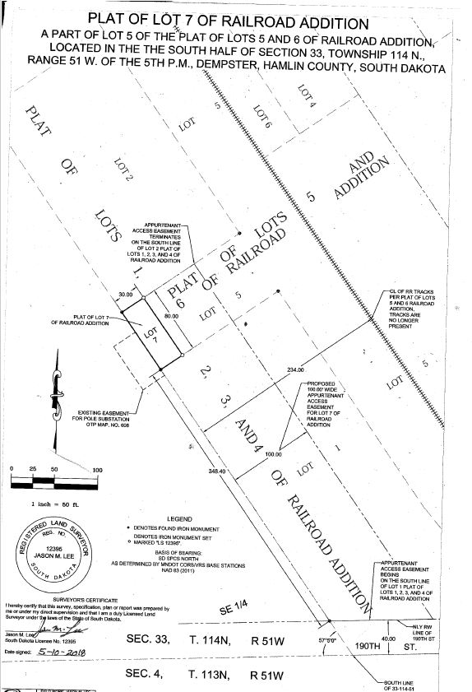

Slide 18
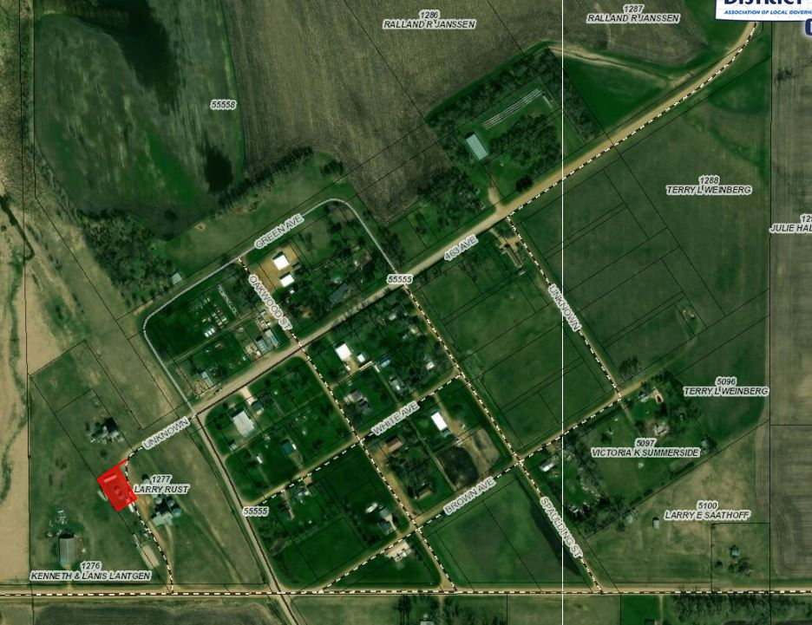

Slide 19
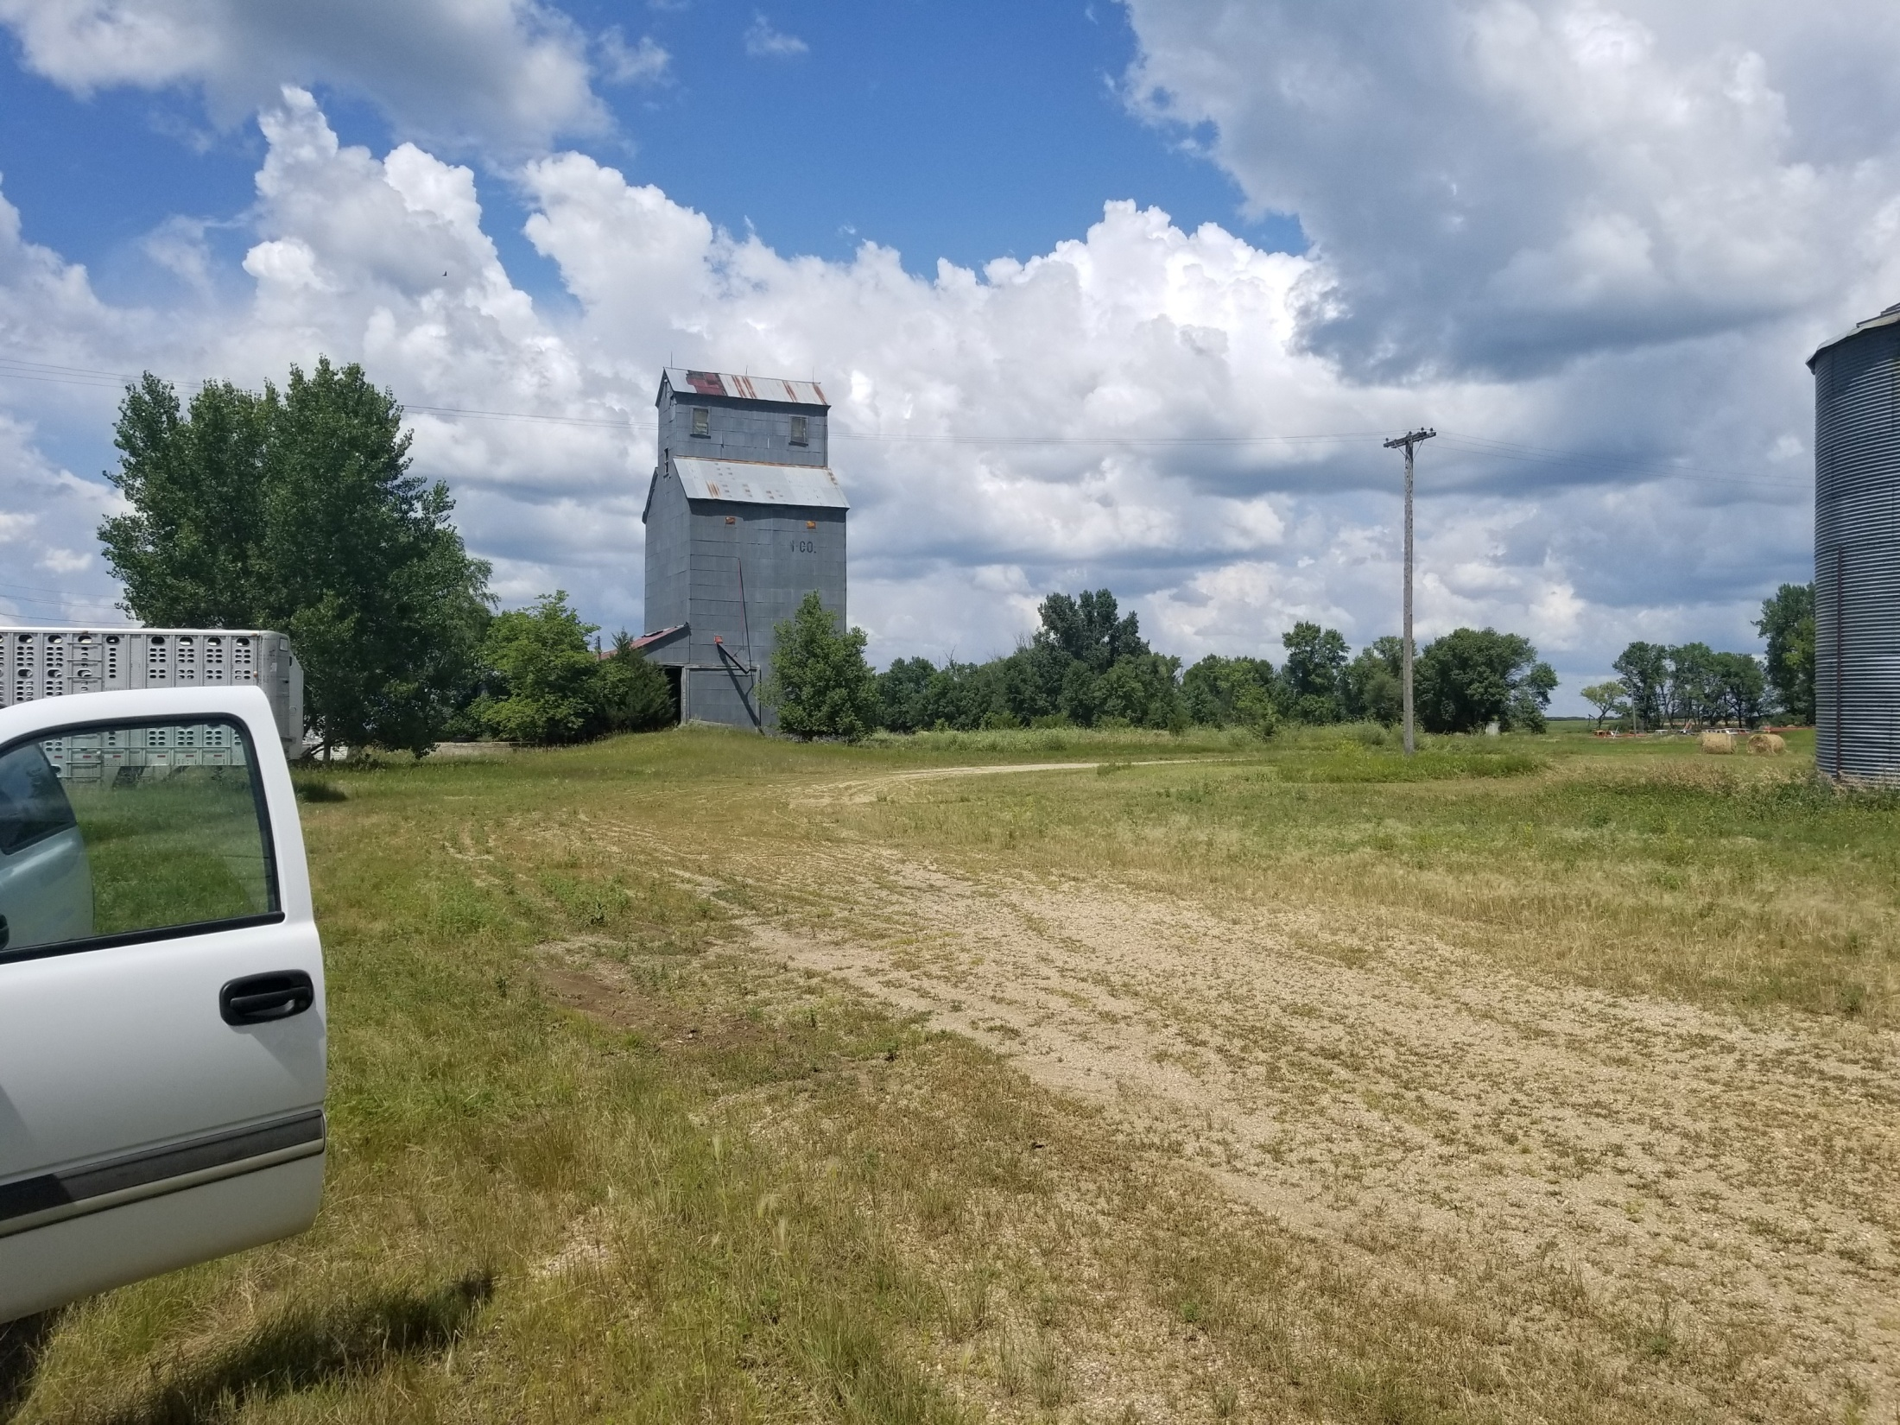

Slide 20
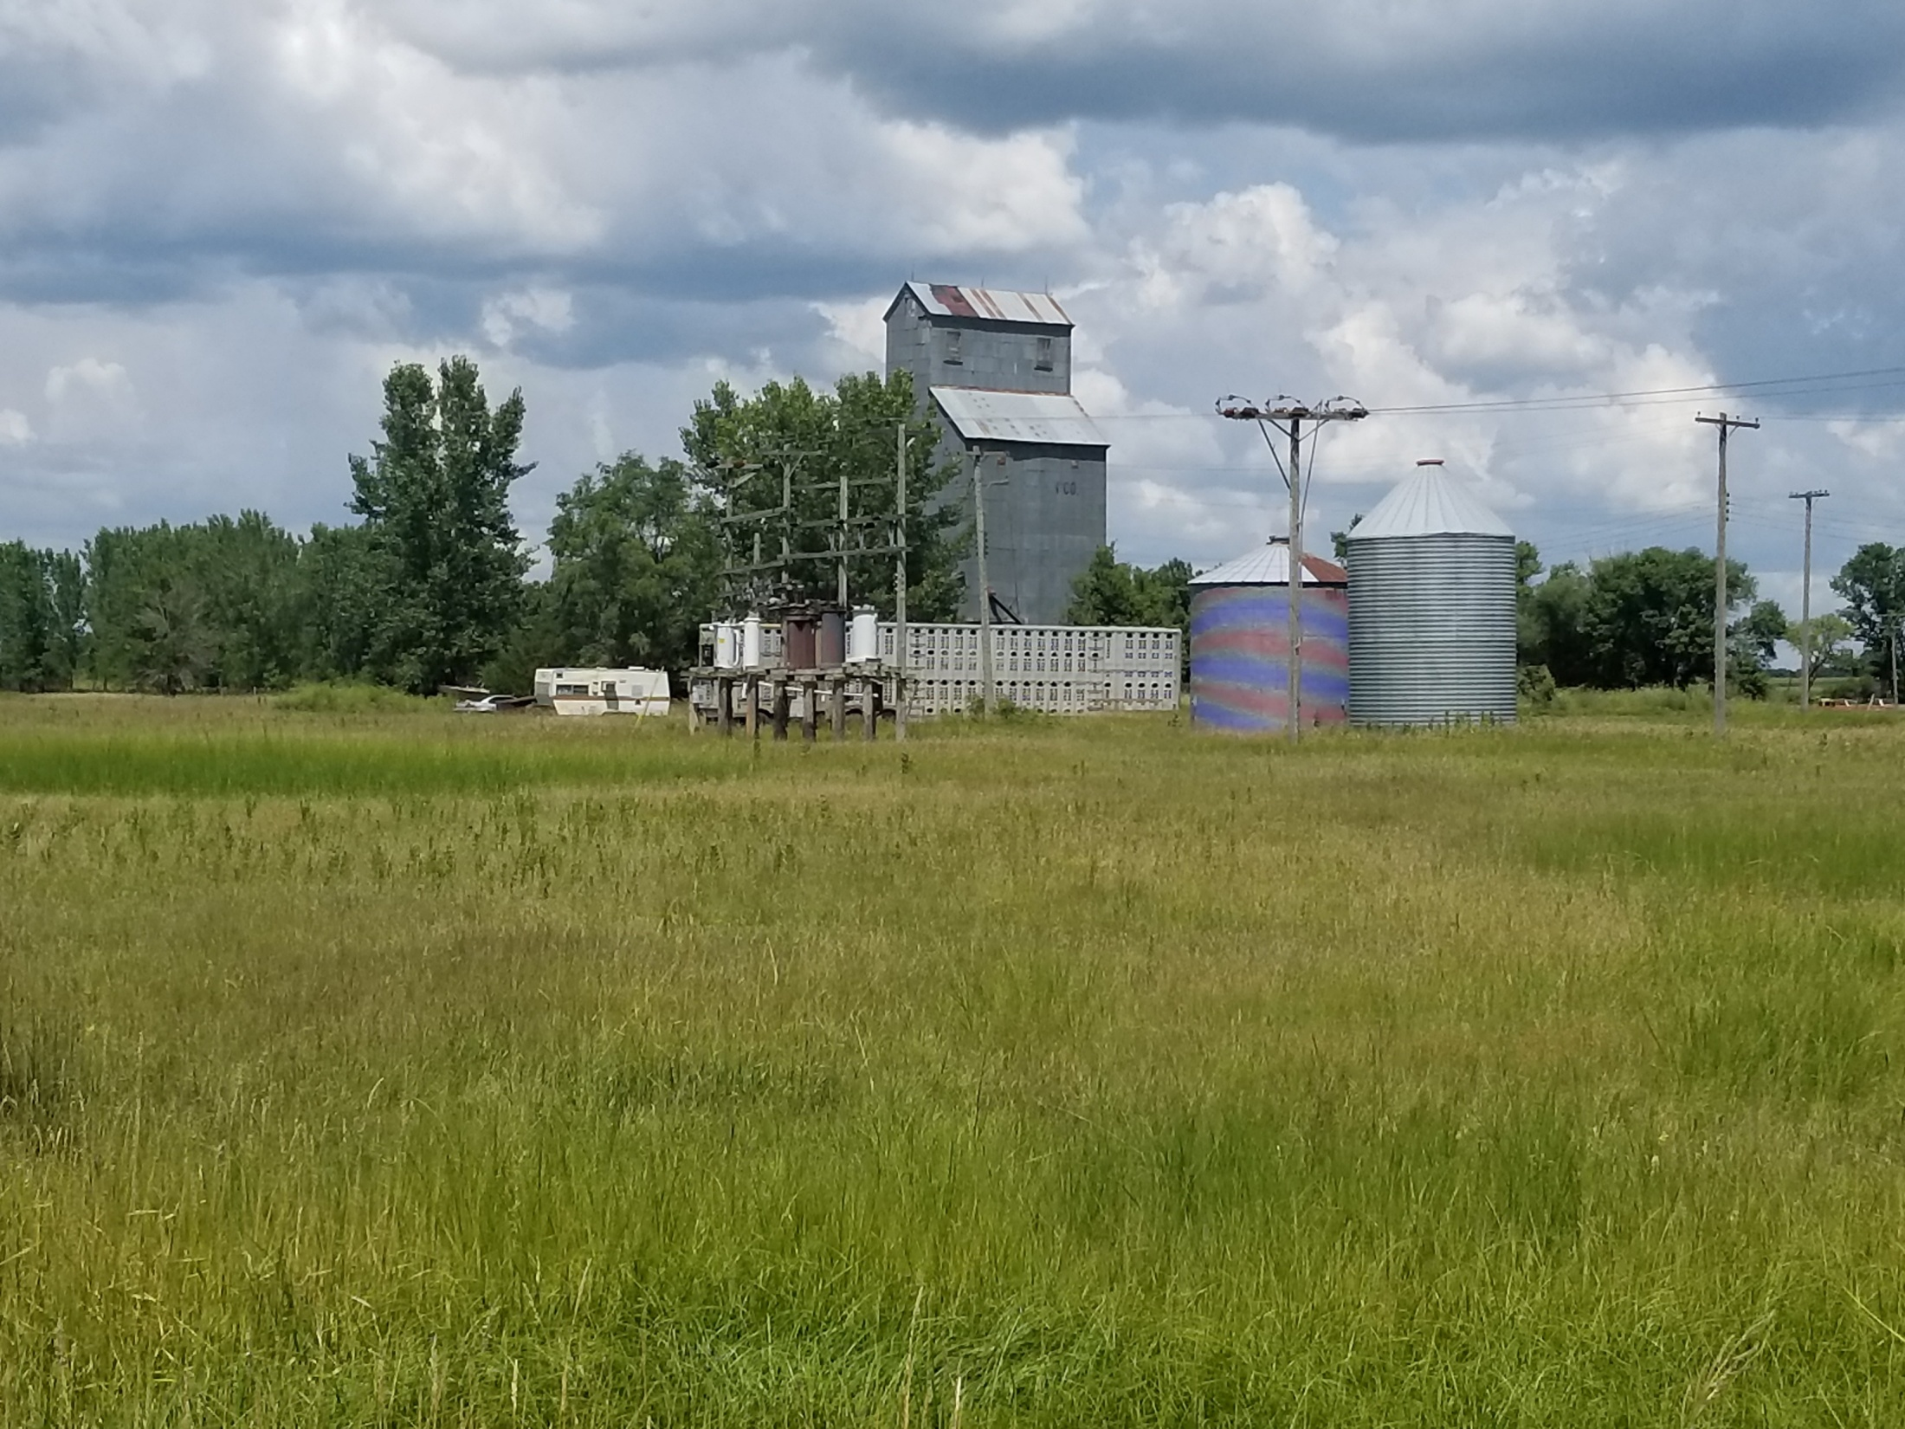
From 190th Street

Slide 21
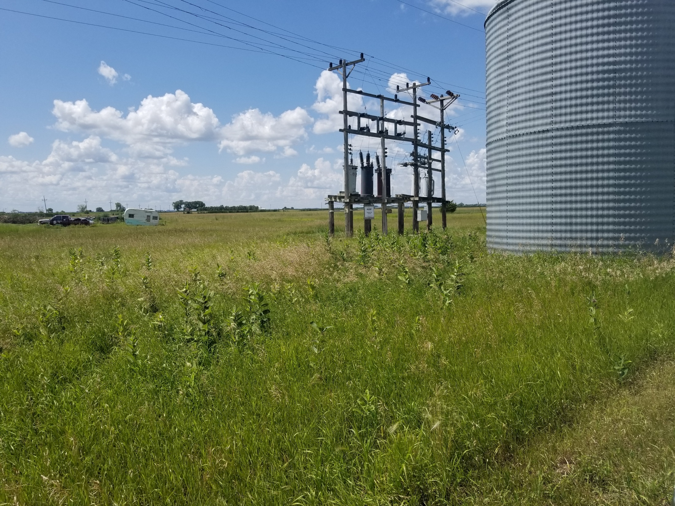

Slide 22
Otter Tail Conditional Use
Property Description: A 50’ wide strip of private property adjacent to (west of) 449th Avenue from 196th Street to the North side of 194th Street; and A 50’ wide strip of private property on the North side of 194th Street from 449th Avenue to the Western boundary of Lake Norden City limits.
Conditional Use: Conditional Uses in the Agricultural District (Essential Public Services)

Slide 23
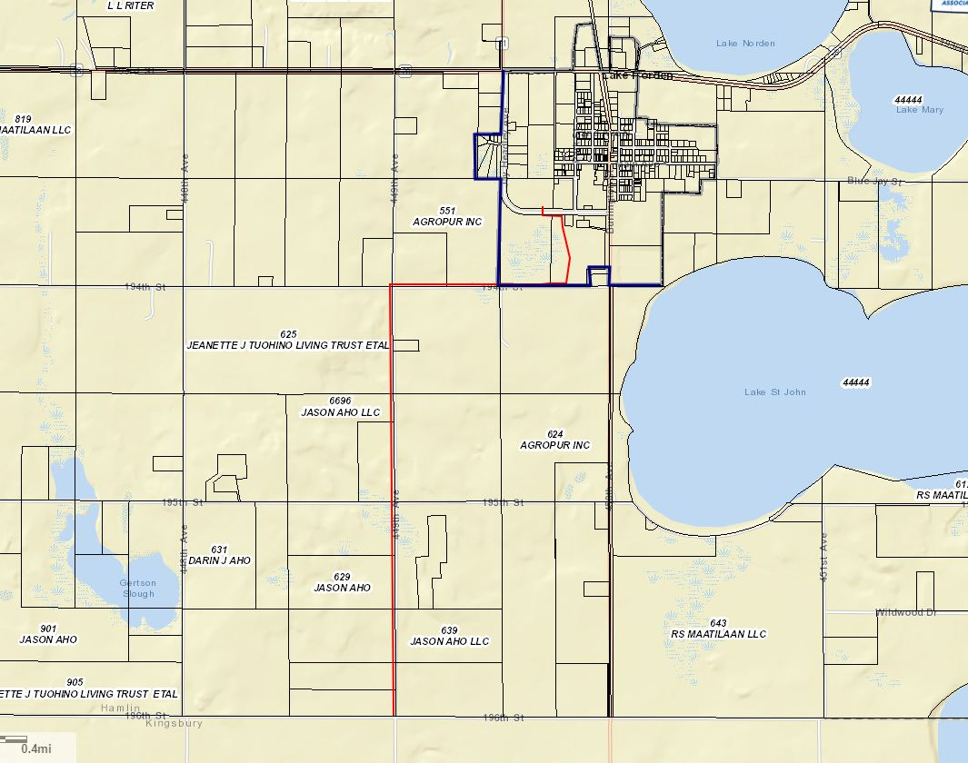

Slide 24
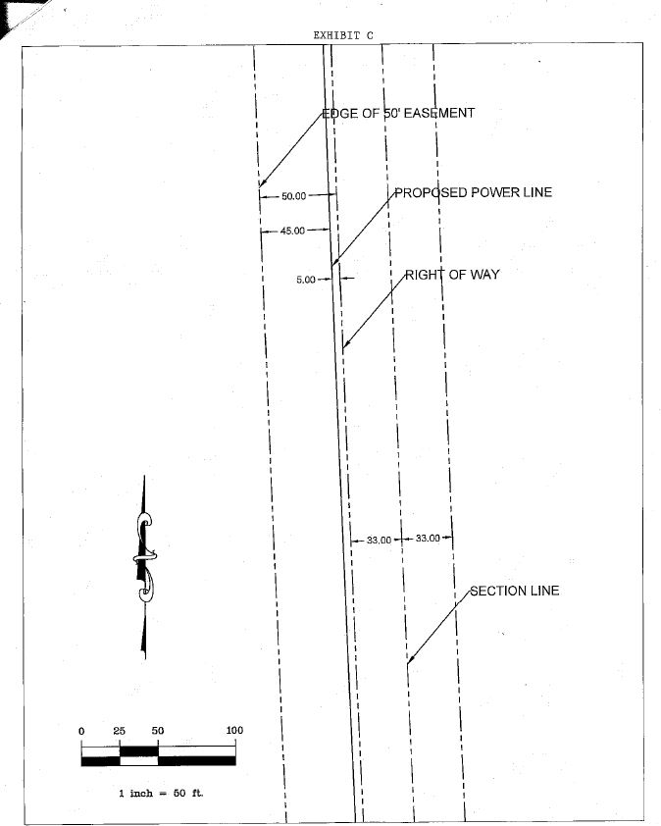

Slide 25
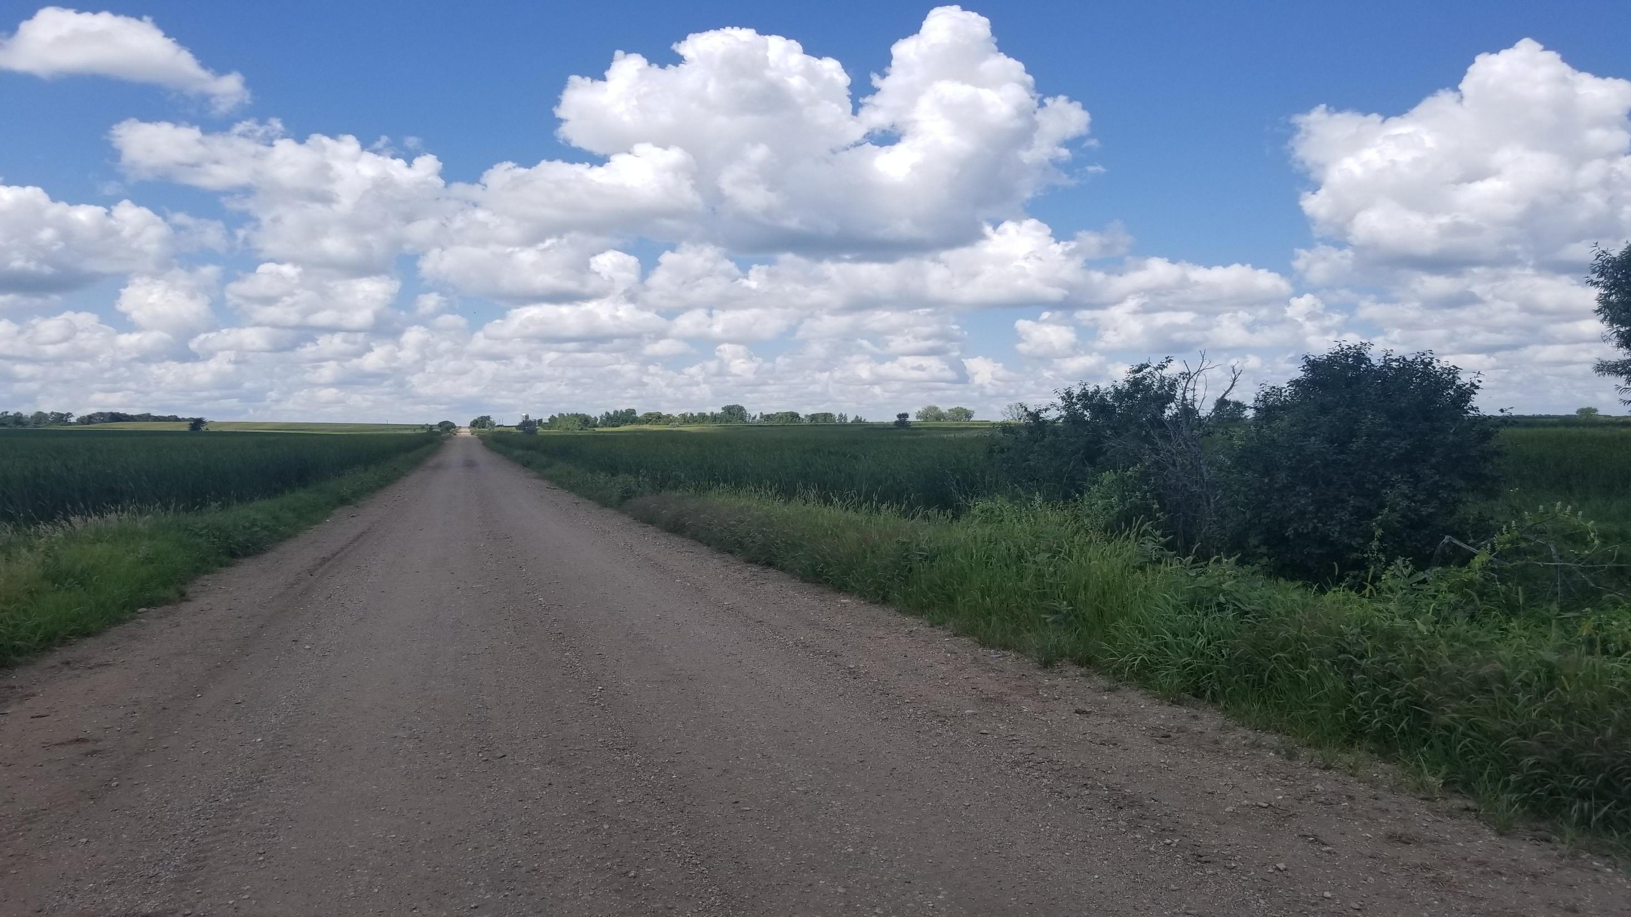
Looking West, Lake Norden City Limits

Slide 26
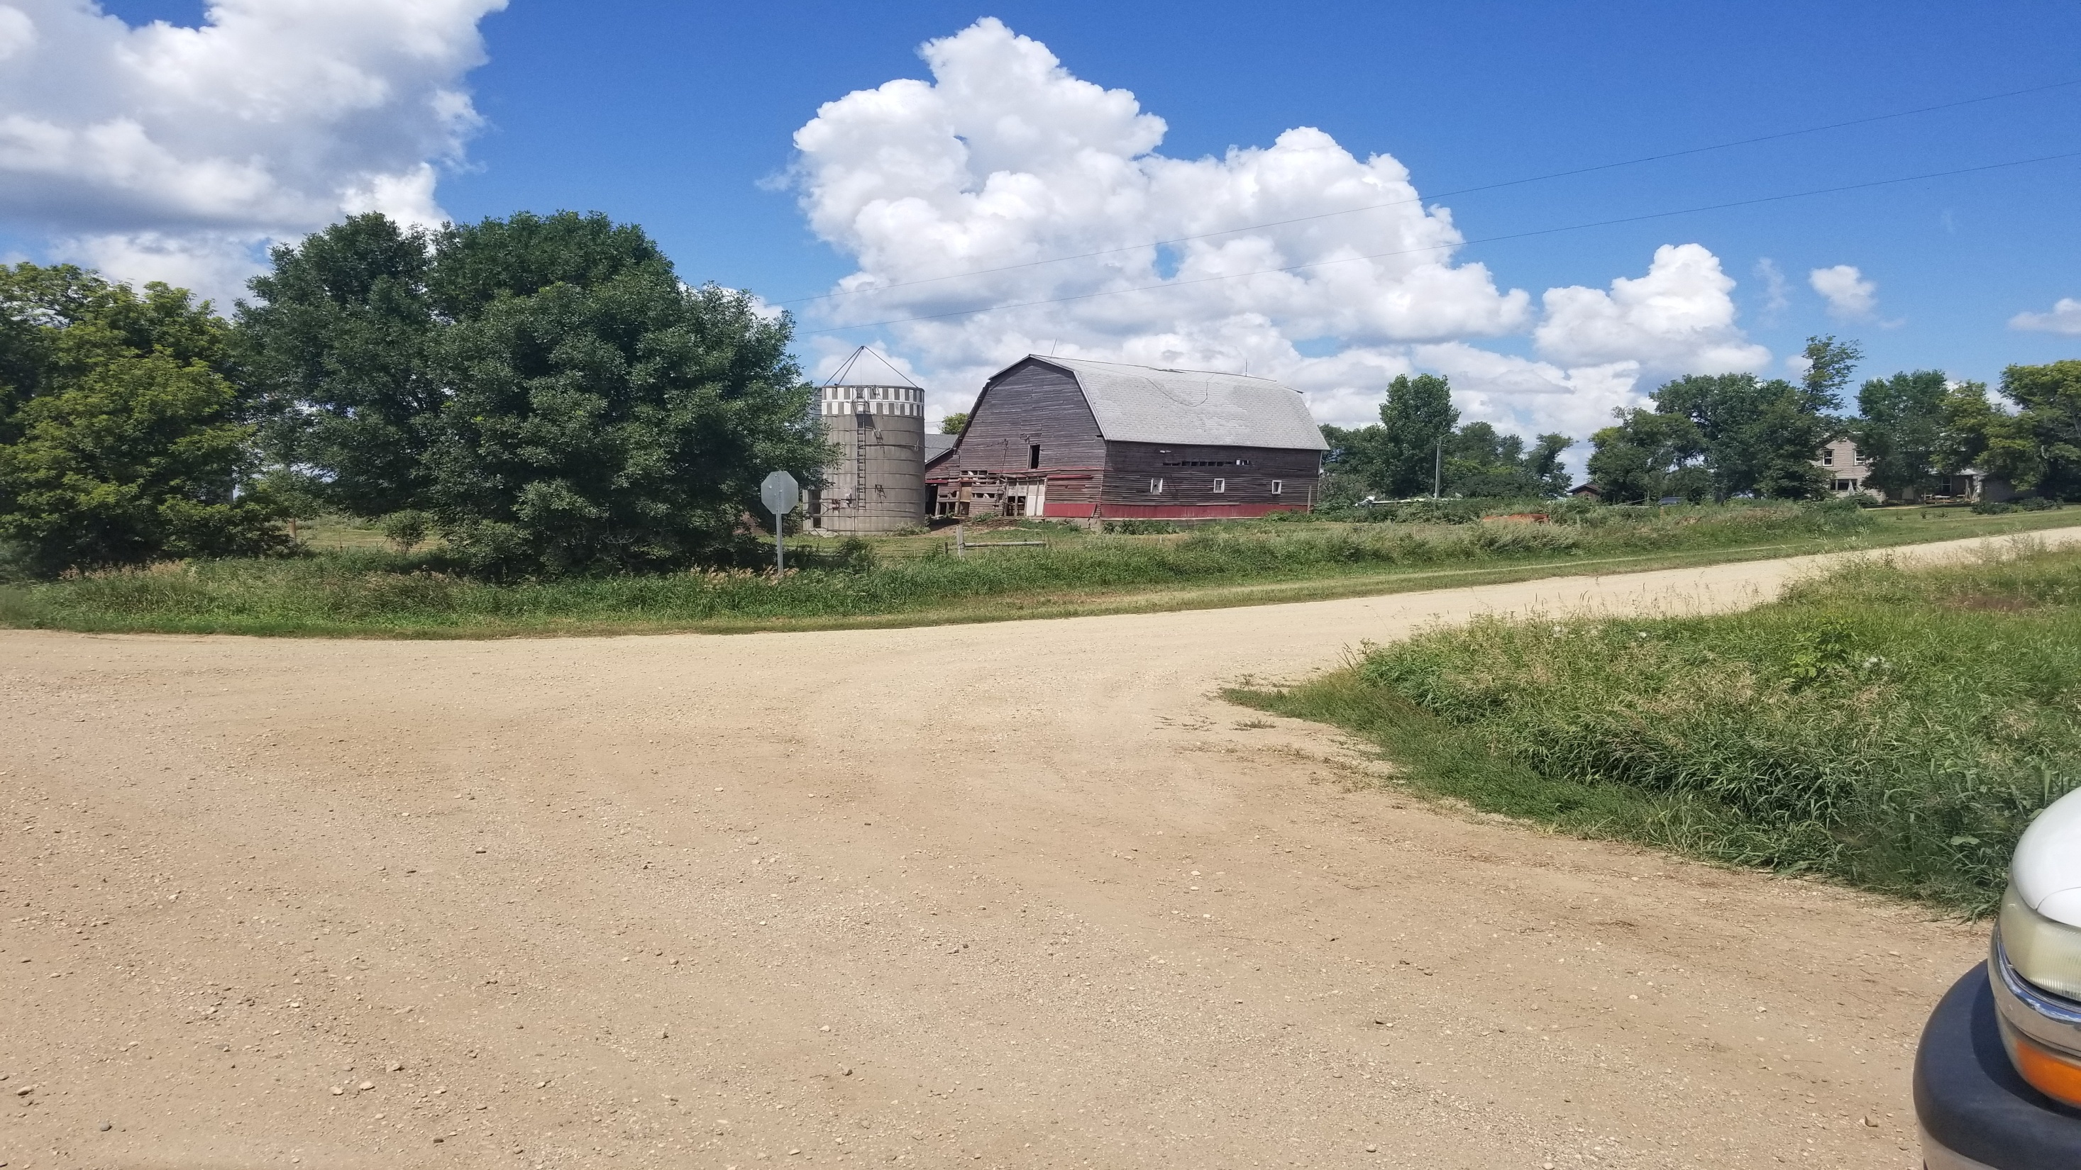
194th and 449th

Slide 27
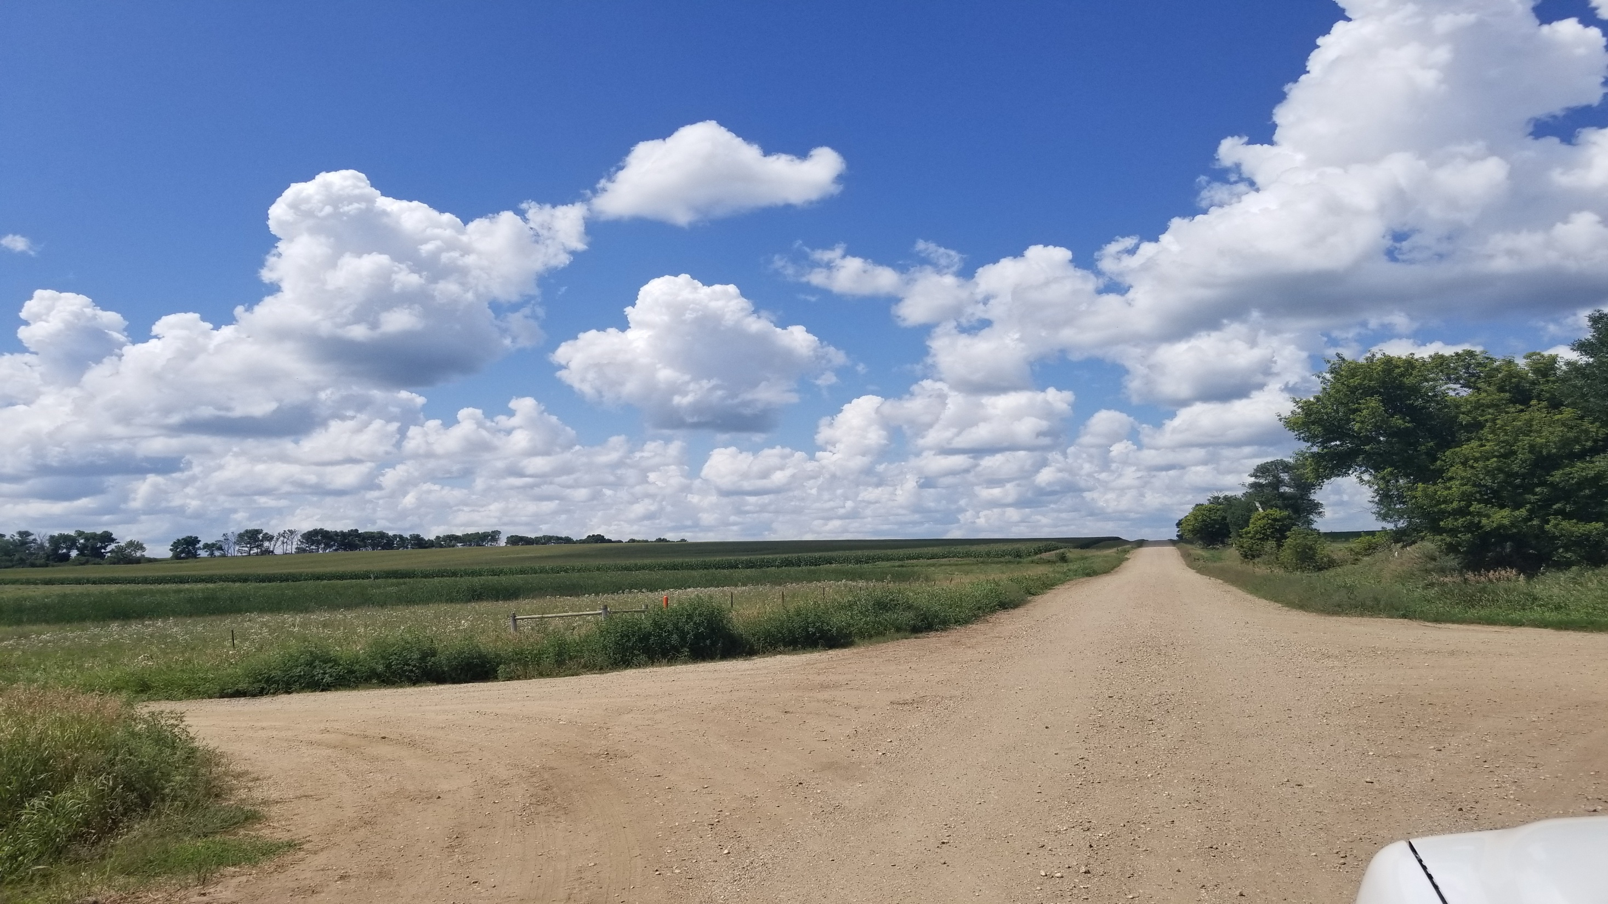

Slide 28
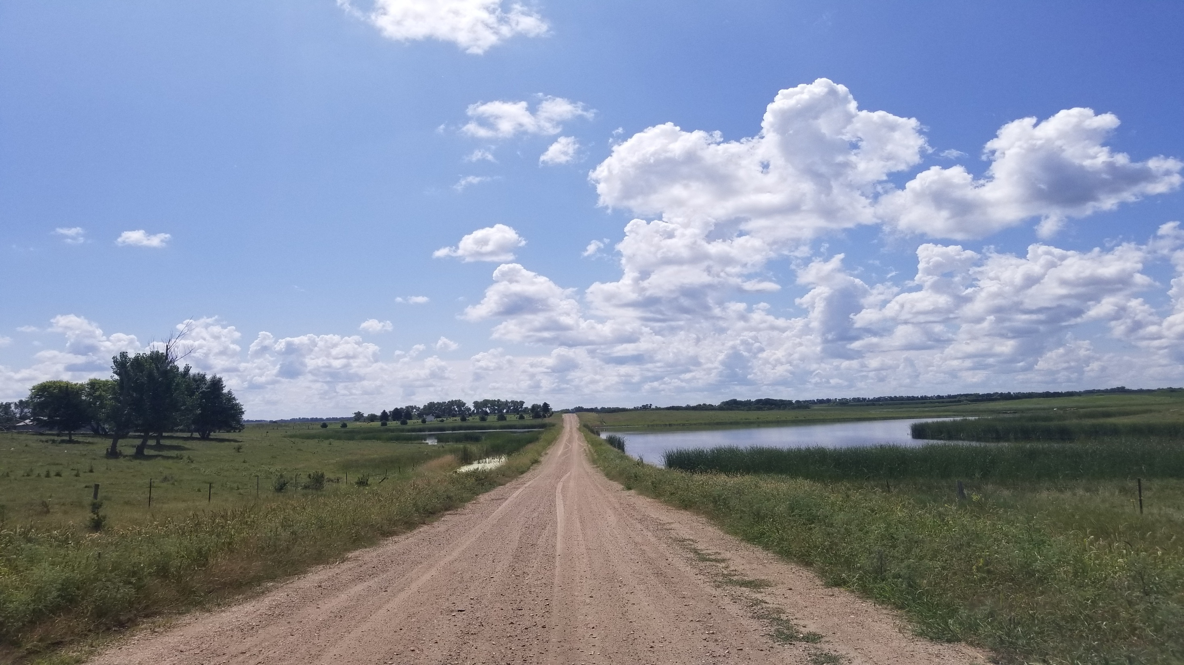

Slide 29
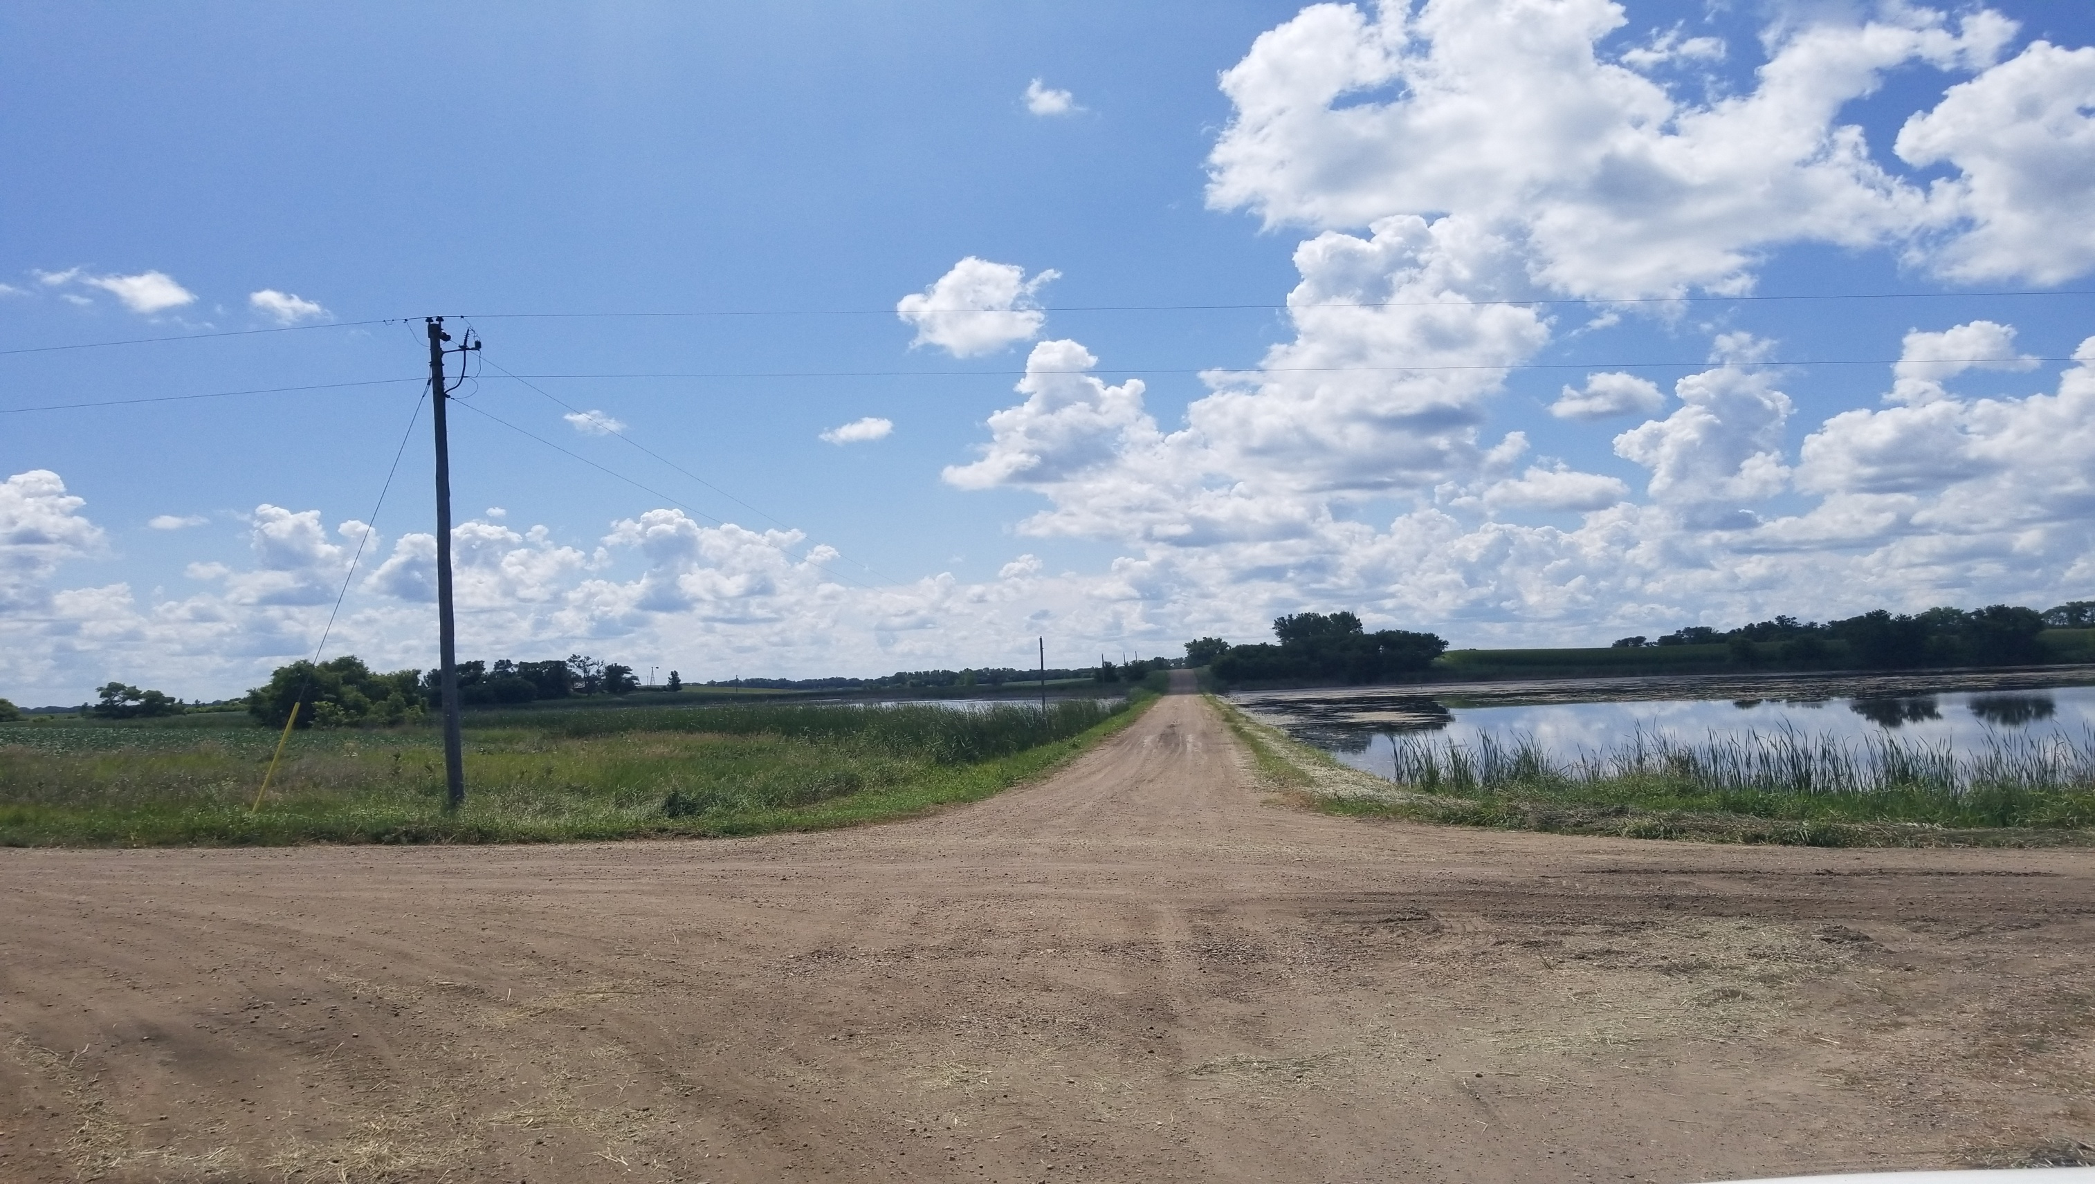
195th and 449th

Slide 30
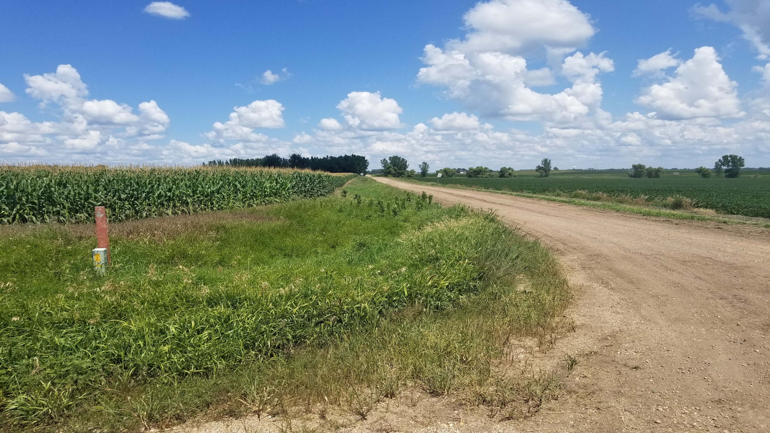
County Line

