Slide 1
Creating gis data and other gis tips and tricks
Ryan Hartley
First District

Slide 2
Topics covered in this presentation
Using ArcCatalog
How to Create Shapefiles
How to Create Geodatabases
How to Create Feature Datasets
How to Create Feature Classes
Explaining the difference between a Shapefile and a Geodatabase Feature Class
Explaining the difference between a File Geodatabase and a Personal Geodatabase
How to Create Domains (Picklists) for your Data
Basic Editing
A Picture of NECOG’s Jeep with 3 Wheels Off the Ground
Other Cool Stuff You Won’t Get Anywhere Else

Slide 3
Arccatalog: What is it?
A program that provides a catalog window that is used to organize and manage various types of geographic information for ArcGIS Desktop. The kinds of information that can be organized and managed in ArcCatalog includes:
Geodatabases
Raster files
Map documents, globe documents, 3D scene documents, and layer files
Geoprocessing toolboxes, models, and Python scripts
GIS services published using ArcGIS Server
Standards-based metadata for these GIS information items
And much more

Slide 4
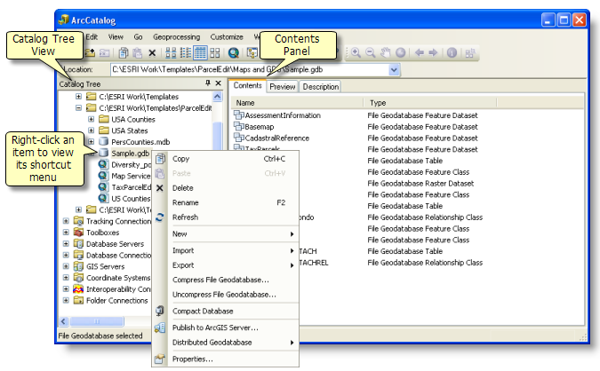
Arccatalog: What is it really?
It is Windows Explorer for your GIS

Slide 5
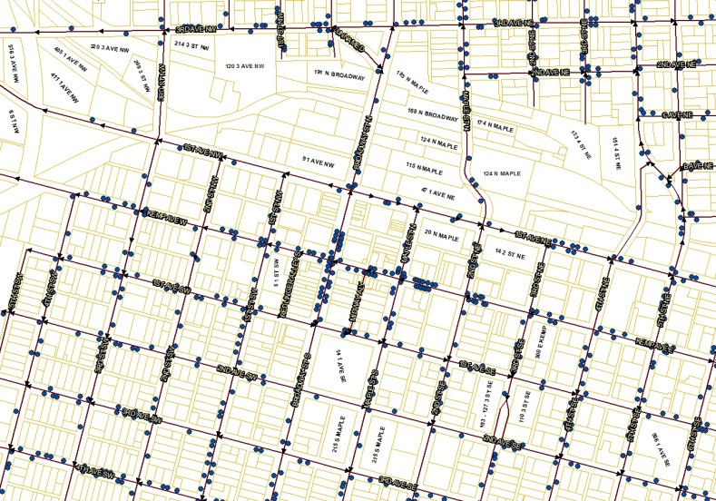
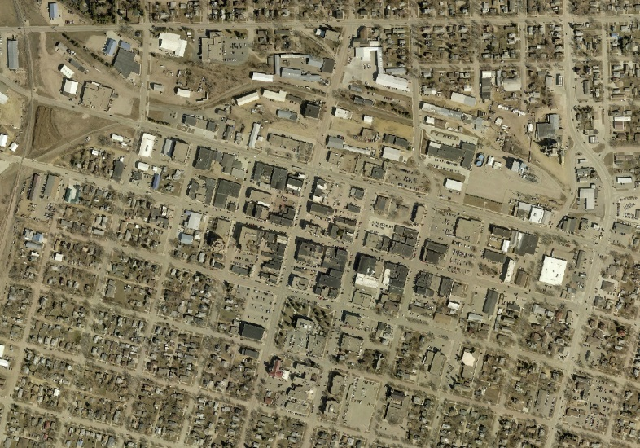
Lets talk about the different types of data for a minute!!!
VECTOR: POINTS, LINES, POLYGONS
RASTER: PIXEL-BASED DATA
Ownership Parcels (Polygon)
Lakes (Polygon)
Roads (Line)
Utility lines (Line)
Light Poles (Point)
Fire Hydrants (Point)
Aerial Photography
Satellite Images

Slide 6
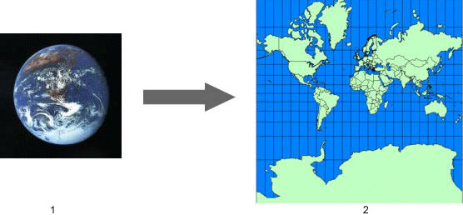
Lets talk about map projections for a minute!!!
A map projection is a mathematical expression that is used to represent the round, 3D surface of the earth on a flat, 2D map.

Slide 7
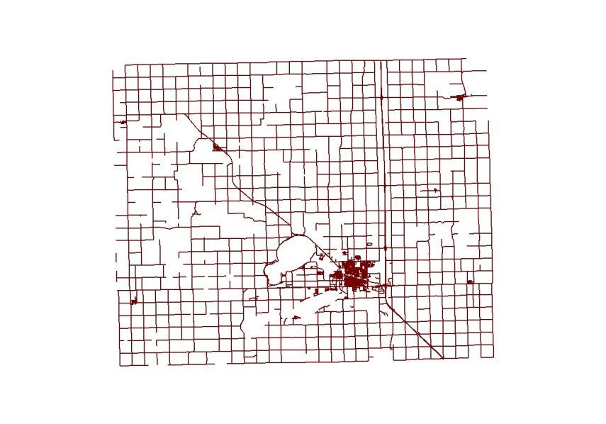
The two main projections in south dakota are:
UTM (Universal Transverse Mercator)
State Plane (Lambert Conformal Conic)
Zone 14 for most of SD
Zone 13 for extreme western SD
DATUM NAD83
Units Meters
FIPS Zone 4001 for the north half of SD (SouthDakotaNorth)
FIPS Zone 4002 for the south half of SD (SouthDakotaSouth)
DATUM NAD83
Units Feet

Slide 8
What is a shapefile?
A shapefile is a simple, nontopological format for storing the geometric location and attribute information of geographic features. Geographic features in a shapefile can be represented by points, lines, or polygons (areas). The workspace containing shapefiles may also contain dBASE tables, which can store additional attributes that can be joined to a shapefile's features.
The shapefile format defines the geometry and attributes of geographically referenced features in three or more files with specific file extensions that should be stored in the same project workspace. They are:
.shp—The main file that stores the feature geometry; required.
.shx—The index file that stores the index of the feature geometry; required.
.dbf—The dBASE table that stores the attribute information of features; required.

Slide 9
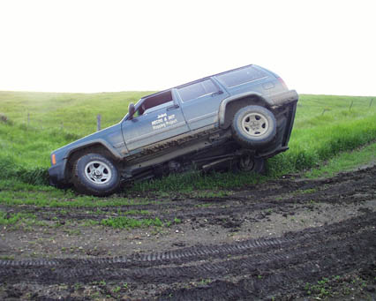
Creating a shapefile using arccatalog
Open ArcCatalog
Start\All Programs\ArcGIS\ArcCatalog

Slide 10
Creating a shapefile using arccatalog
Navigate to your destination folder
Right-click in the contents area and select New→Shapefile

Slide 11
Creating a shapefile using arccatalog
Enter the Name of the New Shapefile
Specify the type of shapefile from the drop-down menu

Slide 12
Creating a shapefile using arccatalog
To define a projection, under the Spatial Reference Description box, click the Edit button
Navigate to Projected Coordinate Systems\State Plane\NAD 1983 (2011) (US Feet)
Scroll Down to NAD 1983 (2011) StatePlane South Dakota N FIPS 4001 (US Feet) or S FIPS 4002 and Click to select and then Click OK

Slide 13
Creating a shapefile using arccatalog
The new Shapefile is created

Slide 14
What is a geodatabase?
The geodatabase is a "container" used to hold a collection of datasets. There are three types:
File Geodatabases—Stored as folders in a file system. Each dataset is held as a file that can scale up to 1 TB in size. This option is recommended over personal geodatabases.
Personal Geodatabases—All datasets are stored within a Microsoft Access data file, which is limited in size to 2 GB.
ArcSDE Geodatabases—Stored in a relational database using Oracle, Microsoft SQL Server, IBM DB2, or IBM Informix. These multiuser geodatabases require the use of ArcSDE and can be unlimited in size and numbers of users.
File and personal geodatabases, which are freely available to all ArcGIS users (i.e., users of ArcView, ArcEditor, and ArcInfo), are designed to support the full information model of the geodatabase. This includes topologies, raster catalogs, network datasets, terrain datasets, address locators, and so on. File and personal geodatabases are designed to be edited by a single user and do not support geodatabase versioning.

Slide 15
What is a feature dataset and a feature Class?
A feature dataset is a collection of related feature classes in a geodatabase that share a common coordinate system. Feature datasets are used to spatially or thematically integrate related feature classes. Their primary purpose is for organizing related feature classes into a common dataset for building a topology, a network dataset, a terrain dataset, or a geometric network.
Feature classes are homogeneous collections of common features, each having the same spatial representation, such as points, lines, or polygons, and a common set of attribute columns, for example, a line feature class for representing road centerlines. The most commonly used feature classes in the geodatabase are points, lines, polygons.

Slide 16
Geodatabase Data model

Slide 17
Ceating a geodatabase
Navigate to your destination folder
Right-click in the contents area and select New→File Geodatabase

Slide 18
Creating a feature dataset
Navigate inside the geodatabase by double-clicking it
Right-click in the contents area and select New→Feature Dataset

Slide 19
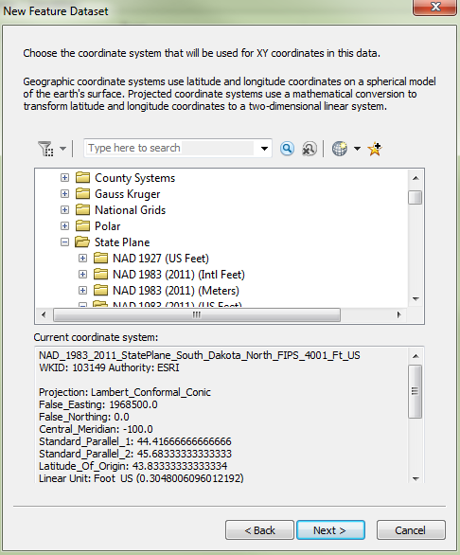
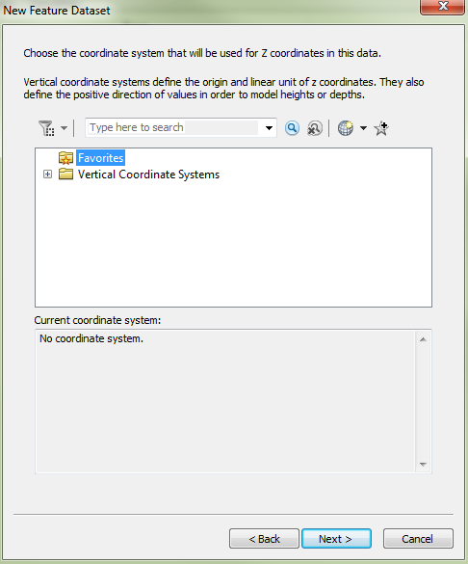
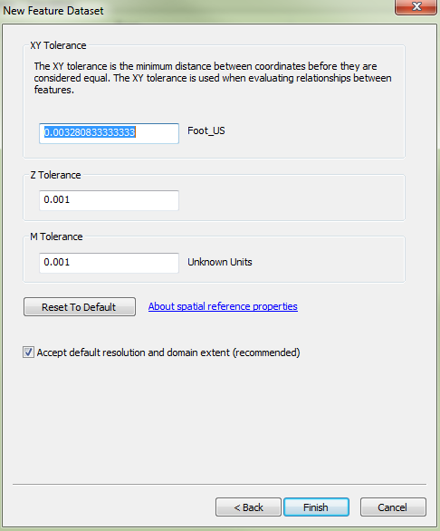
Creating a feature dataset
Enter the feature dataset’s name and click Next
Navigate to Projected Coordinate Systems\State Plane\NAD 1983 (2011) (US Feet), Scroll Down to and select NAD 1983 (2011) StatePlane South Dakota N FIPS 4001 (US Feet) and click Next
If necessary select a vertical coordinate system, otherwise click Next
Use the default tolerances until you are more comfortable with how these work and click Finish

Slide 20
CREATING A FEATURE DATASET

Slide 21
Creating a feature class
Navigate inside the geodatabase feature dataset by double-clicking it
Right-click in the contents area and select New→Feature Class

Slide 22
Creating a feature class
Enter the name of the feature class
Use the drop-down menu to specify the type of feature class
Click Next

Slide 23
Creating a feature class
Click the Default radio button and click Next

Slide 24
Creating a feature class
Add the necessary data fields, specifying the data type
Click Finish

Slide 25
Creating a feature class

Slide 26
Creating a domain for a feature class
Feature classes have the option of creating domains
Domains allow the feature class creator to limit the input of data to a set of choices in a pick list
Avoids corruption of data from input error
Makes data population more efficient
Right-Click on the geodatabase and click Properties

Slide 27
CREATING A DOMAIN
Click the Domain tab
Enter the Domain Name and Description
Specify the Field Type, Domain Type, and if necessary, choose which Split Policy to use
Enter in the Coded Values. The Code is the actual value entered into the database; the Description will be the value shown. In most cases both the Code and the Description are the same.

Slide 28
Creating a domain
In the geodatabase, right-click on the feature class and click properties to bring up the Feature Class Properties box
Click on the appropriate Field Name to bring up the Field Properties
Click the drop-down menu next to the Domain field and select the corresponding domain
Click OK

Slide 29
Basic editing in arcgis
Right-Click on the feature class you want to edit, mouse down to Edit Features→Start Editing

Slide 30
Basic editing
Click the Editor Toolbar button on your main menu to open the Editor Toolbar

Slide 31
Basic editing
Click the Create Features button on the Editor toolbar to open the Create Features box located on the right side of the screen
In the Create Features box, click the BuildingsGeoDatabase feature class to add a new point feature

Slide 32
Basic editing
Click on the map viewer window to add a new building point
Click on the Attributes button on the Editor toolbar to bring up the Attribute Editor box on the left side of the screen
Enter in the attributes for the building point

Slide 33
Basic editing
BE SURE TO SAVE YOUR EDITS
To save your edits, click the Editor button, then slick Save Edits

Slide 34
Basic editing
Deleting a point:
Select the feature using either the Edit tool or the Select Features tool
Click the Delete Button

Slide 35
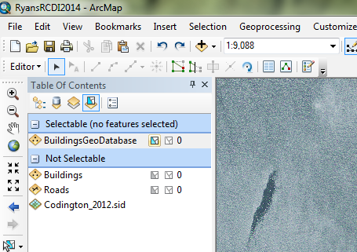
Other gis related tips: Setting a layer to make it selectable
At the top of the Table of Contents, click the List by Selection button
Scroll down to the layer to make selectable and click the Click to Toggle Selectable button

Slide 36
Other gis related tips: “help I’ve lost my table of contents!!!”
Under the Windows menu, click the Table of Contents Option

Slide 37
Other gis related tips: “how can I get a lat/long position?”
Using your Identify button, click on the feature or area
Once the Identify Results box opens, click on the arrow button to the right of the Location pane
Choose the type of measurement desired

Slide 38
Other gis related tips: measuring areas
Click on the Measure tool
Click on the Measure an Area button on the Measure tool pop-up box
To change the unit of measure, click Choose Units→Area and then click on the preferred unit of measurement

Slide 39
Questions/comments?

Slide 40
Thanks
Ryan Hartley
GIS Coordinator
First District
ryan@1stdistrict.org
(605) 882-5115

