Slide 1
Hamlin County
Planning Commission/Board of Adjustment
August 27th, 2018
We ask that you silence your cell phones and if you need to have any conversations with anyone in the audience we ask that you step outside so everyone can hear the Board and other testimony.
If you wish to testify on an issue, you are required to sign in.
Anyone responsible for disruptive behavior or noise may be asked to leave the meeting.
Prior to any testimony a motion will be made in the affirmative based upon staff recommendation as read.
Staff will provide report and recommendation/ Public Hearing is opened.
The applicant may address the Board (from table up front)
Proponents will be called to testify – you may address the Board (from table up front)
Opponents will be called to testify – you may address the Board(from the table up front)
Please provide your name and address before providing comment
All comments and questions are to be directed to the Board
The public hearing will be closed.
The Board will discuss the item and ask questions of the applicant or audience members.
The Board will amend any conditions or findings it deems necessary
A roll call vote will be held – An affirmative vote of 5 members is required to rule in favor of an applicant/applicants.

Slide 2
Planning Commission Agenda
Call to Order
Items to be added to the Agenda by the Commission members or staff
Invitation for citizens to schedule time on the Planning Commission agenda for an item not listed. 5-minute maximum time allotted.
Approval of Agenda
Approve July 31st, 2018 Planning Commission Meeting Minutes
Plats
Lyle Gehrke – S. Gehrke Addition in the SW ¼ of Section 8, Township 114N, Range 52W of the 5th P.M., Hamlin County, South Dakota.
Gregory Wellhouse – Block 1 Wellhouse Addition in the S ½ and the NW ¼ of Section 26, Township 115N, Range 51W of the 5th P.M., Hamlin County, South Dakota.
Board Discussion – Spilde RV Campground
Board of Adjustment Agenda
Call to Order (at the conclusion of the Planning Commission)
Items to be added to the agenda by the Board members or staff
Invitation for citizens to schedule time on the Board of Adjustment agenda for an item not listed. 5-minute maximum time allotted.
Approval of Agenda
Approve July 31st, 2018 Board of Adjustment Meeting Minutes
New Business
Variance: Intensity of Use in the Agricultural District (3.04.06.2) – Applicant/Owner: Gordon and Delores Kangas – Property Description: E 573’ of N 551’ of NW ¼ of Section 20, Township 113N, Range 53W of the 5th P.M., Hamlin County, South Dakota. (Norden Township)
Conditional Use: Accessory Agricultural Housing (5.25.06) – Applicant/Owner: Rodney Elliot, Drumgoon Dairy – Property Description: NW ¼ of Section 6, Township 113N, Range 52W of the 5th P.M. in Hamlin County, South Dakota. (Norden Township)
Conditional Use: Class C Concentrated Animal Feeding Operation (3.04.04.9) Applicant/Owner: Herb Wollman/Poinsett Hutterian Bretheren Inc.– Property Description: SE ¼ of Section 27, Township 114N, Range 51W of the 5th P.M., Hamlin County, South Dakota. (Dempster Township).
Staff Report
Open
Executive Session
Adjourn

Slide 3
Plat: S. Gehrke Addition
Property Description: S. Gehrke Addition in the SW ¼ of Section 8, Township 114N, Range 52W of the 5th P.M., Hamlin County, South Dakota.
(Florence Township)

Slide 4
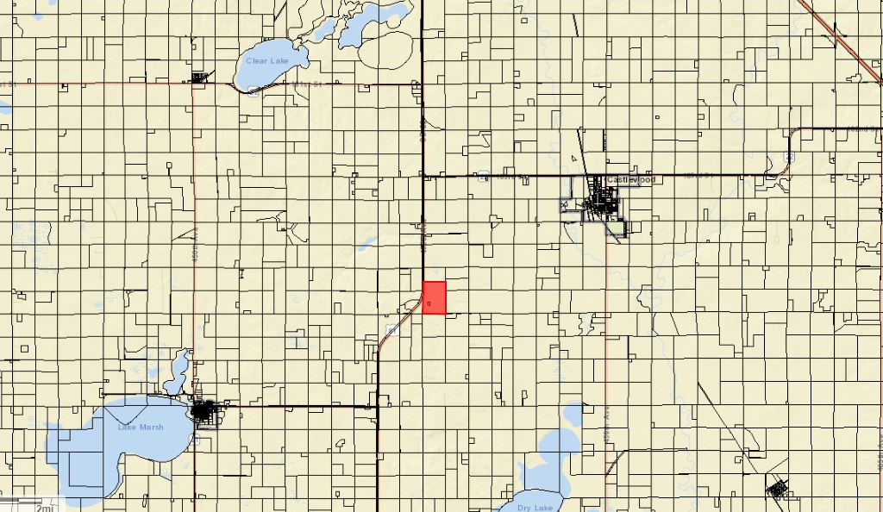

Slide 5
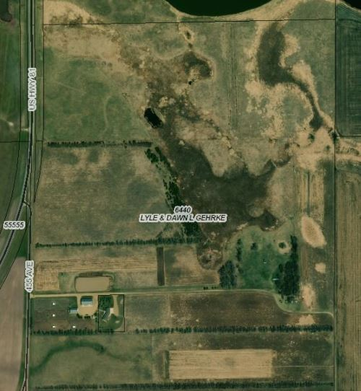

Slide 6
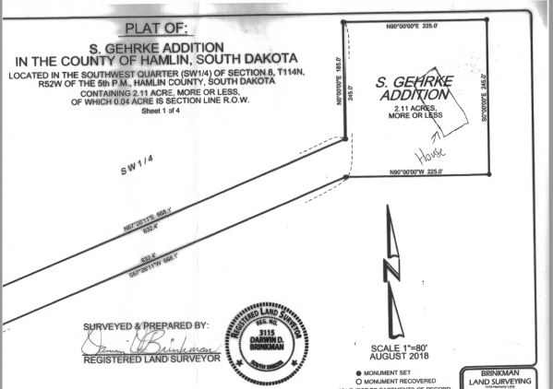

Slide 7
Plat: Block 1 Wellhouse Addition
Property Description: Block 1 Wellhouse Addition in the S ½ and the NW ¼ of Section 26, Township 115N, Range 51W of the 5th P.M., Hamlin County, South Dakota. (Hamlin Township).

Slide 8
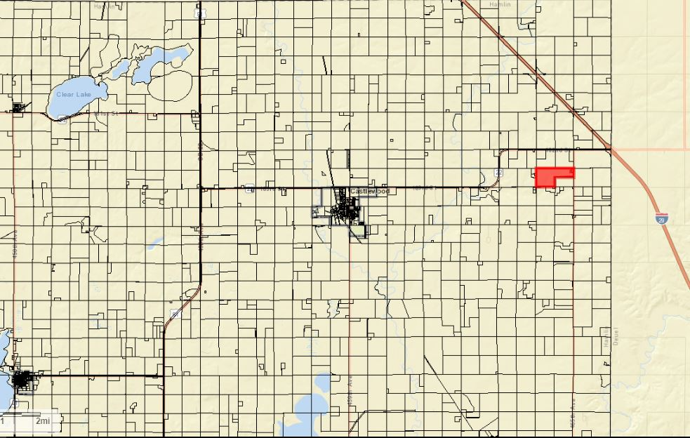

Slide 9
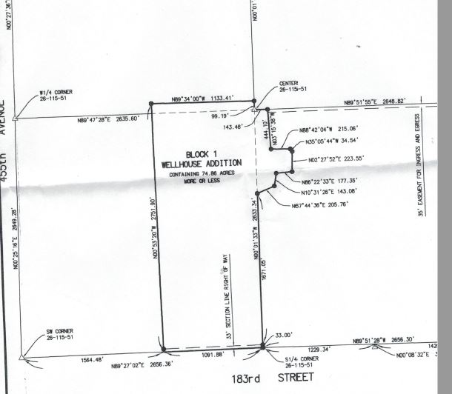

Slide 10
Kangas Variance
Property Description: E 573’ of N 551’ of NW ¼ of Section 20, Township 113N, Range 53W of the 5th P.M., Hamlin County, South Dakota. (Norden Township)
Variance: Intensity of Use in the Agricultural District (3.04.06.2)

Slide 11
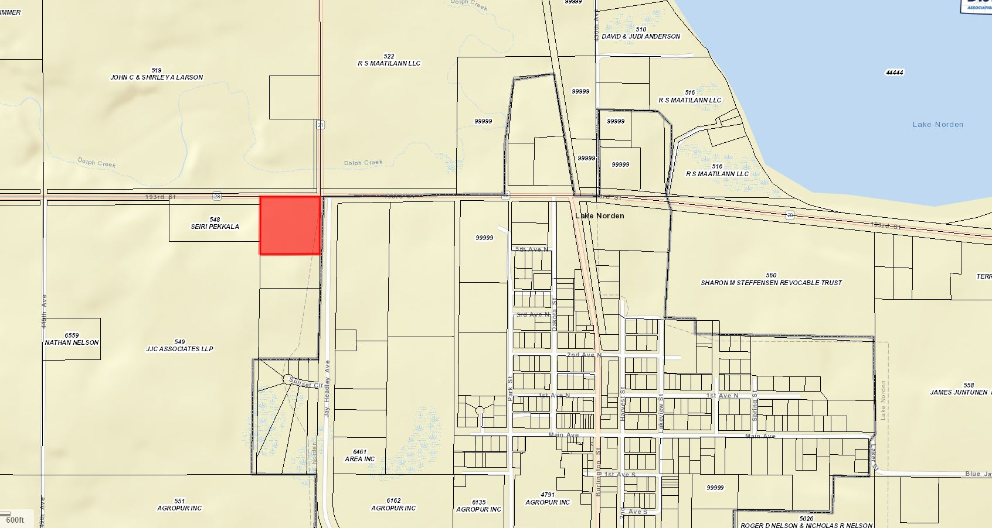

Slide 12
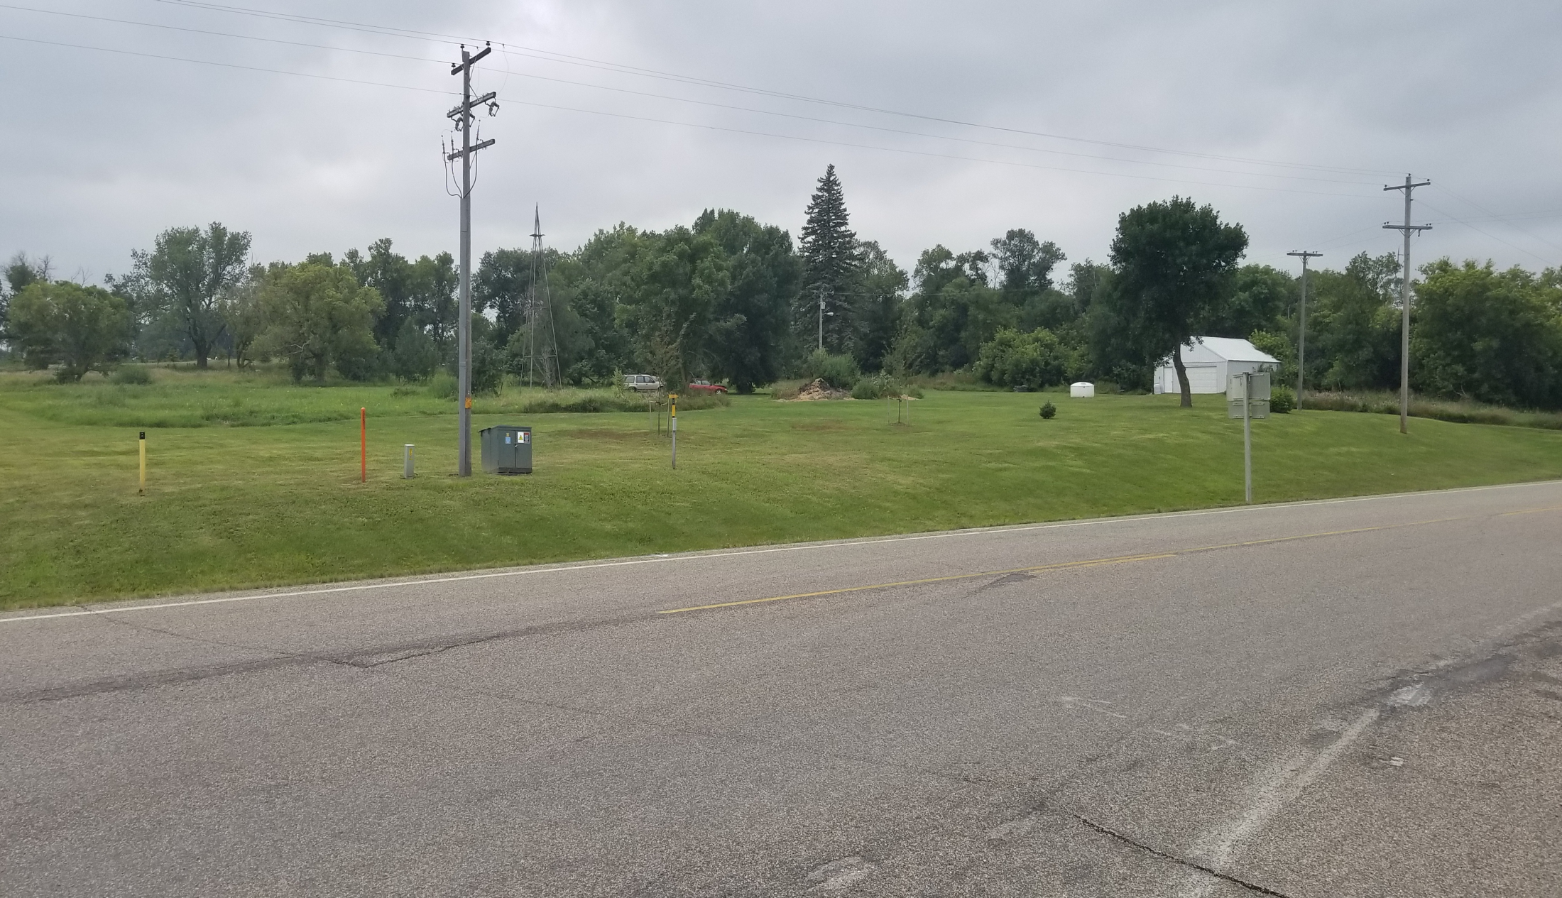
Intersection of Highways 21 & 28

Slide 13
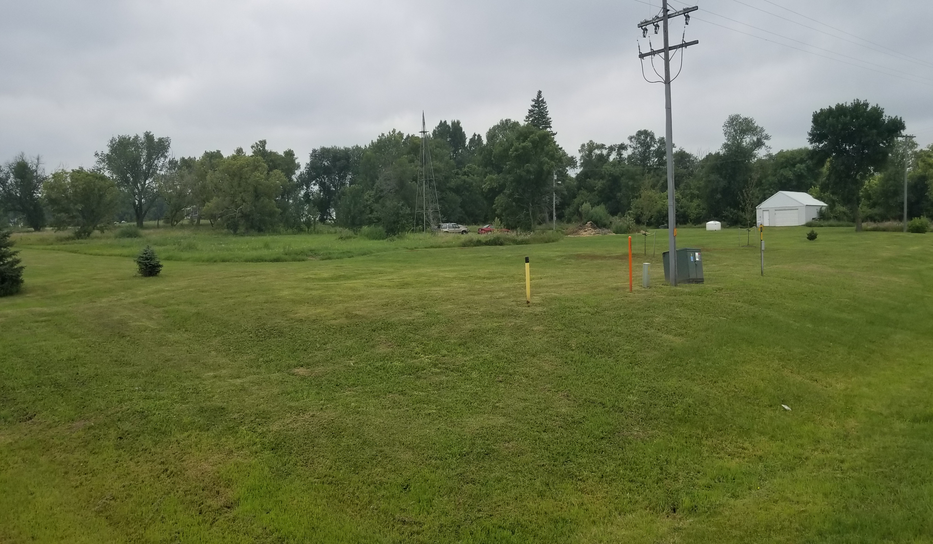

Slide 14
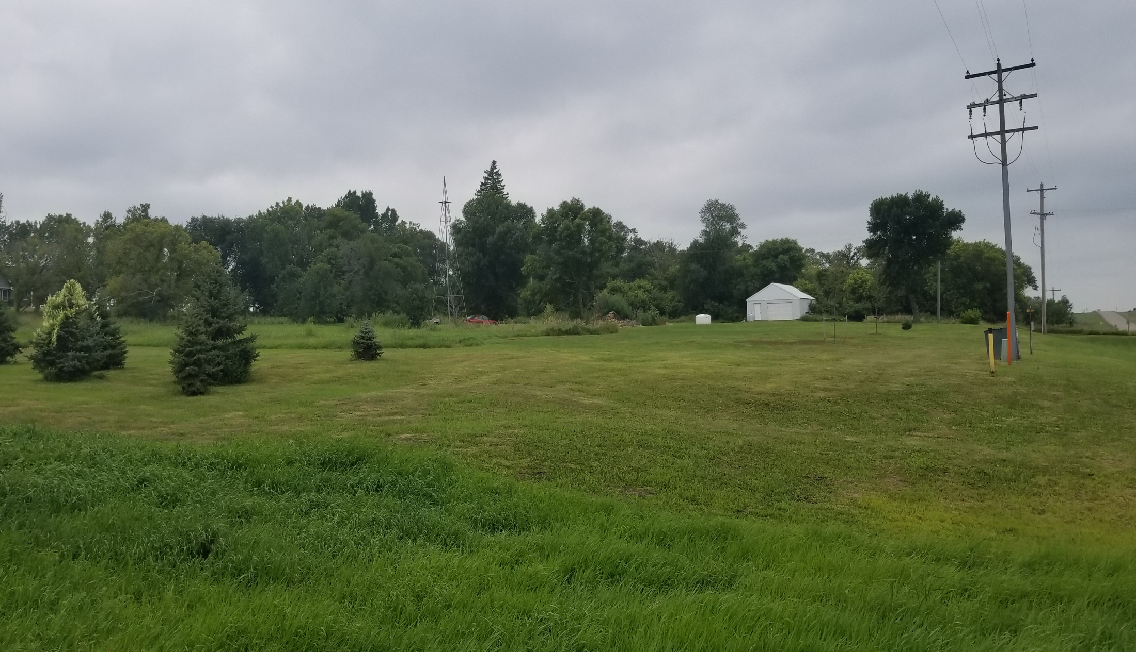
Jay Headley Road looking West

Slide 15
Drumgoon Conditional Use
Property Description: NW1/4, Section 6-T113N-R52W, Hamlin County, South Dakota.
Conditional Use: Accessory Agricultural Housing (

Slide 16
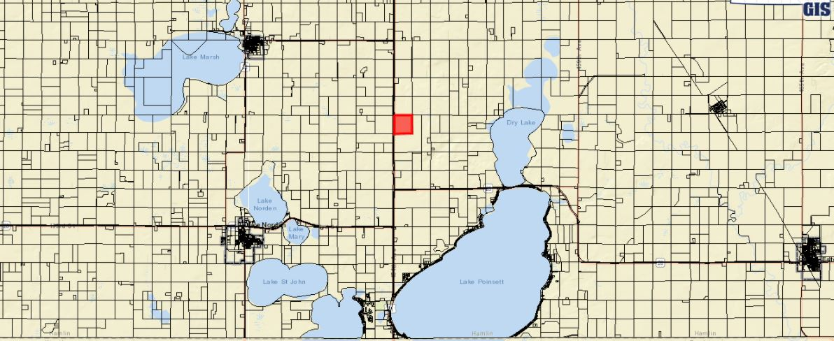

Slide 17
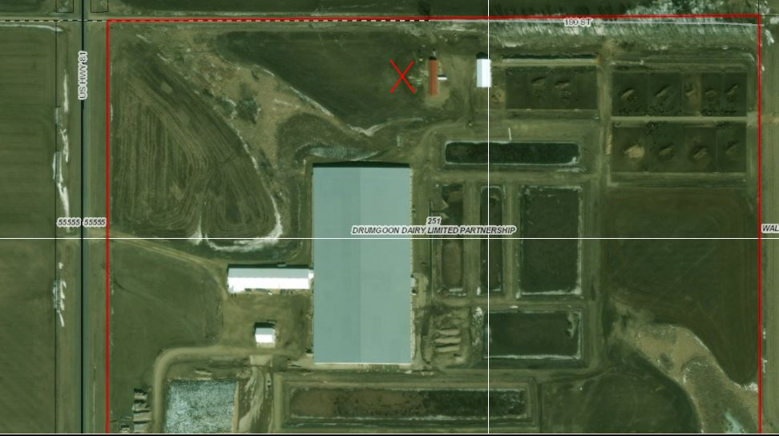

Slide 18
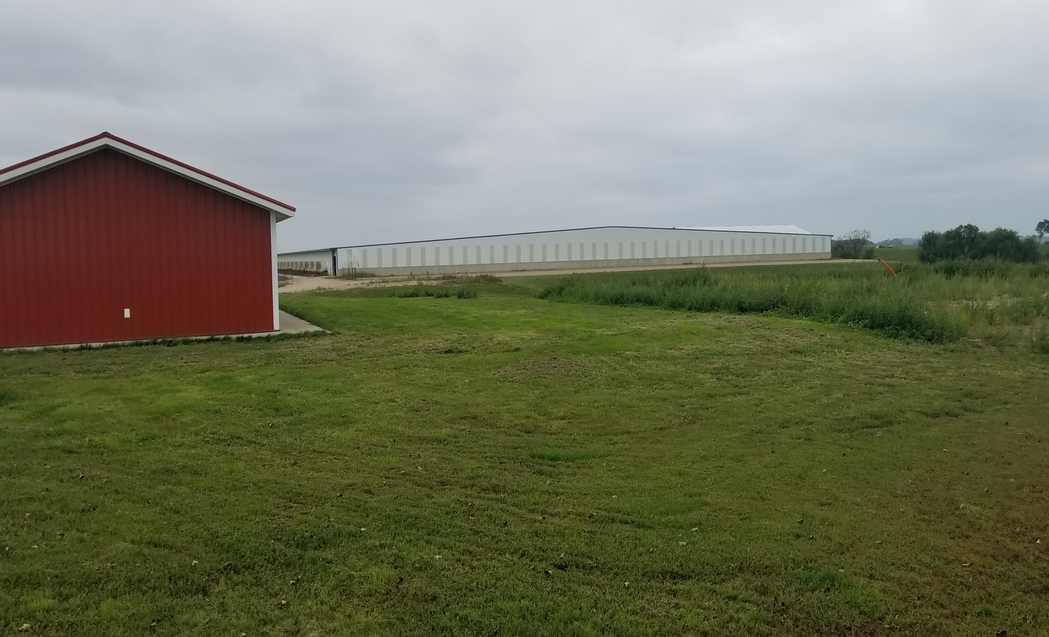

Slide 19
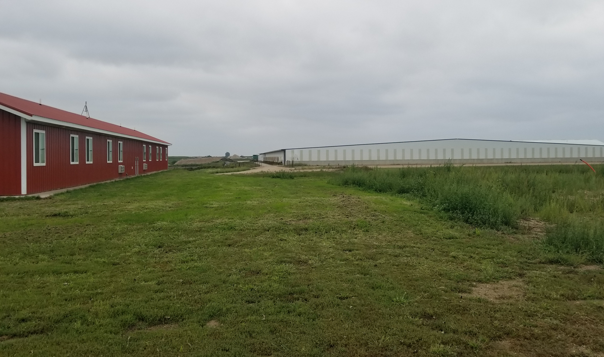

Slide 20
Poinsett Colony Conditional Use
Property Description: SE ¼ of Section 27, Township 114N, Range 51W of the 5th P.M., Hamlin County, South Dakota. (Dempster Township).
Conditional Use: Class C CAFO (3.04.04.9)

Slide 21
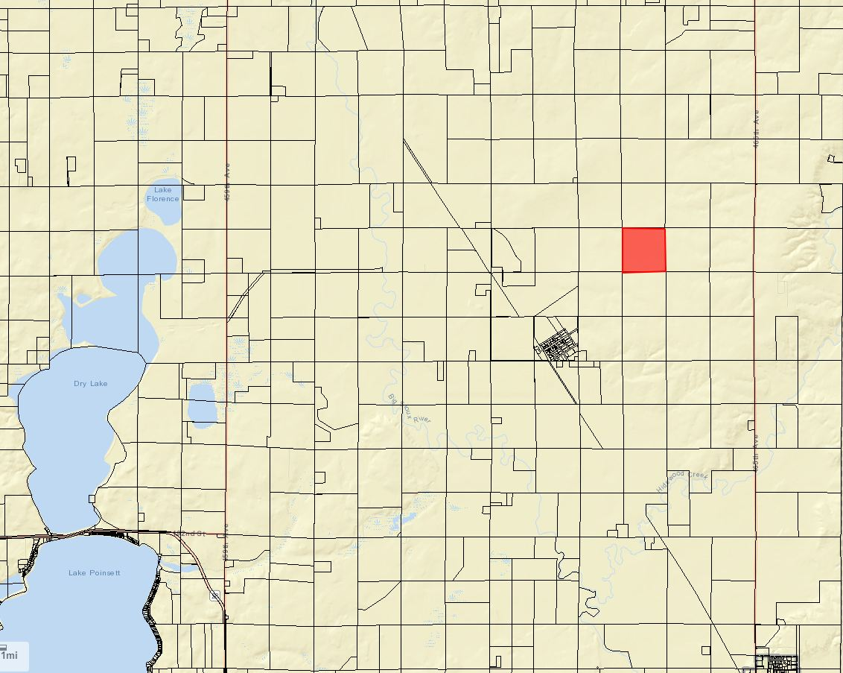

Slide 22
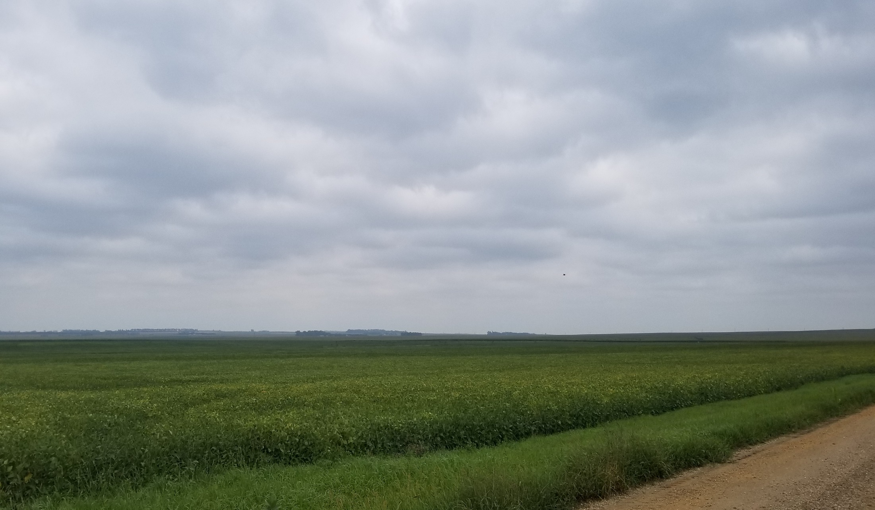
Looking North on 189th Street

Slide 23
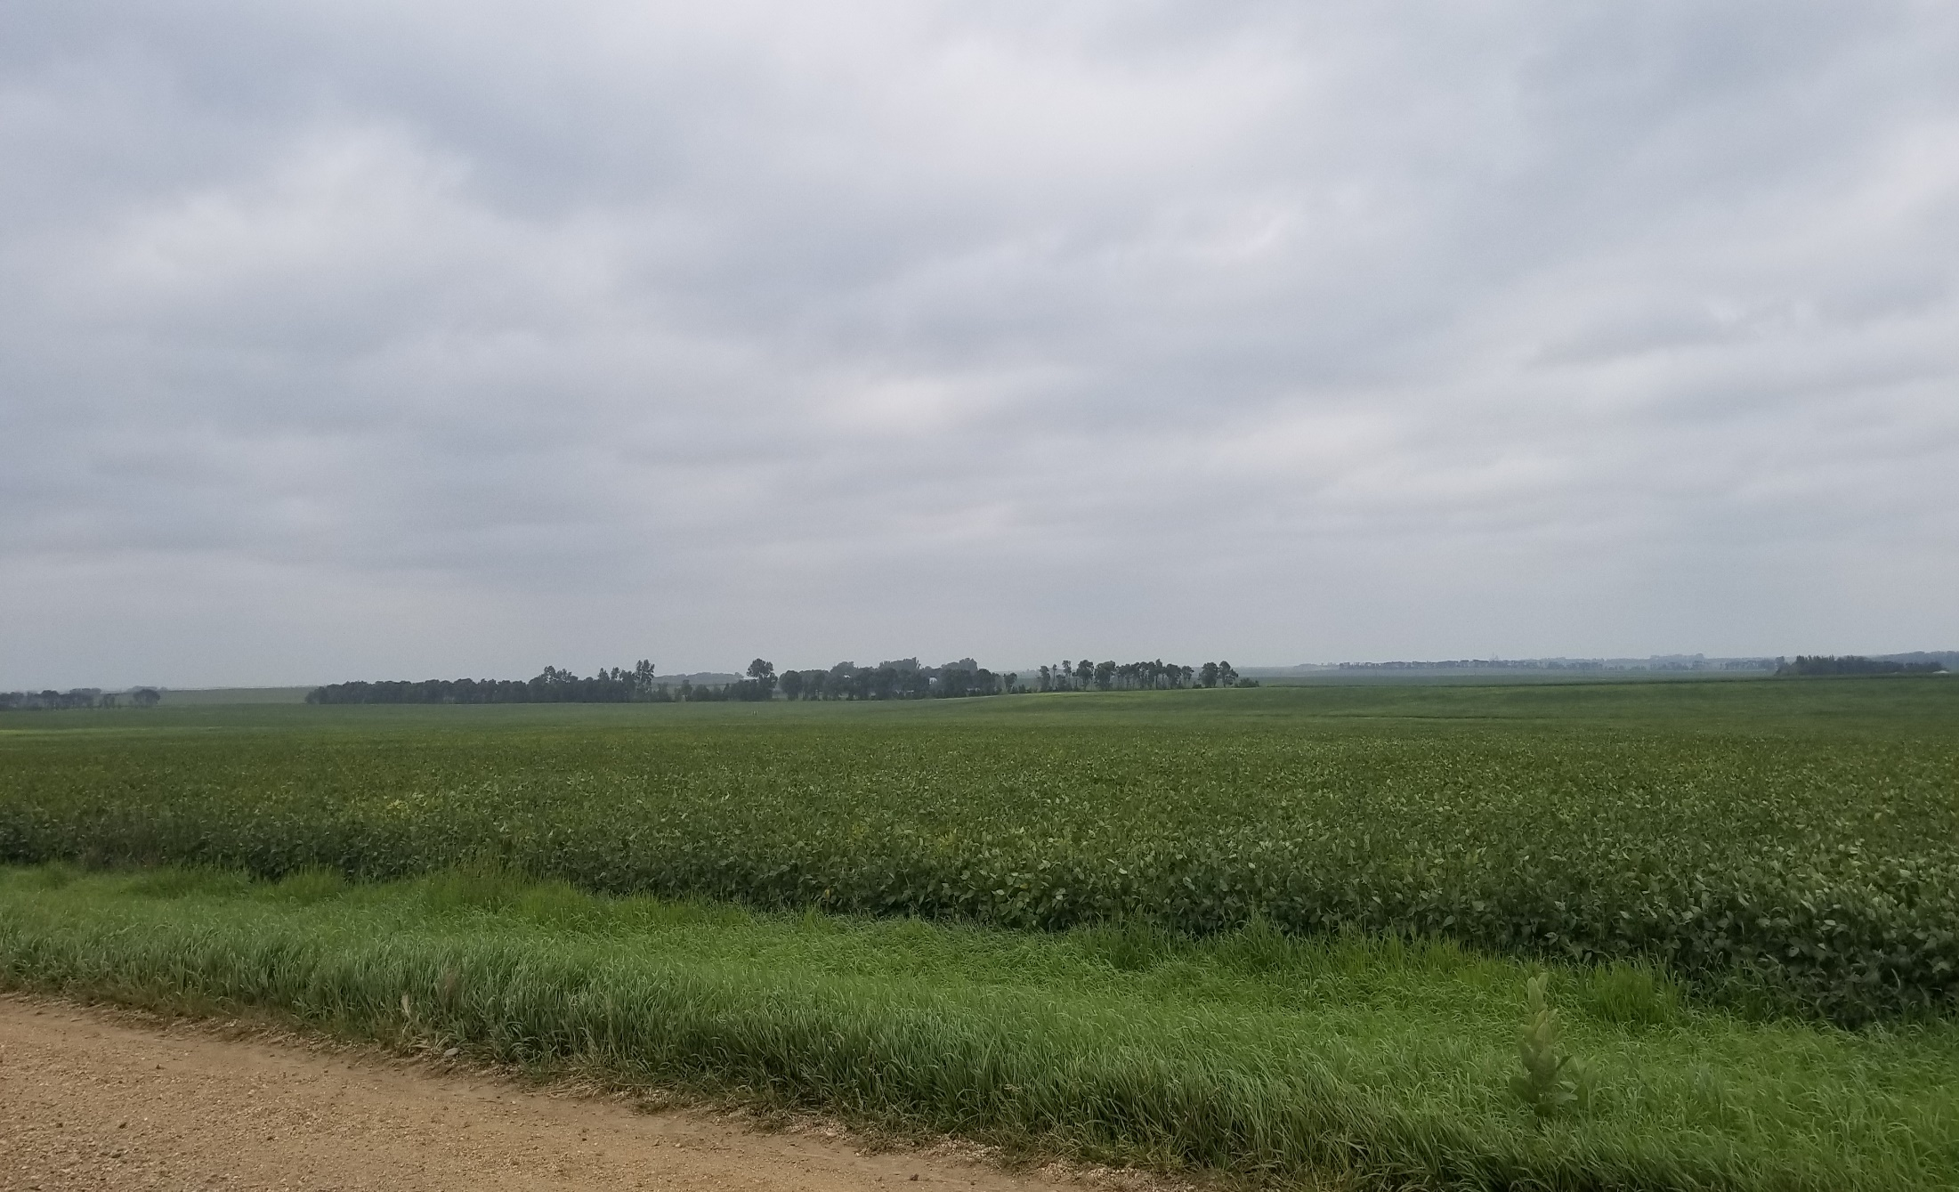

Slide 24
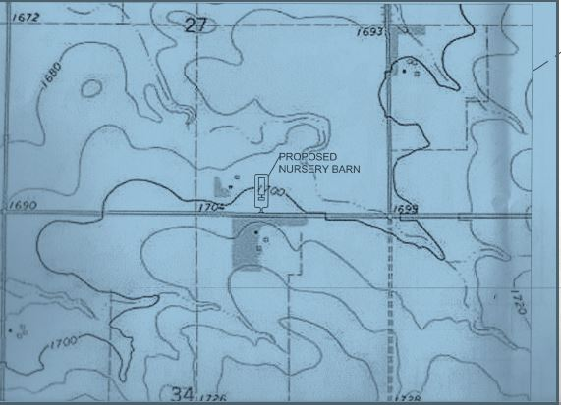

Slide 25
