Slide 1
Hamlin County Planning Commission/Board of Adjustment
April 23th, 2018 –7:00 P.M.
We ask that you silence your cell phones and if you need to have any conversations with anyone in the audience we ask that you step outside so everyone can hear the Board and other testimony.
If you wish to testify on an issue, you are required to sign in.
Anyone responsible for disruptive behavior or noise may be asked to leave the meeting.
Prior to any testimony a motion will be made in the affirmative based upon staff recommendation as read.
Staff will provide report and recommendation/ Public Hearing is opened.
The applicant may address the Board (from table up front)
Proponents will be called to testify –you may address the Board (from table up front)
Opponents will be called to testify –you may address the Board(from the table up front)
Please provide your name and address before providing comment
All comments and questions are to be directed to the Board
The public hearing will be closed.
The Board will discuss the item and ask questions of the applicant or audience members.
The Board will amend any conditions or findings it deems necessary.
A roll call vote will be held –An affirmative vote of 5 members is required to rule in favor of an applicant/applicants.

Slide 2
Planning Commission Agenda
Call to Order (at the conclusion of the Board of Adjustment)
Items to be added to the Agenda by the Commission members or staff
Invitation for citizens to schedule time on the Planning Commission agenda for an item not listed. 5-minute maximum time allotted.
Approval of Agenda
Approve April 23th, 2018 Meeting Minutes
Ordinance Amendment # 02-18: Essential Public Services in Town District
Board Discussion: Accessory Agricultural Housing
Adjournment
Board of Adjustment Agenda
Call to Order
Items to be added to the agenda by the Board members or staff
Invitation for citizens to schedule time on the Board of Adjustment agenda for an item not listed. 5-minute maximum time allotted.
Approval of Agenda
Approve April 23, 2018 Meeting Minutes
New Business
Conditional Use – Private Park & Campground (3.07.05.2) – Applicant/Owner: John Hurley – Property Description: Lot 1 of Block 1 & Block 2 of Lake Poinsett Estates Addition in Section 36-113N-53W (Norden Township).
Staff Report
8. Open
9. Executive Session
10. Adjourn

Slide 3
Ordinance Amendment #02-18
Essential Public Services in the Town District

Slide 4
Board Discussion: Accessory Agricultural Housing

Slide 5
Hurley Conditional Use
Property Description: Lot 1 of Block 1 & Block 2 of Lake Poinsett Estates Addition in Section 36-113N-53W (Norden Township).
Conditional Use: Private Park & Campground (3.07.05.2)

Slide 6
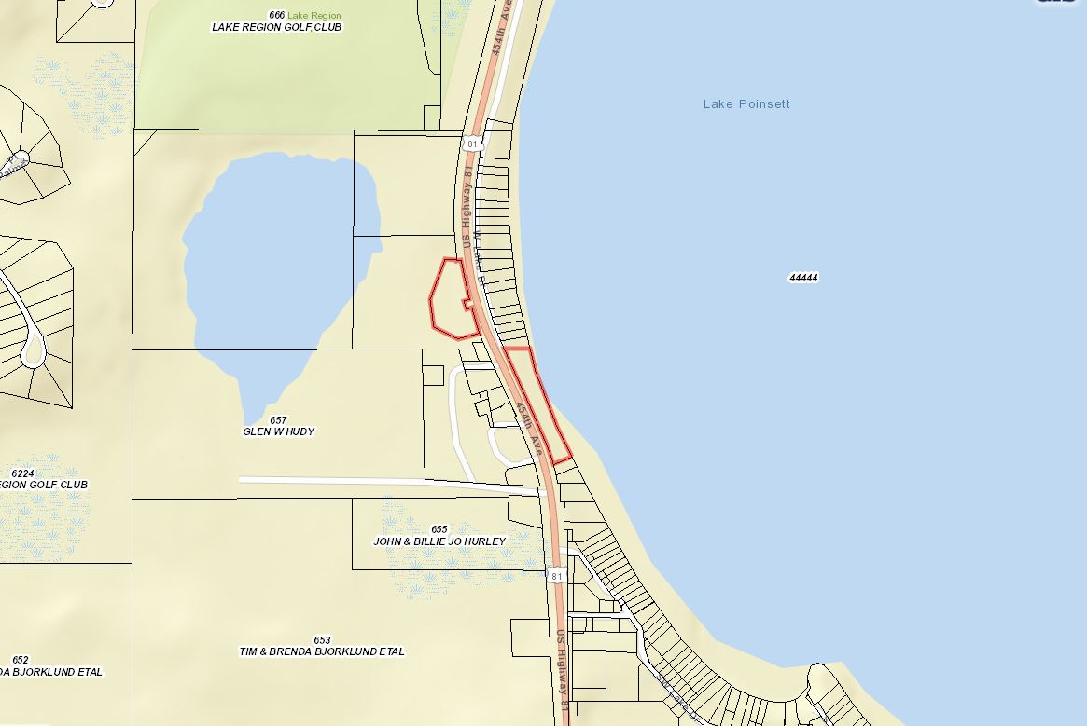

Slide 7
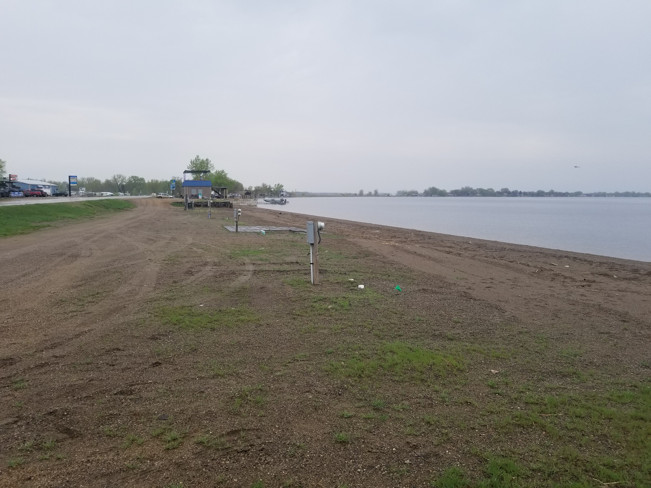

Slide 8
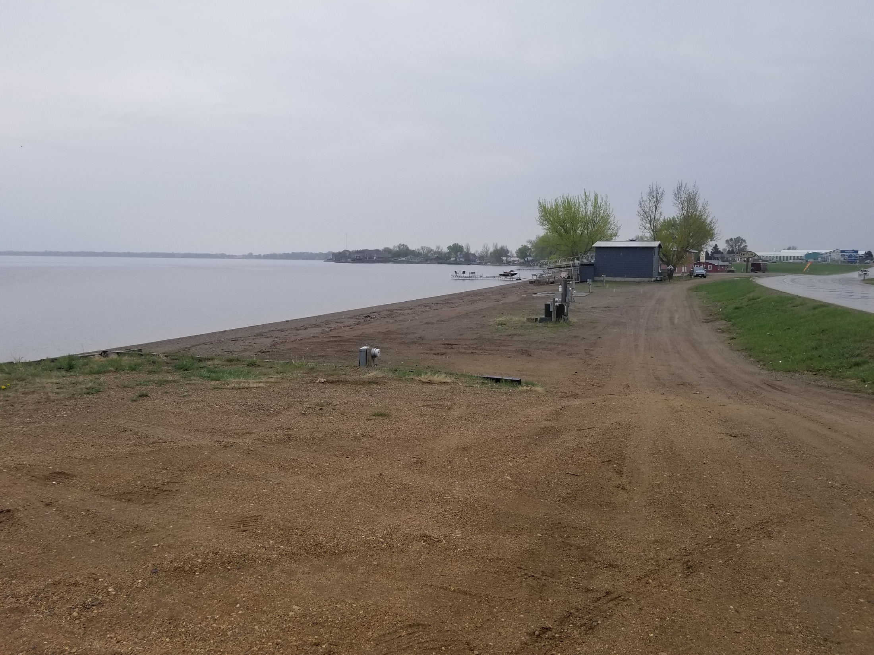

Slide 9
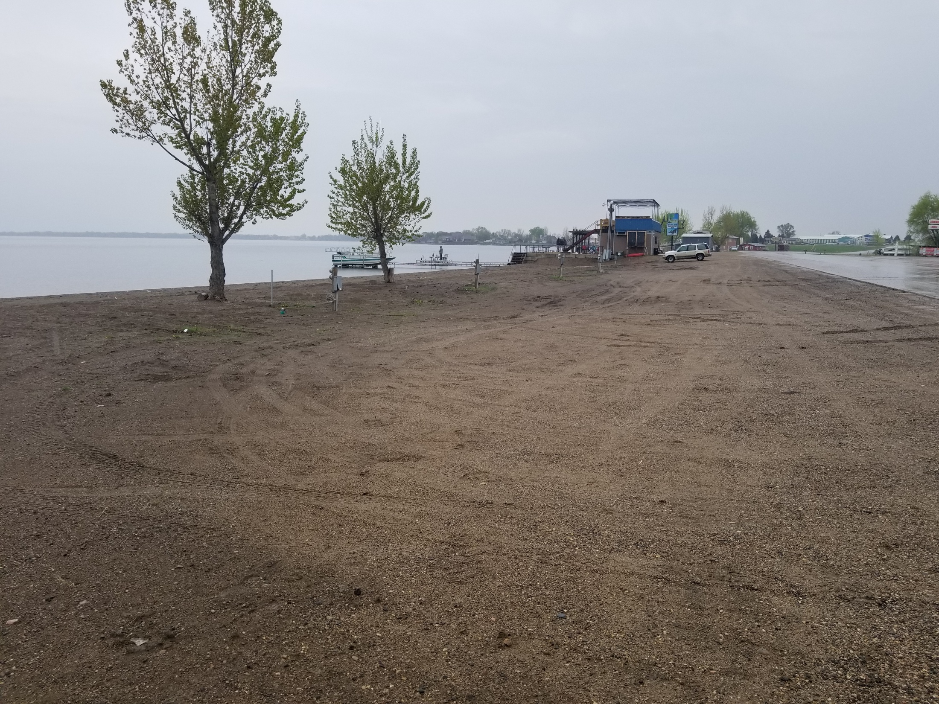

Slide 10
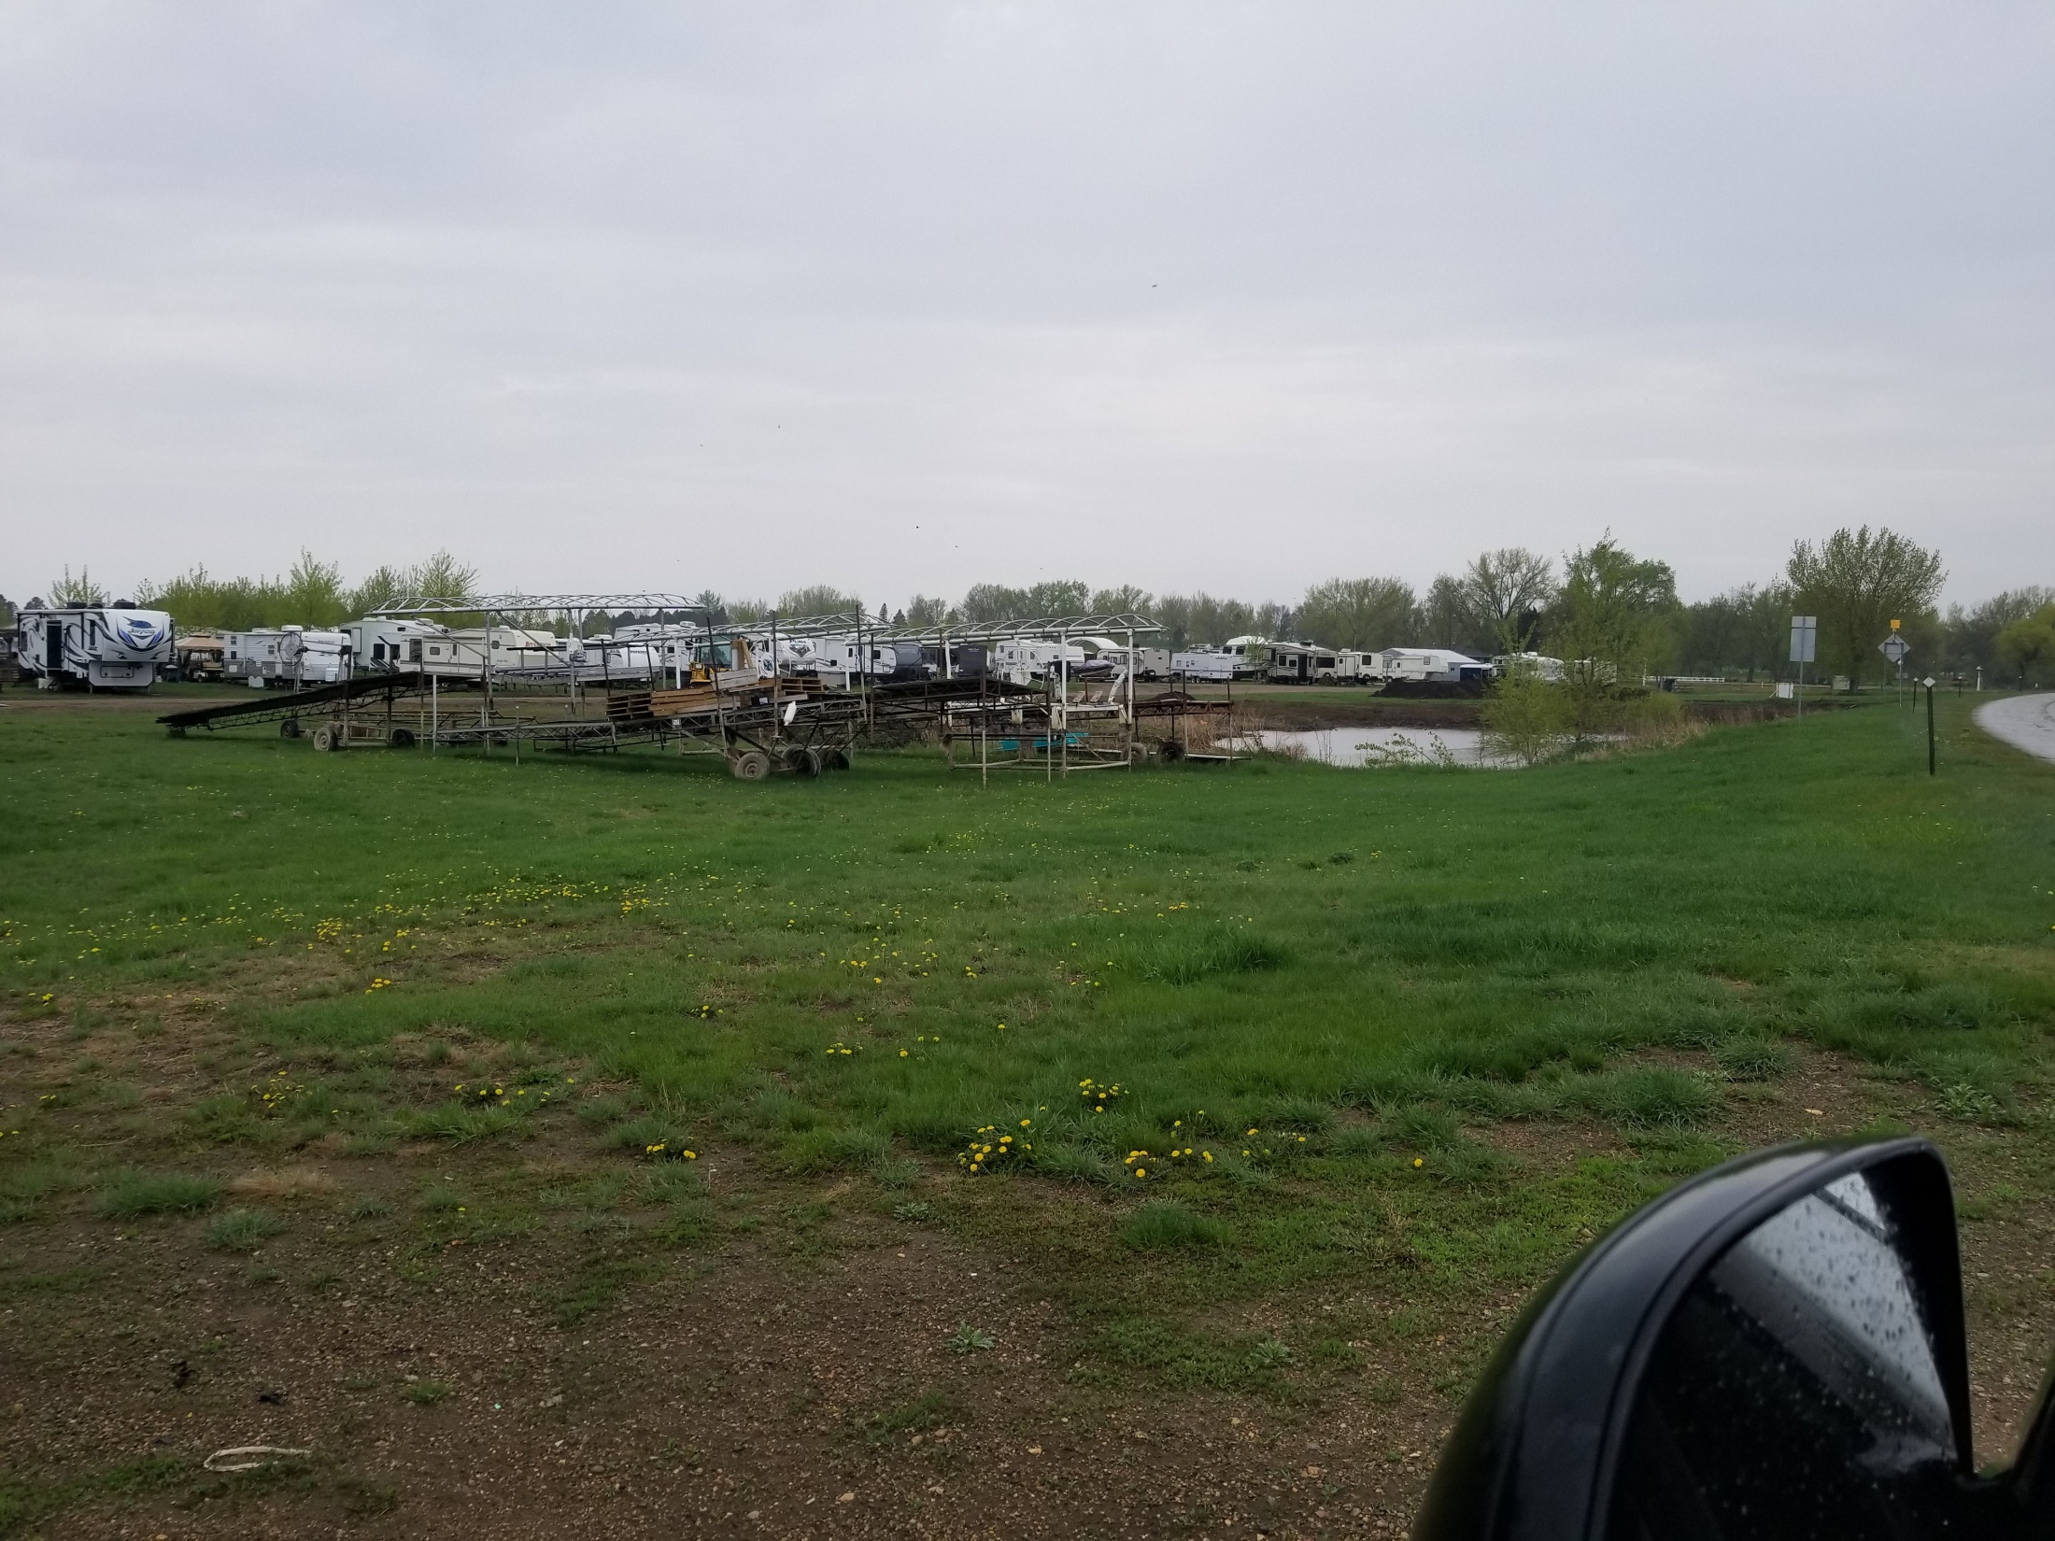
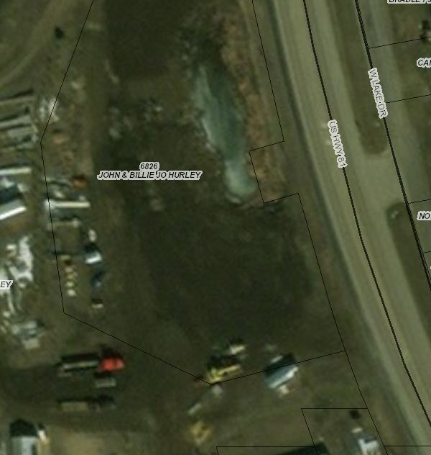

Slide 11
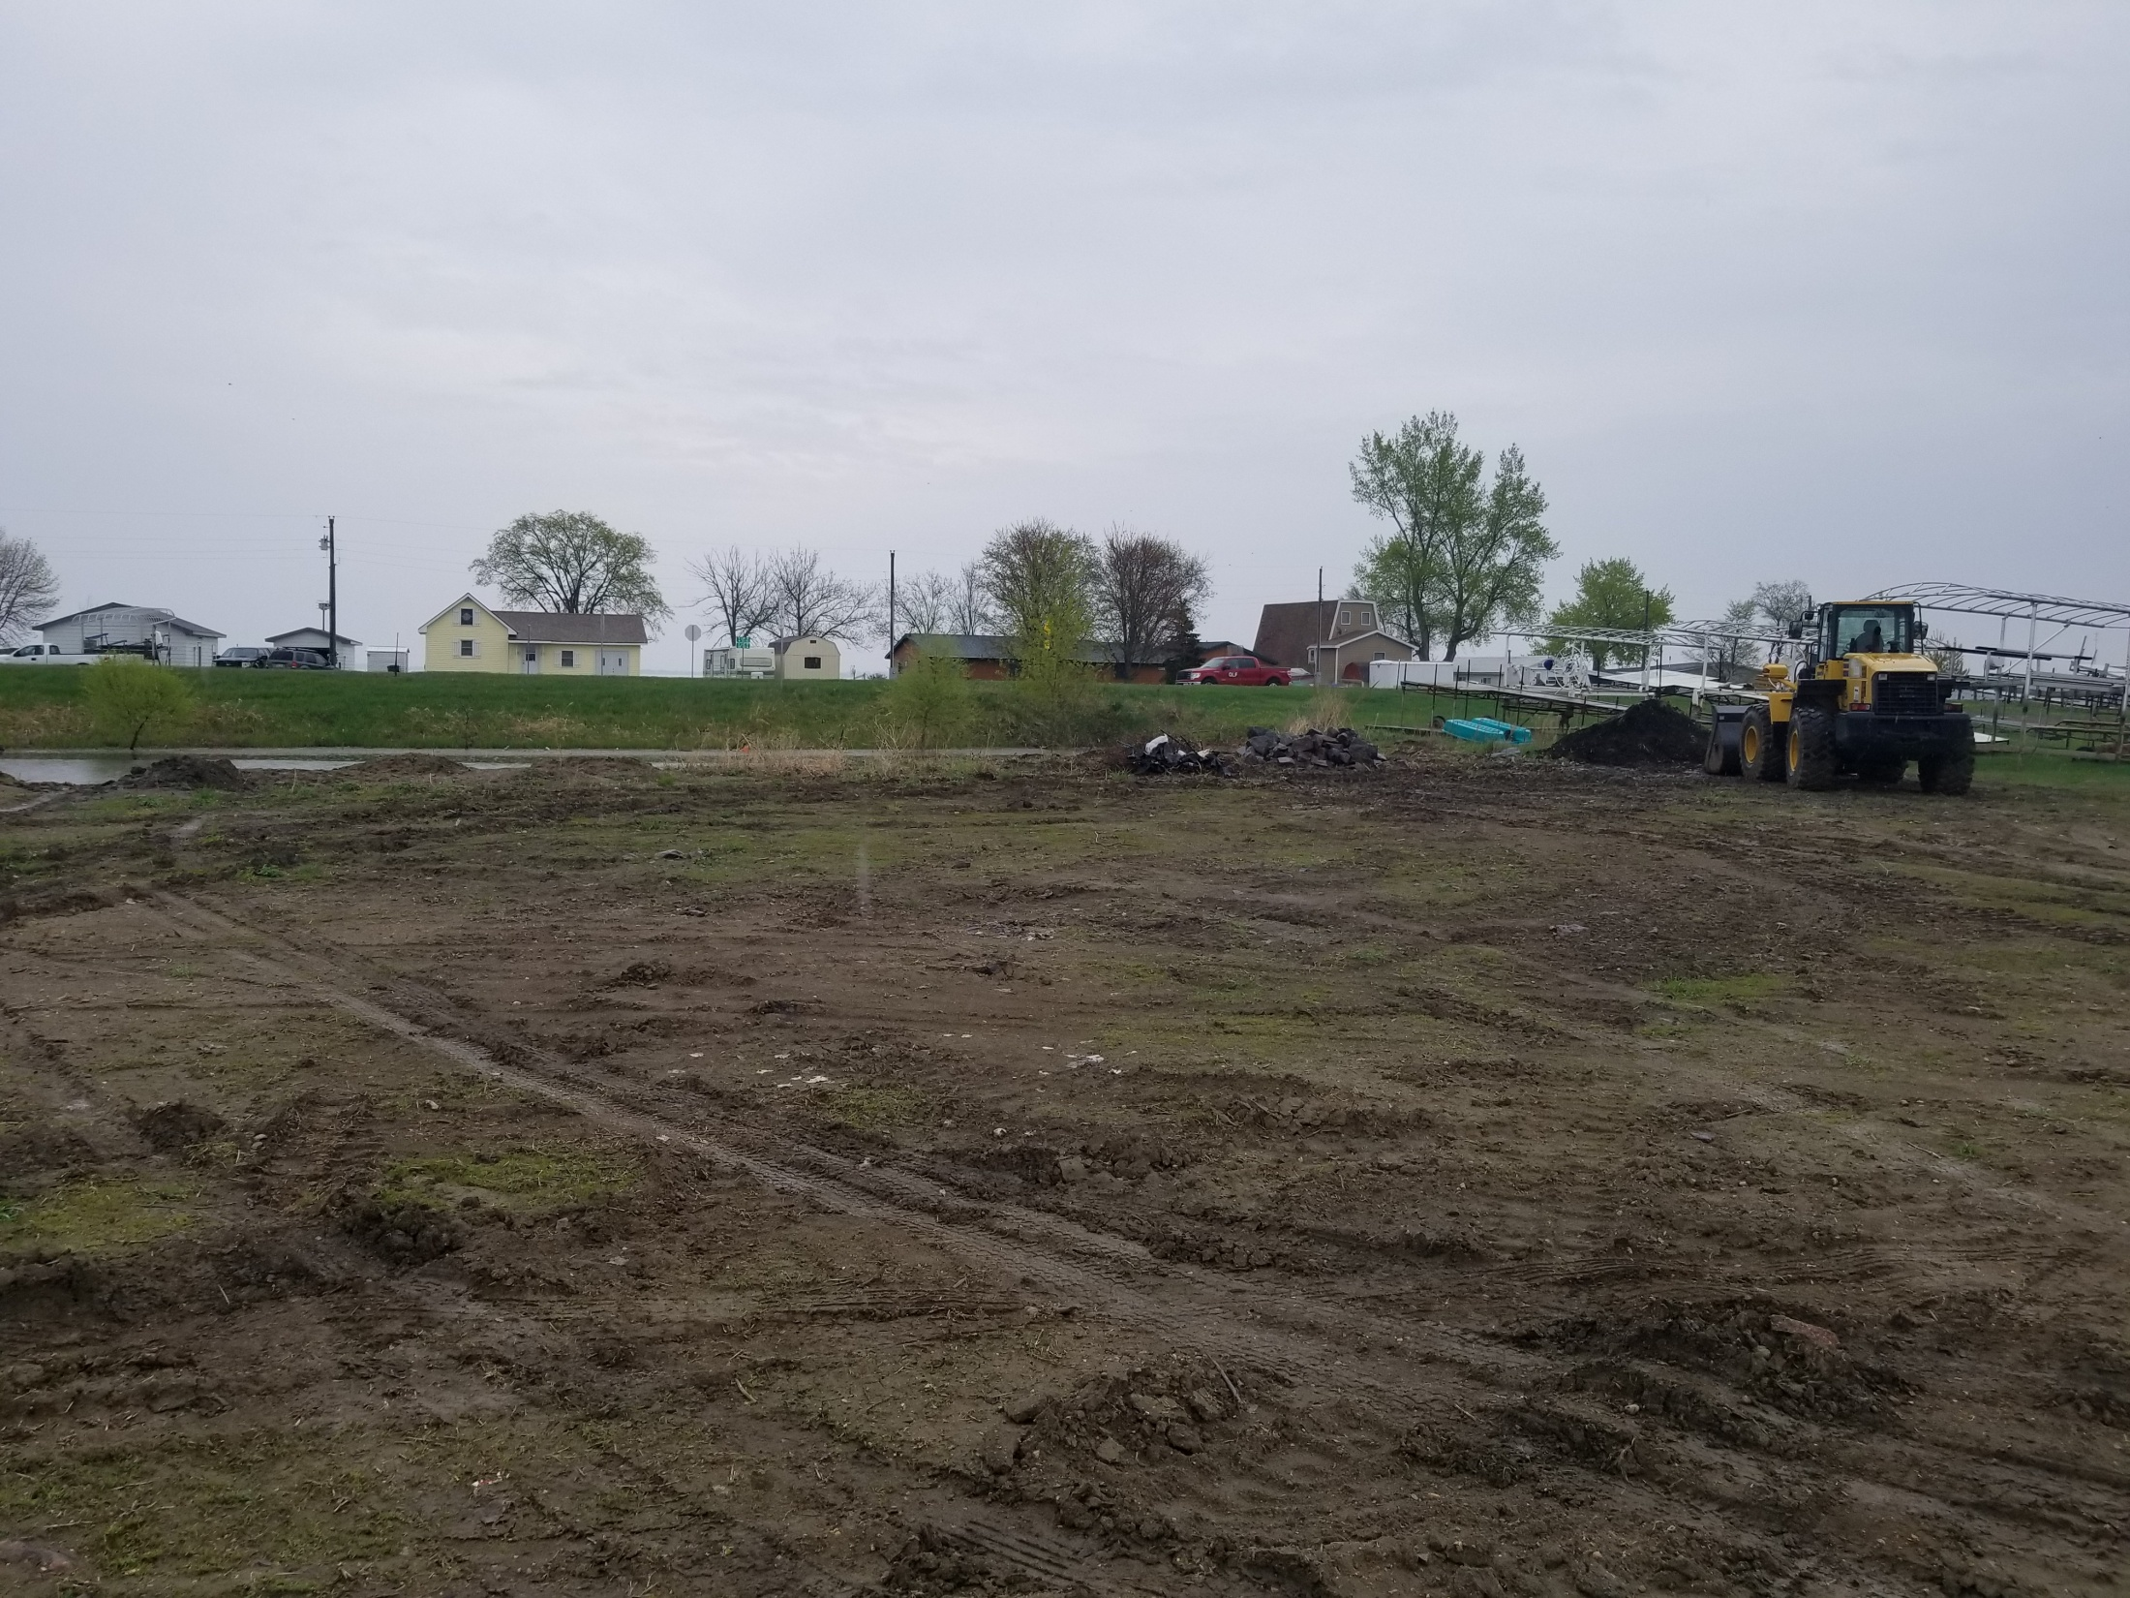

Slide 12
