Slide 1
Hamlin County Planning Commission/Board of Adjustment
April 23th, 2018 –7:00 P.M.
We ask that you silence your cell phones and if you need to have any conversations with anyone in the audience we ask that you step outside so everyone can hear the Board and other testimony.
If you wish to testify on an issue, you are required to sign in.
Anyone responsible for disruptive behavior or noise may be asked to leave the meeting.
Prior to any testimony a motion will be made in the affirmative based upon staff recommendation as read.
Staff will provide report and recommendation/ Public Hearing is opened.
The applicant may address the Board (from table up front)
Proponents will be called to testify –you may address the Board (from table up front)
Opponents will be called to testify –you may address the Board(from the table up front)
Please provide your name and address before providing comment
All comments and questions are to be directed to the Board
The public hearing will be closed.
The Board will discuss the item and ask questions of the applicant or audience members.
The Board will amend any conditions or findings it deems necessary.
A roll call vote will be held –An affirmative vote of 5 members is required to rule in favor of an applicant/applicants.

Slide 2
Board of Adjustment Agenda
Call to Order
Items to be added to the agenda by the Board members or staff
Invitation for citizens to schedule time on the Board of Adjustment agenda for an item not listed. 5-minute maximum time allotted.
Approval of Agenda
Approve March 26, 2018 Meeting Minutes
New Business
Variance Request – Shelterbelt Setback Requirements (5.18) – Applicant/Owner: Page Koistinen, Richard and Harold Koistinen–
Property Description: W ½ of the NW ¼ less Block 1 Jensen Addition in Section 24 Township 114N Range 53W (Hayti Township) in Hamlin County, South Dakota.
2. Conditional Use and Variance Request – Class B CAFO (3.02.04.9) & Required Setbacks and Separation Distance for CAFOS (5.25.05.6) –
Owner/Applicant: Roe Farm LLC – Property Description: S 30 Rods of E 50 Rods of NE ¼ & SE ¼ less E 364’ of N 248’ of SE ¼ of Section 27 Township 115N Range 54W (Oxford Township) in Hamlin County, South Dakota.
7. Staff Report
8. Open
9. Executive Session
Adjourn
Planning Commission Agenda
Call to Order (at the conclusion of the Board of Adjustment)
Items to be added to the Agenda by the Commission members or staff
Invitation for citizens to schedule time on the Planning Commission agenda for an item not listed. 5-minute maximum time allotted.
Approval of Agenda
Approve March 26th , 2018 Meeting Minutes
Plat: Ottertail Power Company in Dempster
Plat: Northbay 11th Addition - Bob Winters/Todd Voss
Board Discussion: Accessory Agricultural Housing
Adjournment

Slide 3
Koistinen Variance
Property Description: W ½ NW ¼ less Block 1 Jensen Addition Section 24, Township 114N, Range 53W (Hayti Township)
Variance: Shelterbelt Setback Requirements (5.18)

Slide 4
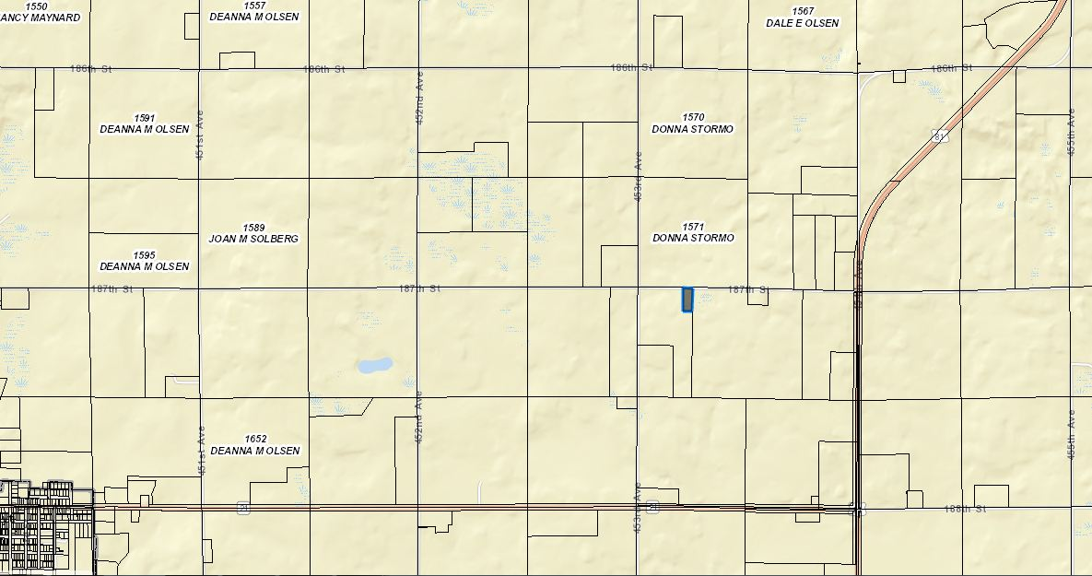

Slide 5
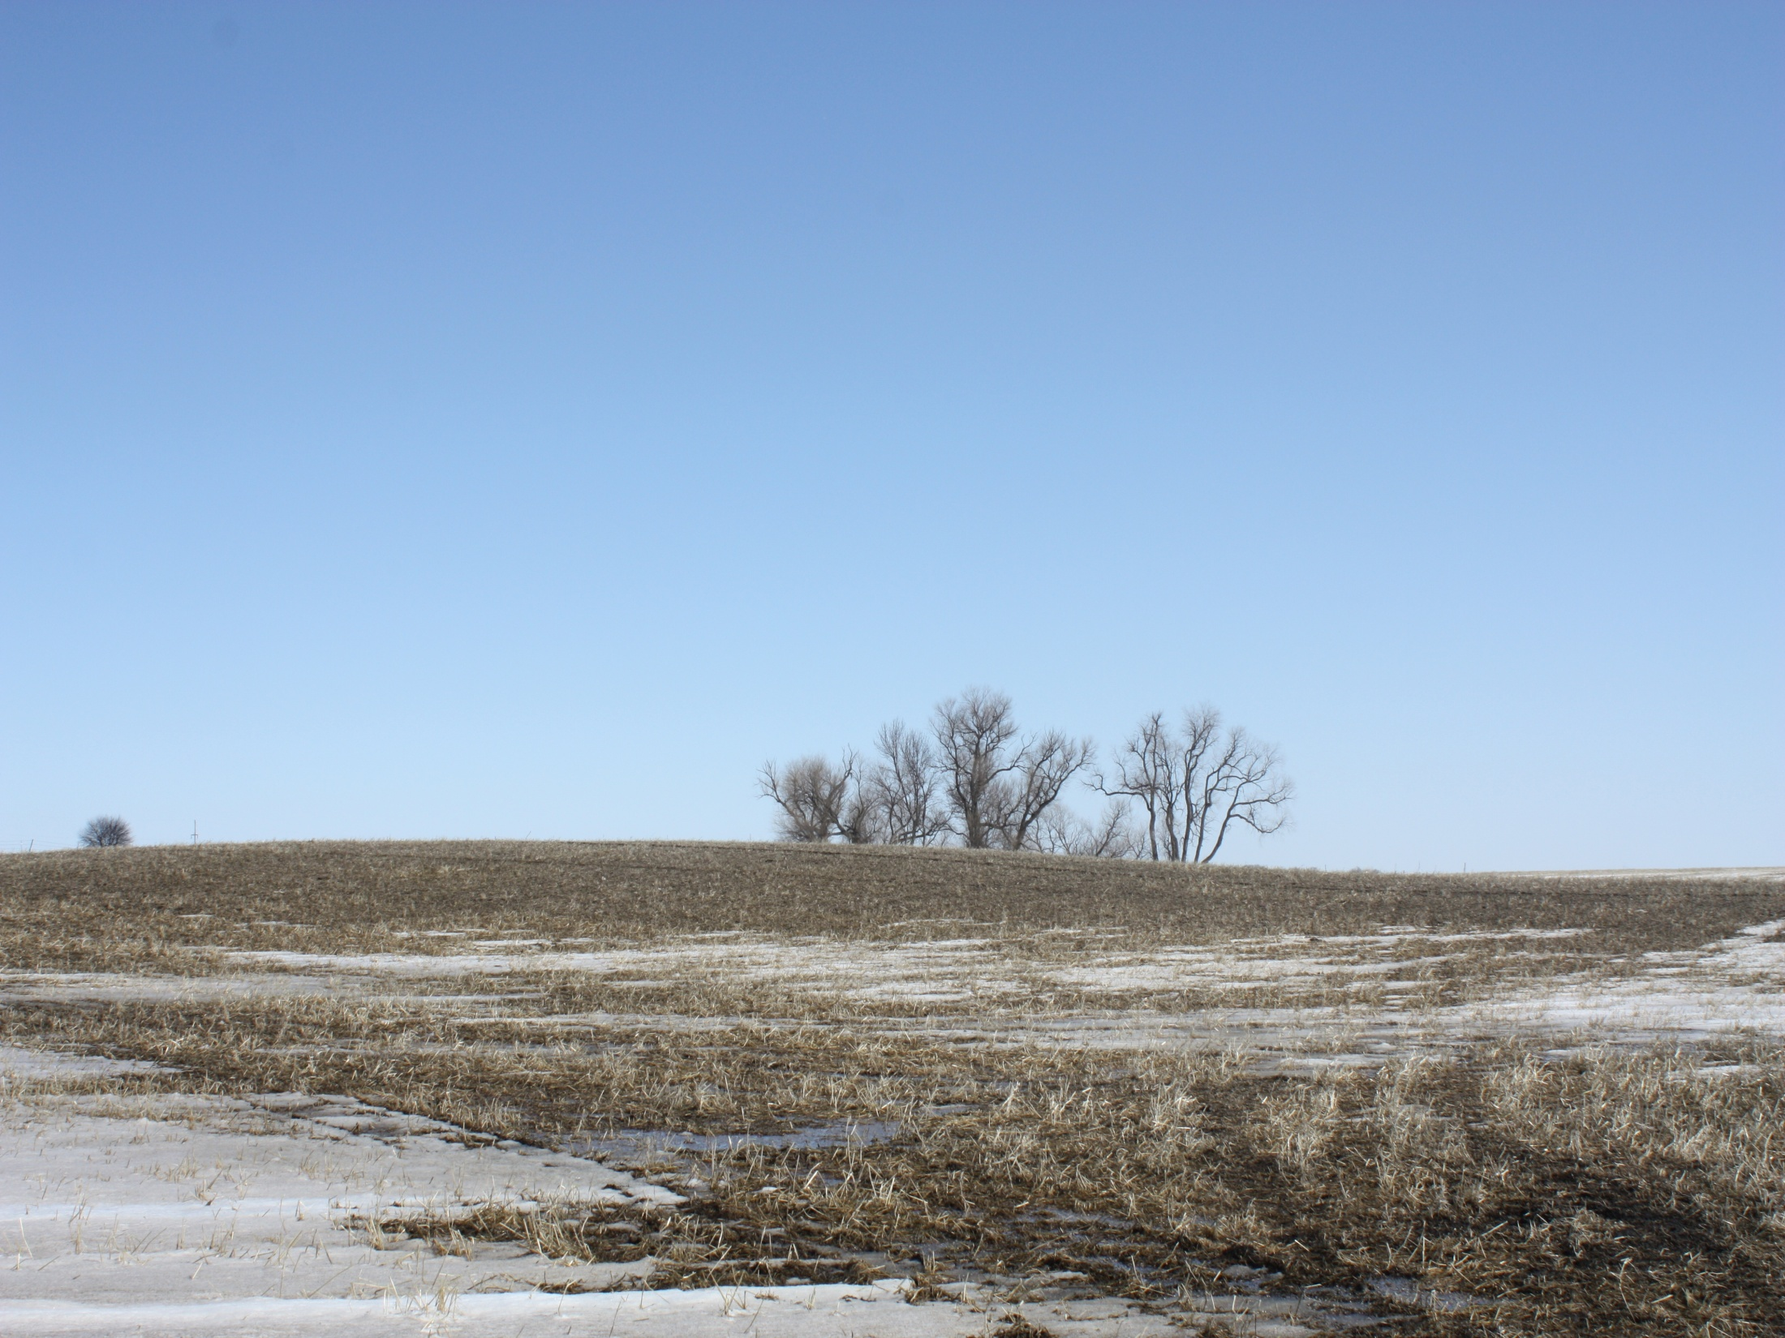
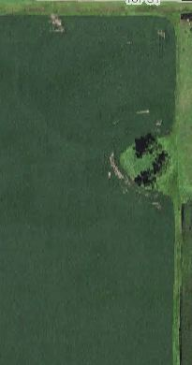

Slide 6
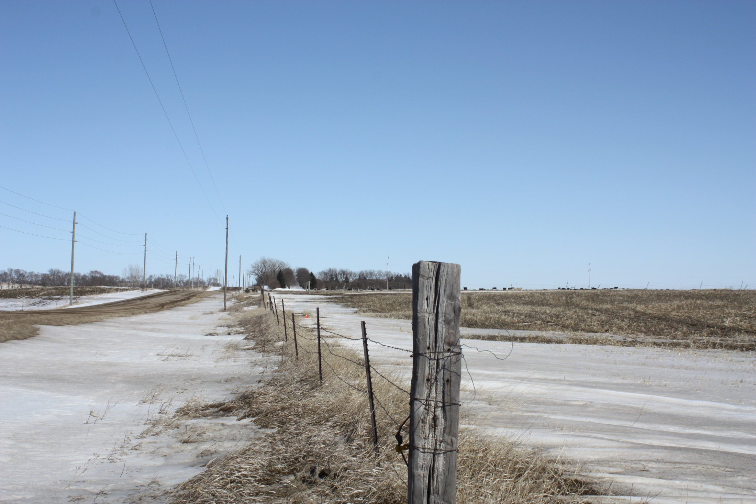

Slide 7
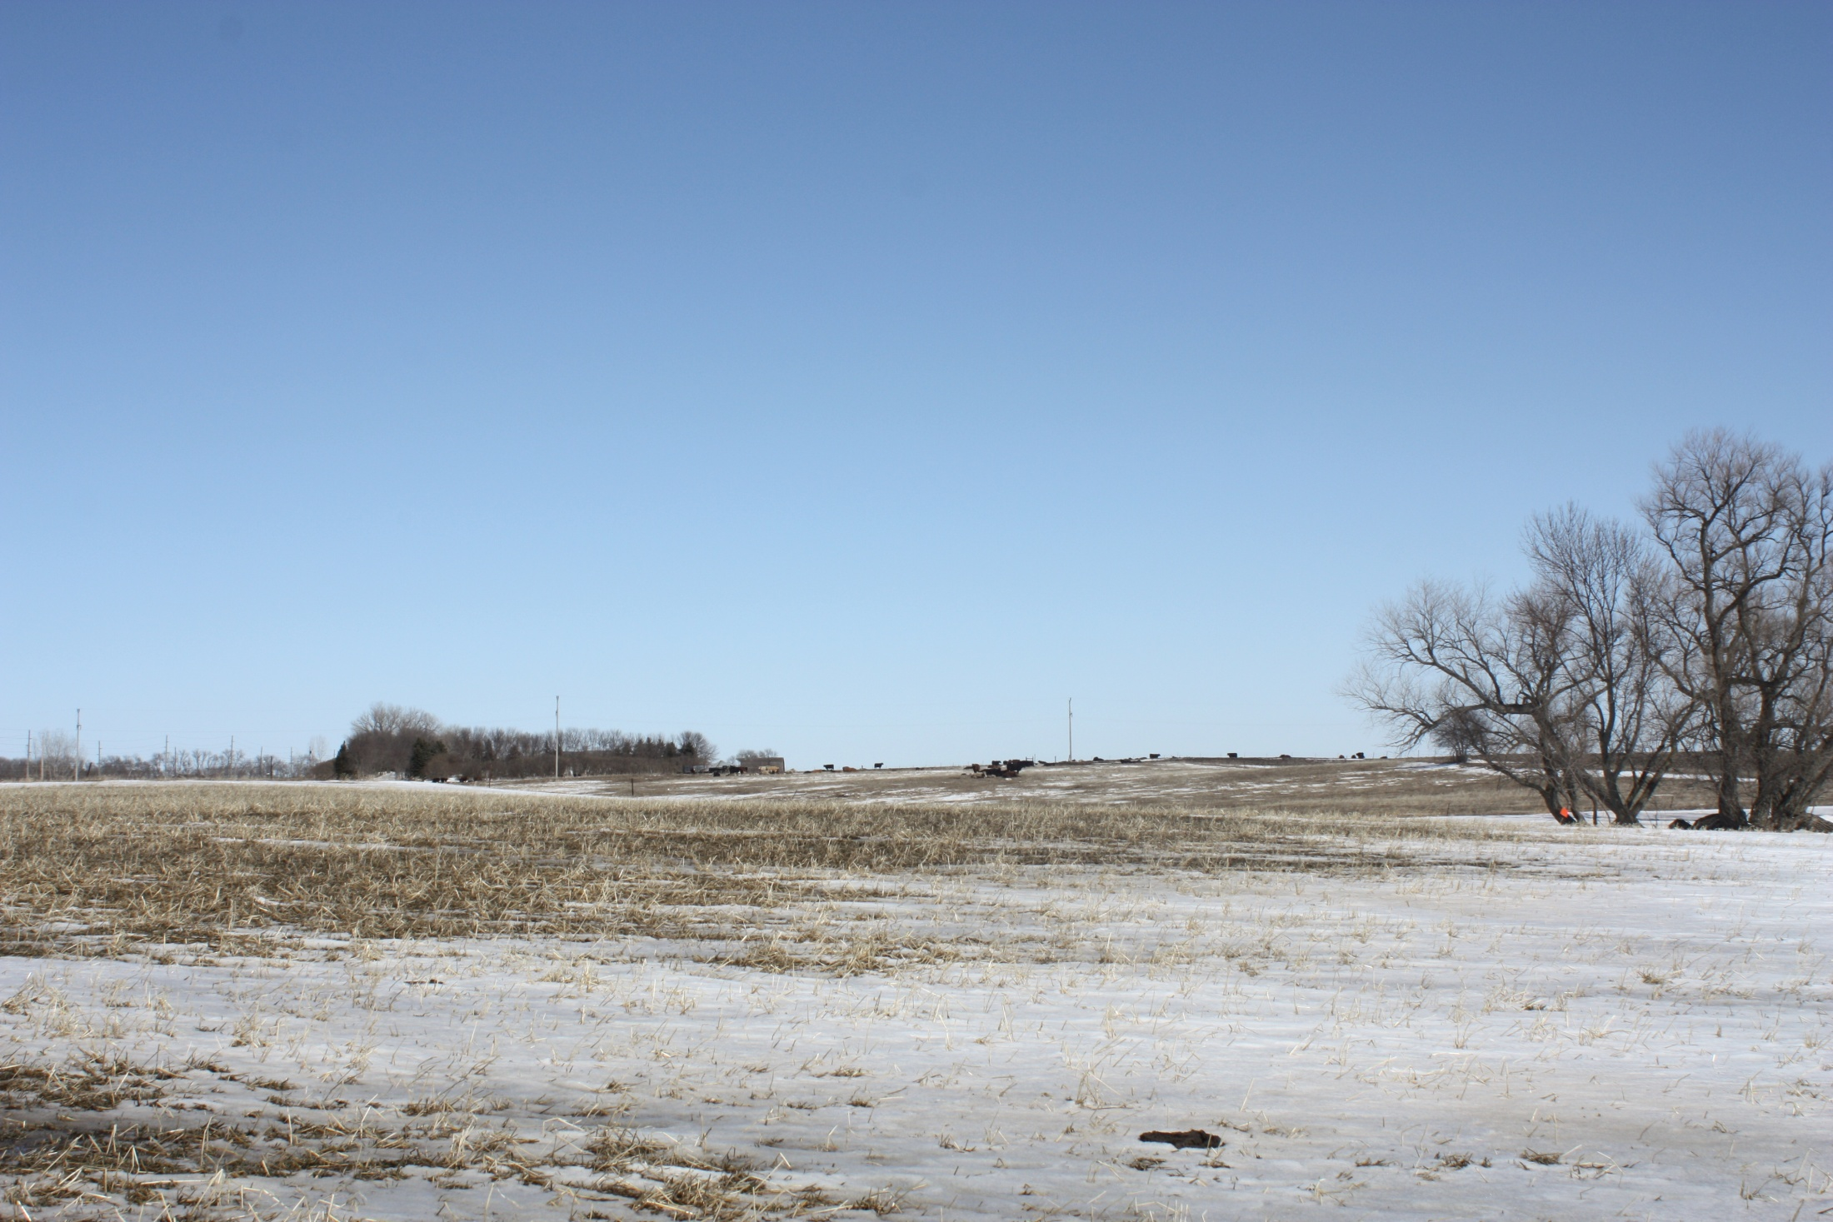

Slide 8
Roe Conditional Use and Variance
Property Description: SE ¼ Section 27-Township 115N-Range 54W (Oxford Township)
Conditional Use: Class B CAFO (3.04.04.9)
Variance: Required Setback and Separation Distances (5.25.05.6)

Slide 9
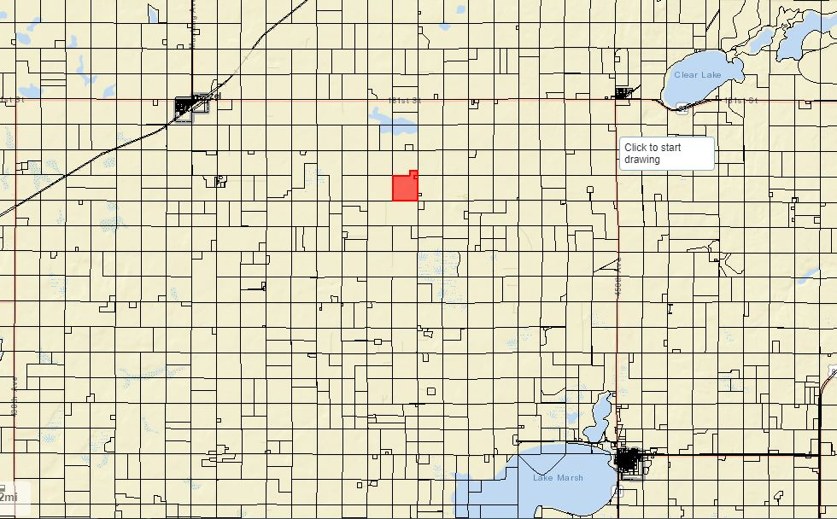

Slide 10
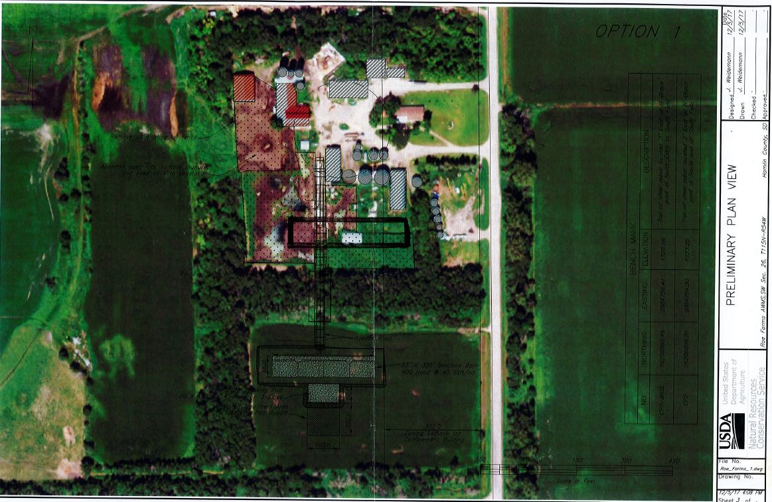

Slide 11
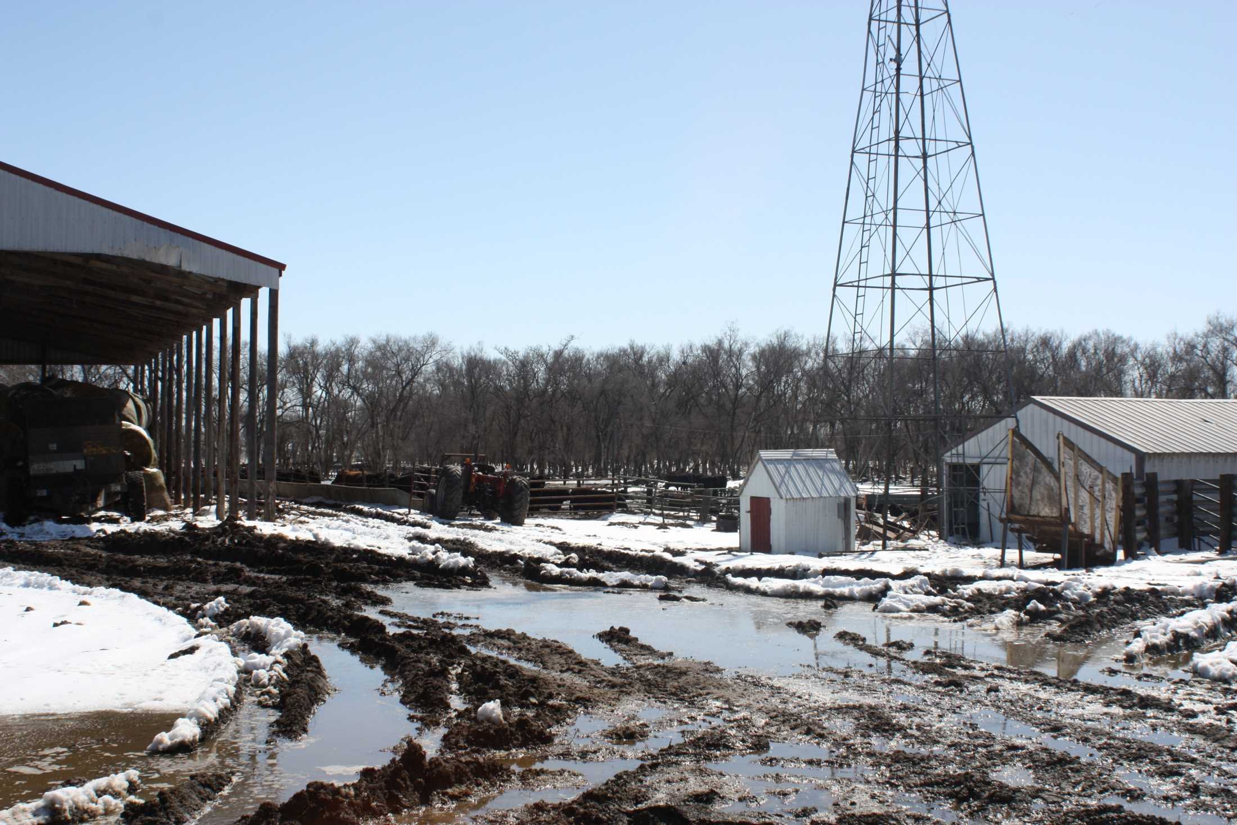
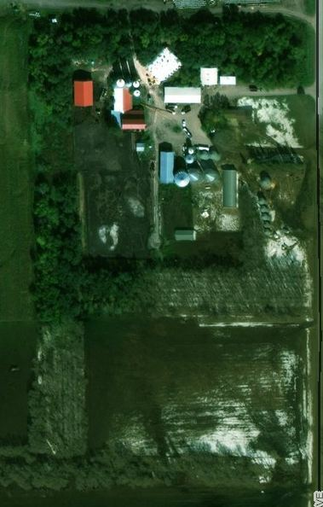

Slide 12
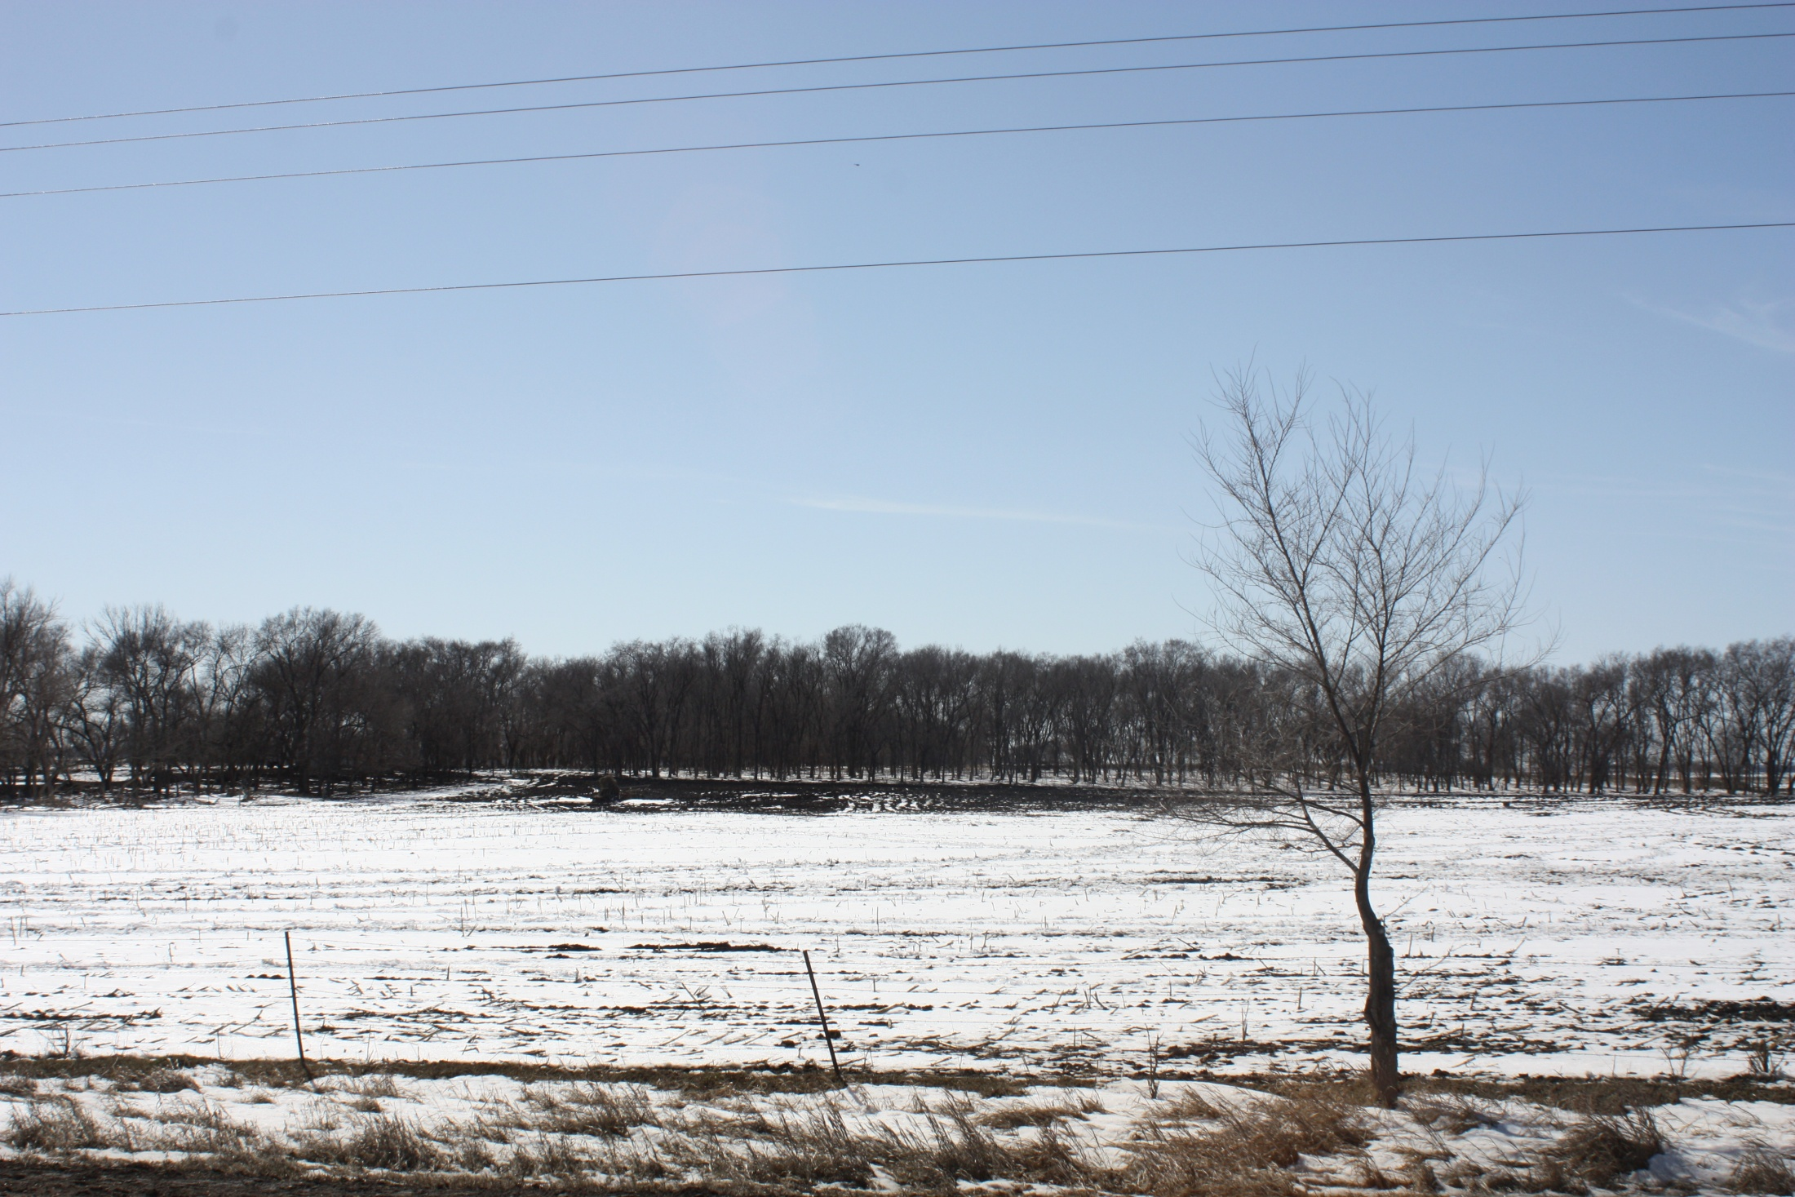

Slide 13
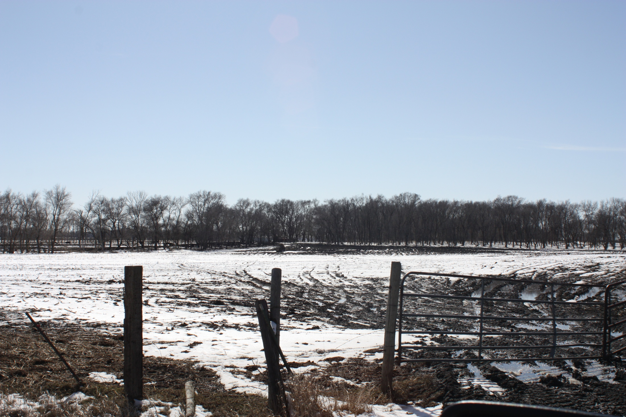

Slide 14
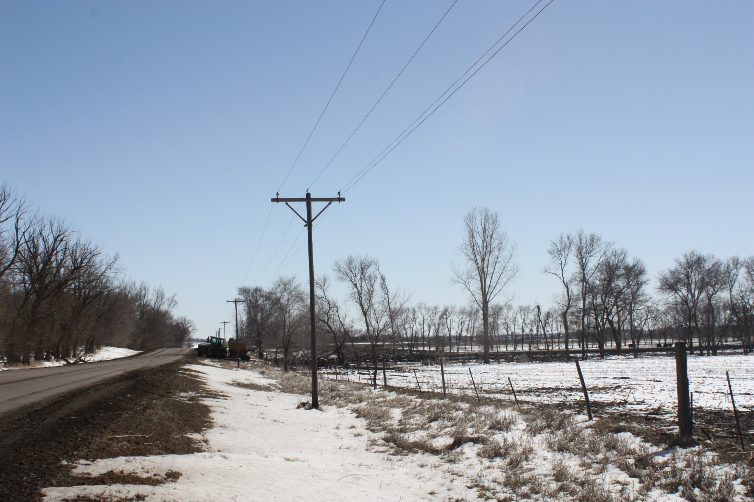

Slide 15
Plat: North Bay 11th Addition
Property Description: Lots 121-127, North Bay Eleventh Addition in the W ½ of Section 36-Township 113N-Range 53W of the 5th P.M., Hamlin County, South Dakota.

Slide 16
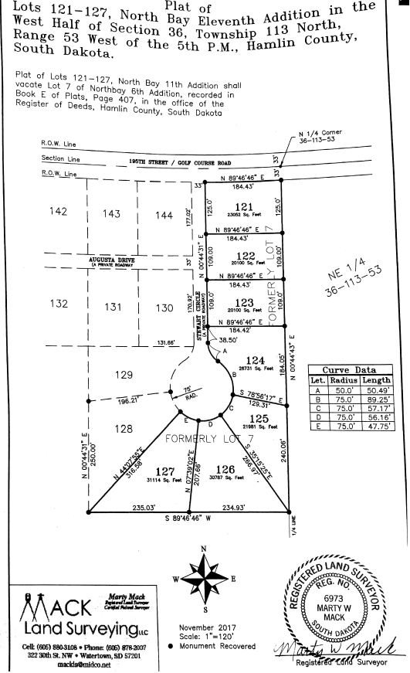

Slide 17
Plat: Lot 7 of Railroad Addition
Property Description: Lot 7 of Railroad Addition, A Part of Lot 5 of the Plat of Lots 5 and 6 of Railroad Addition, in S ½ of Section 33, Township 114N, Range 51W of the 5th P.M., Dempster, Hamlin County, South Dakota.

Slide 18
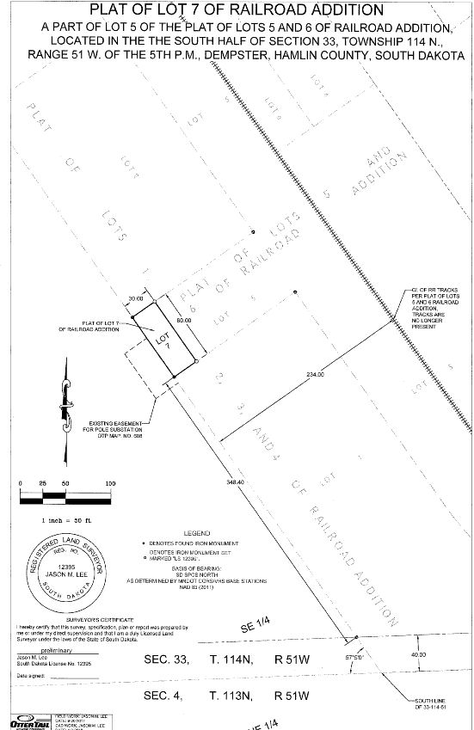

Slide 19
Board Discussion: Accessory Agricultural Housing

Slide 20
