Slide 1
How to make a Map:
Land Valuation using your local cama database

Slide 2
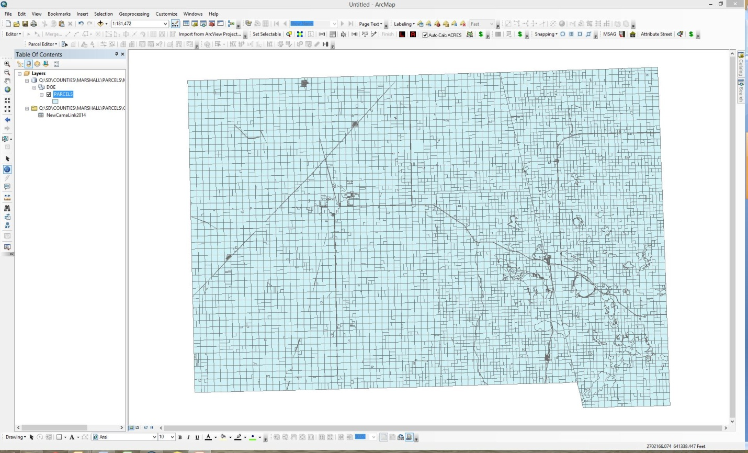
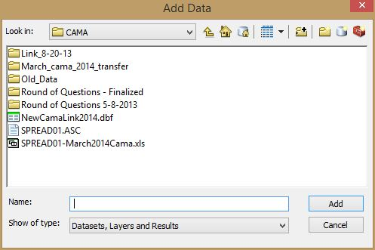
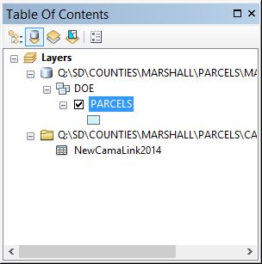
First Step is to add your data

Slide 3
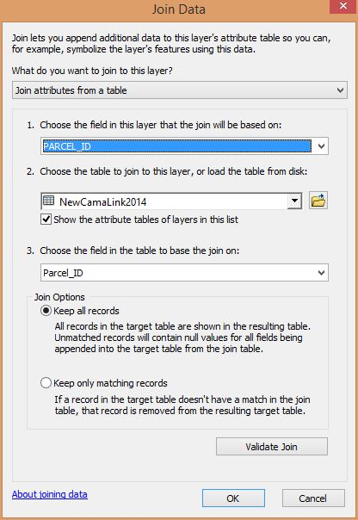
Second Step – Link Data

Slide 4
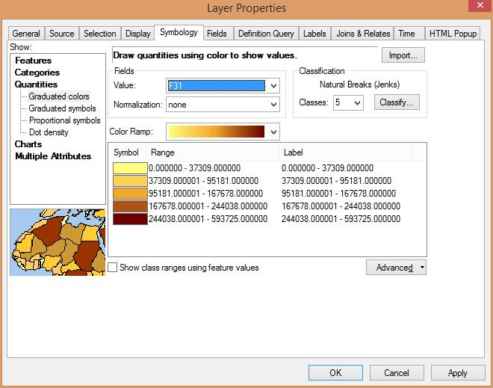
Symbology of your Data
*Value (F31) will vary from county to county. You will use the field that has your assessed value or whatever cama information you are wanting to make (

Slide 5
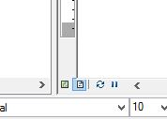
Layout View

Slide 6
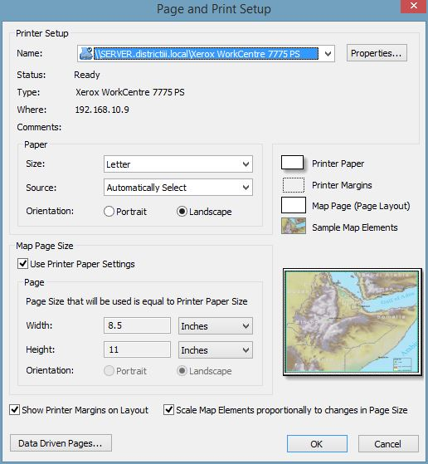
Layout View – Print Setup

Slide 7
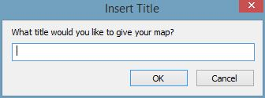
Layout View – Insert Title / Text

Slide 8
Layout View – Text Property
Double Click on Text to bring up text properties
Single Click on text to highlight it and mover it around the map (Light blue box will show what you have selected)

Slide 9
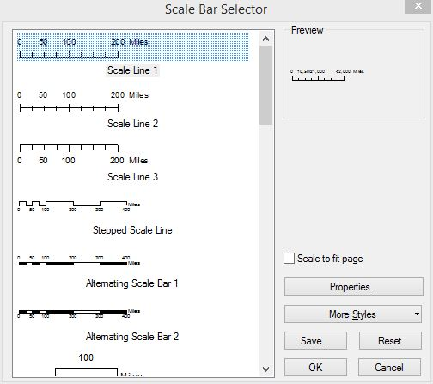
Layout View – Insert Scale

Slide 10
Layout View – Scale Property
Many options to play with when it comes to the Scale Bar
I suggest playing around or find one that you like and use the default)
Double Click on Scale bar to bring up Scale properties
Single Click on Scale bar to highlight it and mover it around the map (Light blue box will show what you have selected)

Slide 11
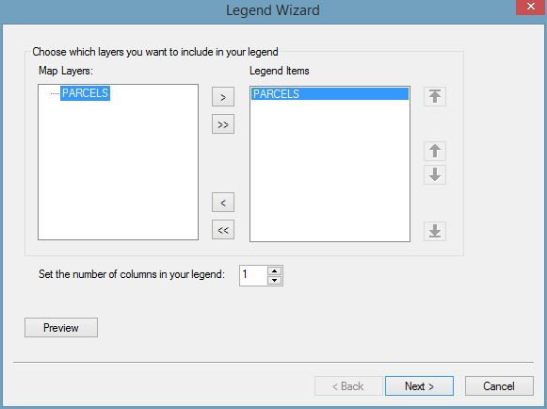
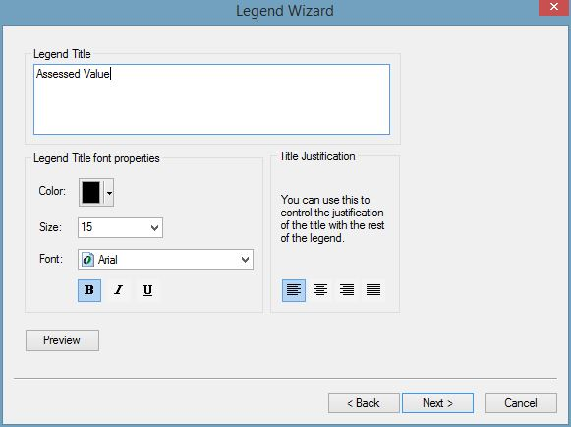
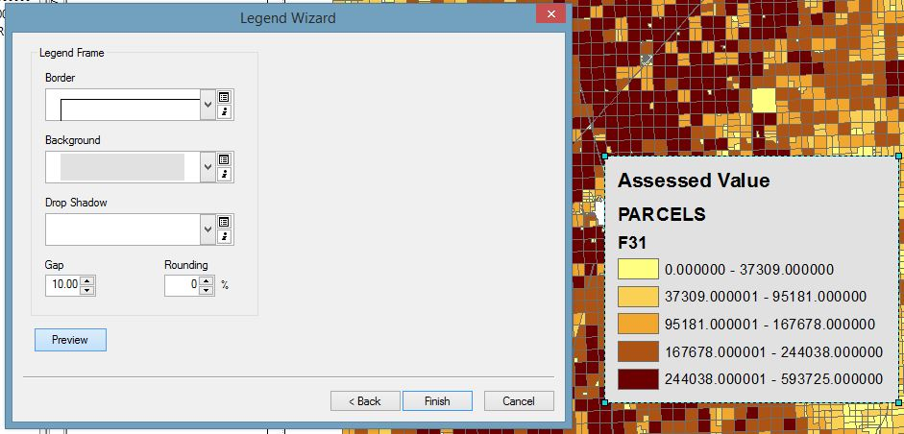
Layout View – Legend

Slide 12
Layout View – Legend Properties

Slide 13
Layout View – Finalized Map
You can also add:
North Arrow
Disclaimer
Logo
You do this by using the same process as all other elements added in the insert tab

